Slide 1
A Word, or Two,
About Sand Dunes

Slide 2
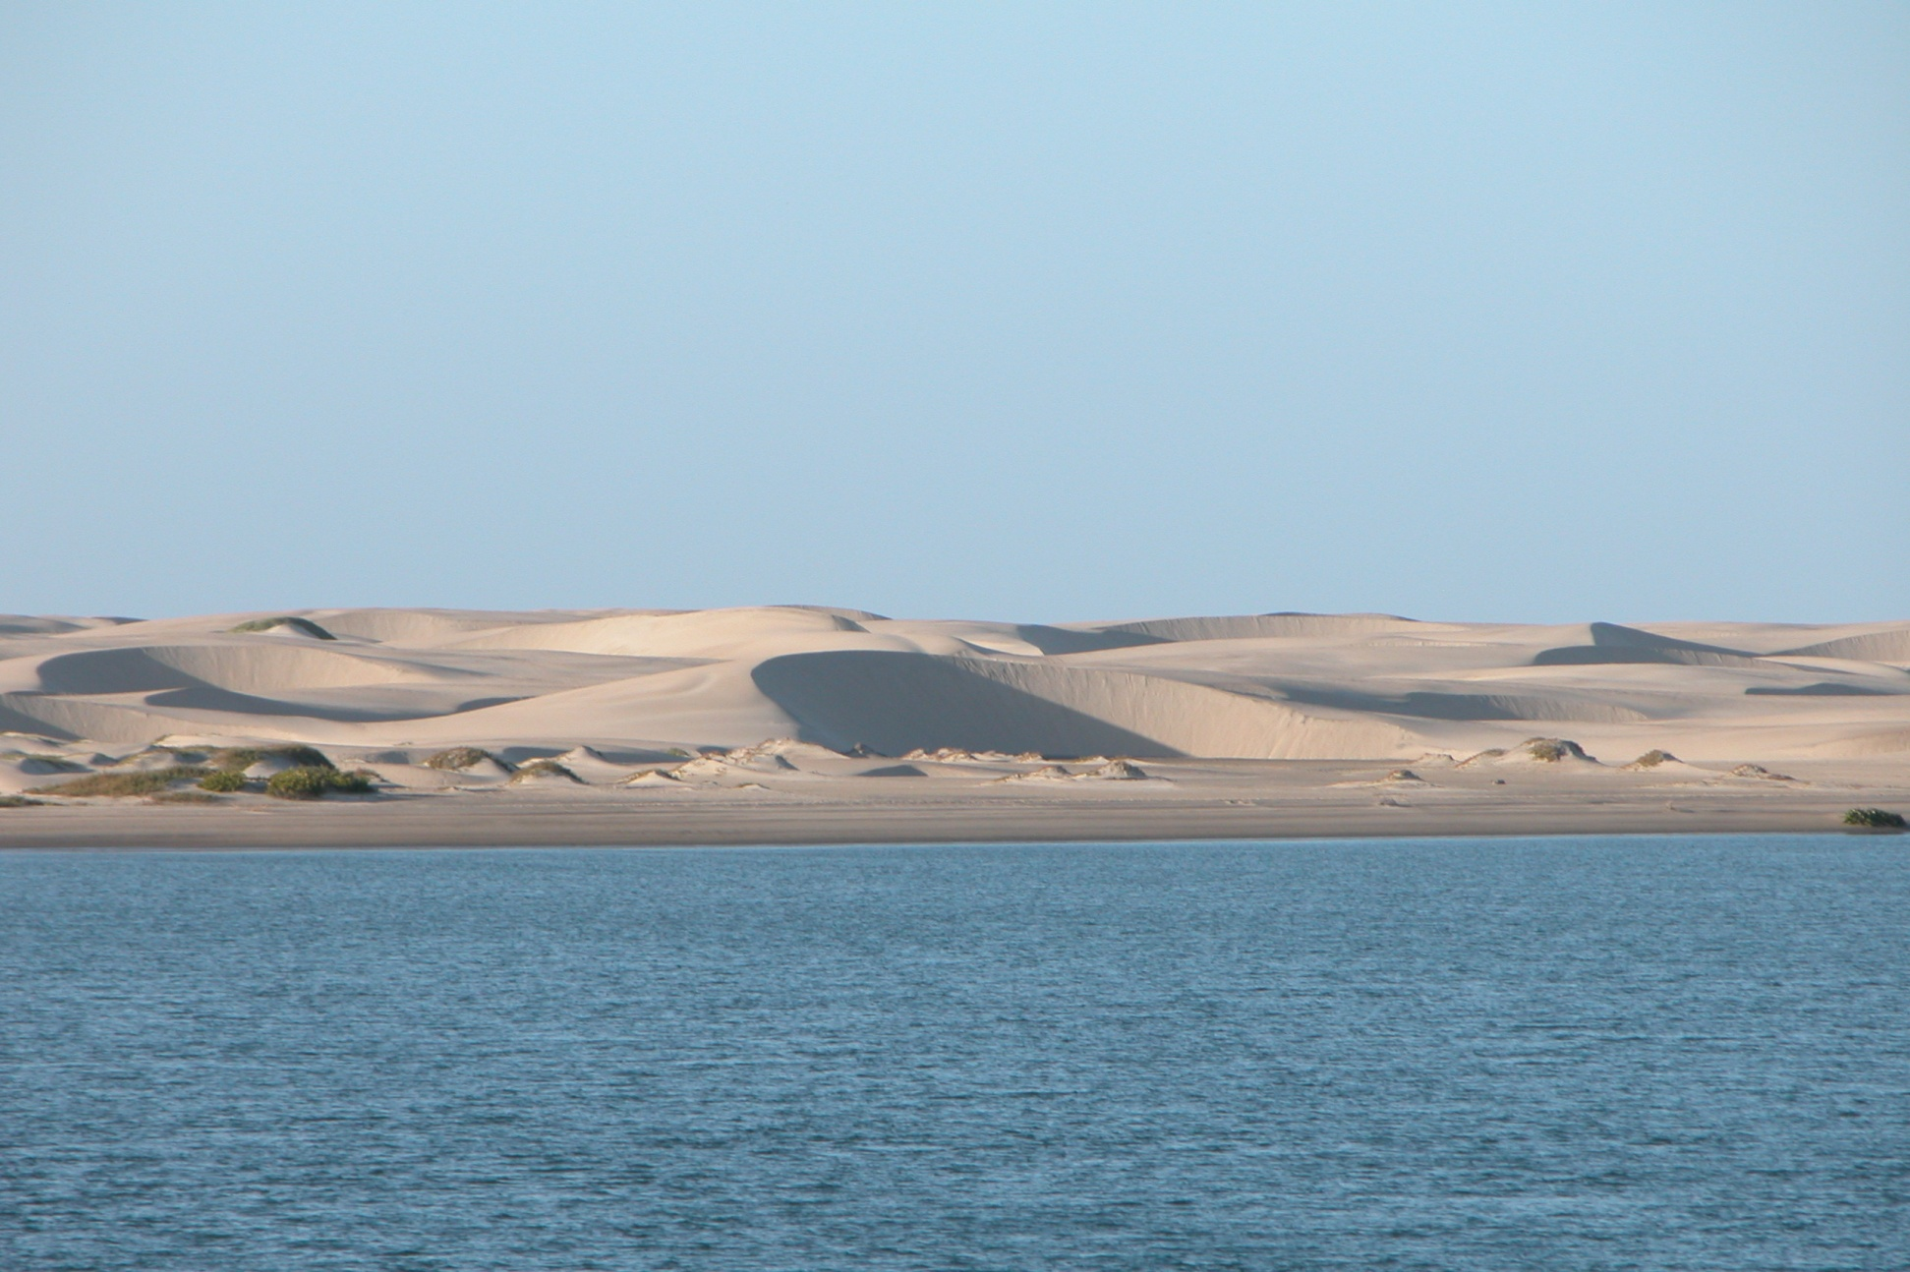
Barchan Dunes, Isla Magdalena

Slide 3
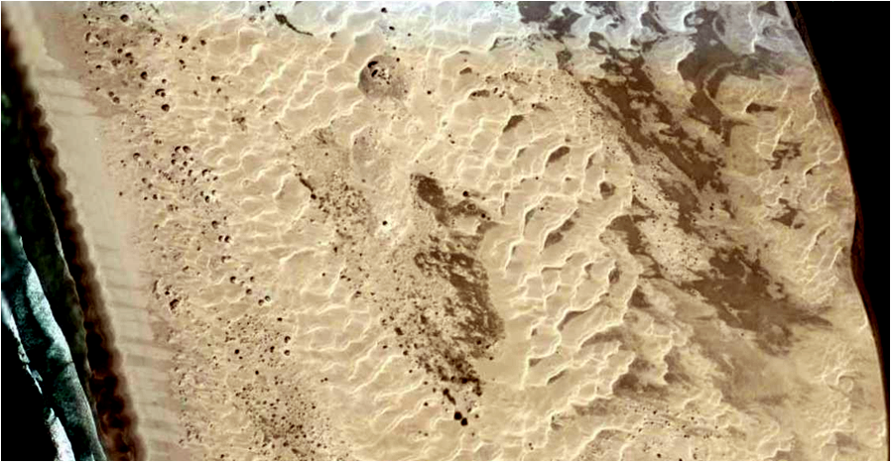
Isla Magdalena Dune Field

Slide 4
It has been Suggested that Barchan Dunes Exhibit Soliton Behavior

Slide 5
So, What the Heck is a Soliton?

Slide 6
An Example From Water Waves:

Slide 7
Often Groups of Surface Waves
Travel at the Same Velocity

Slide 8
When Overtaken by a Faster Wave,
the Energy of the Faster Wave is
Shared with the Slower Group
And the New Group Speeds up a Bit

Slide 9
But in Solitons, the Faster Wave
Passes Right Through the Group
Unaffected

Slide 10
The Gap Produced by People in Line
Moving Forward is a Soliton

Slide 11
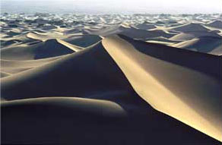
Dunes in the Sahara Desert

Slide 12
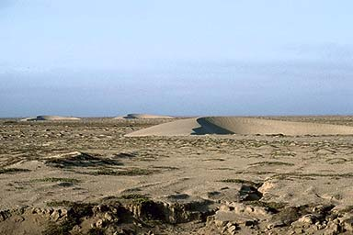
Barchan Dunes in the Arabian Desert

Slide 13
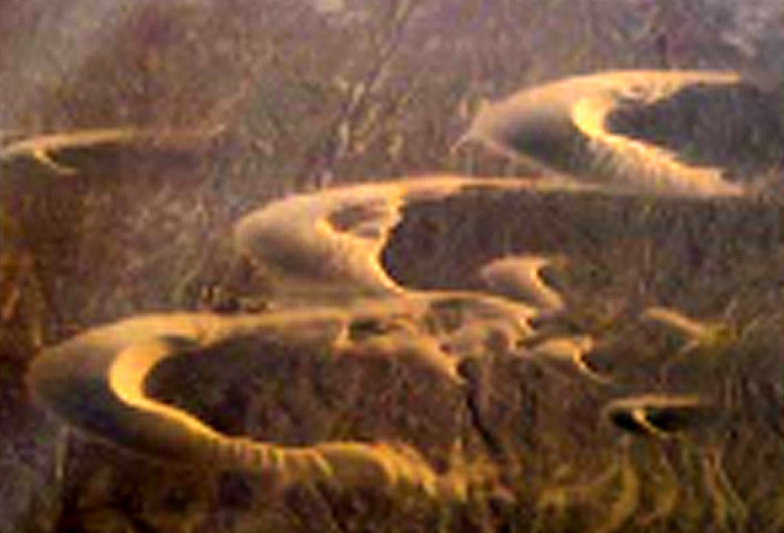
Barchan Dunes in the La Pampa Desert, Peru

Slide 14
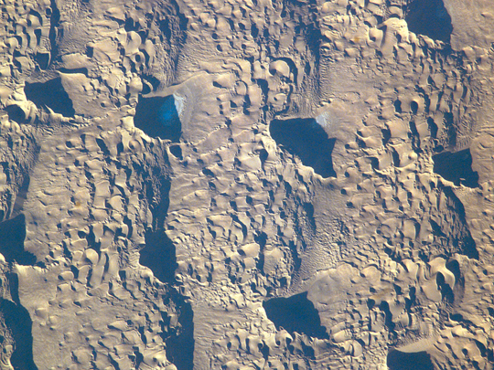
Badain Jaran Desert in
Western Inner Mongolia

Slide 15
Barchan Dunes
on Mars

Slide 16
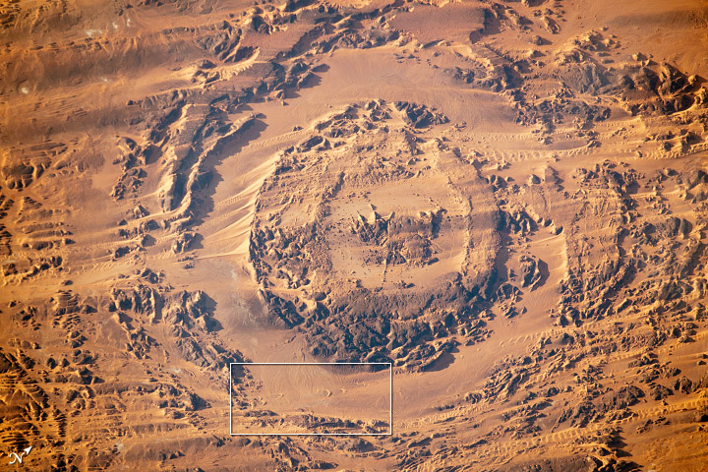
The Aorounga impact structure in northern
Chad is 12.6 kilometers (7.8 miles) in diameter
6 January 2013

Slide 17
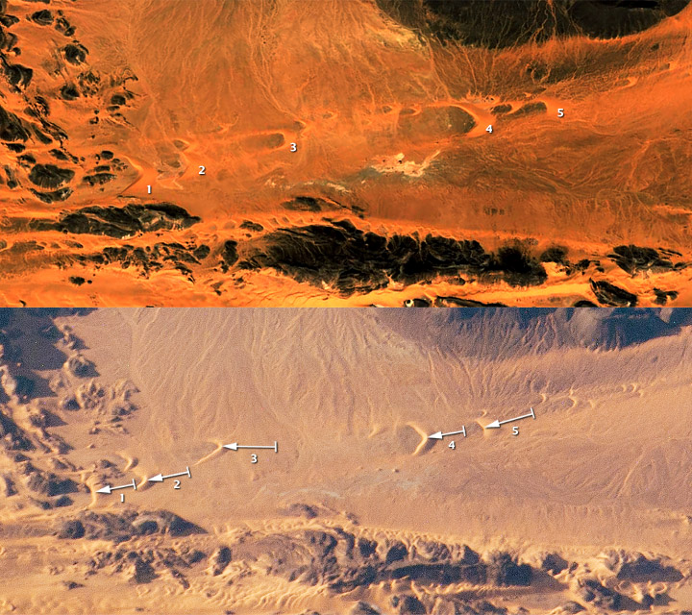
Movement of
The Dunes in
9 Years
Dune 1---316m
Dune 2---275m
Dune 3---405m
Dune 4---318m
Dune 5---381m
Smaller Dunes
Move Faster
2003—Google Earth
2013--ISS
NASA Earth
Observatory

Slide 18
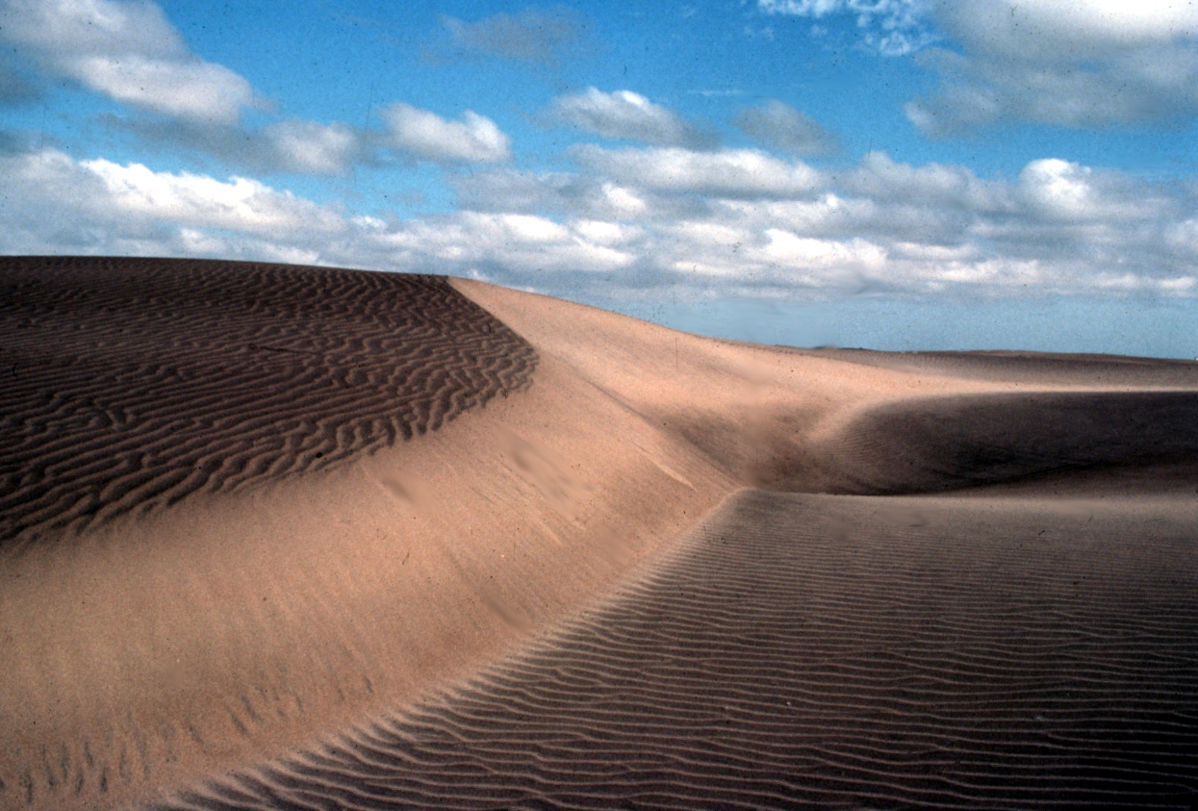
Large Transverse Dune, Isla Magdalena

Slide 19
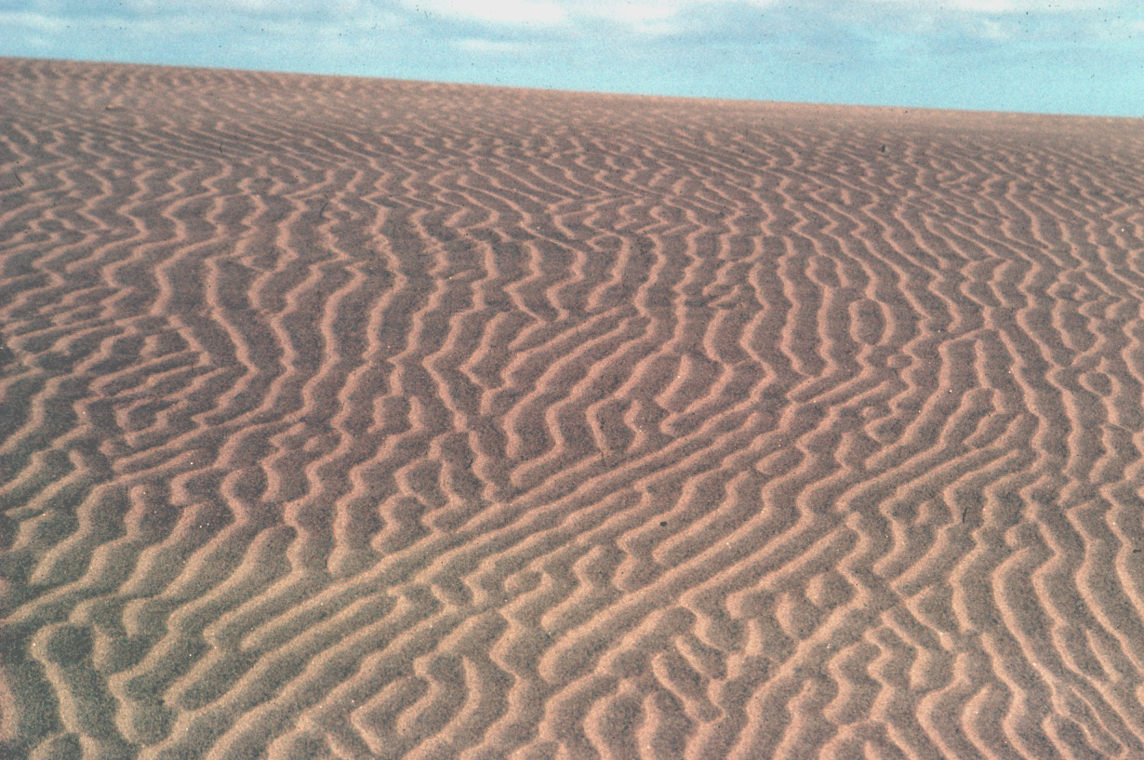
Small Transverse Dunes, Isla Magdalena

Slide 20
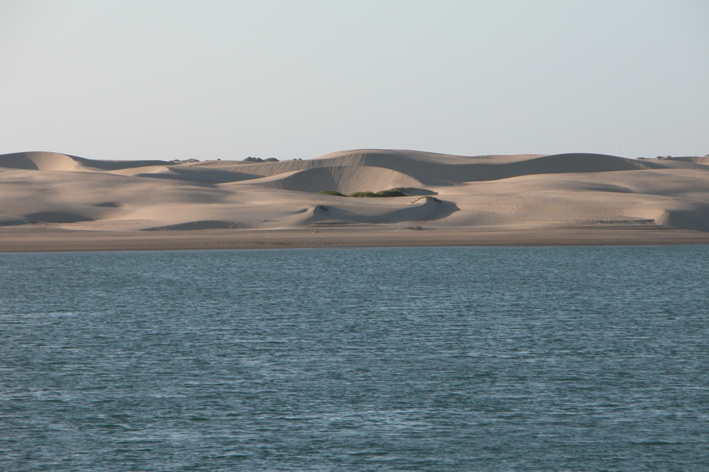
Barchan Dunes, Isla Magdalena

Slide 21
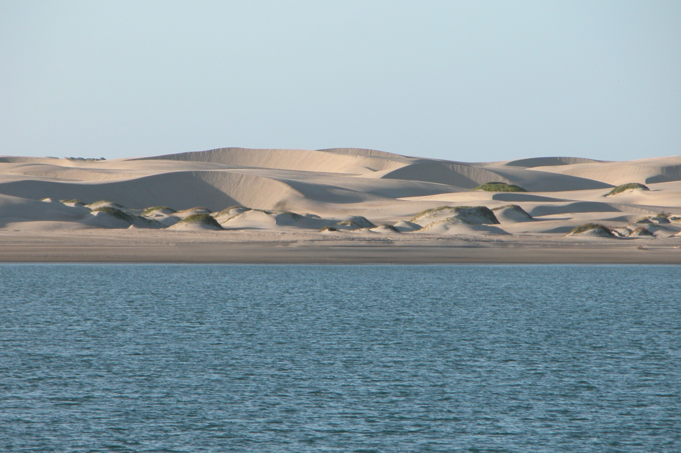
Barchan Dunes, Isla Magdalena

Slide 22
Barchan
Sand Dune
Wind Direction

Slide 23
Barchan Dunes
Move Slowly, Tens of Meters per Year
They Disrupt Roads, Pipelines, etc.
Their Slow Movement Makes Predicting Their Behavior Difficult

Slide 24
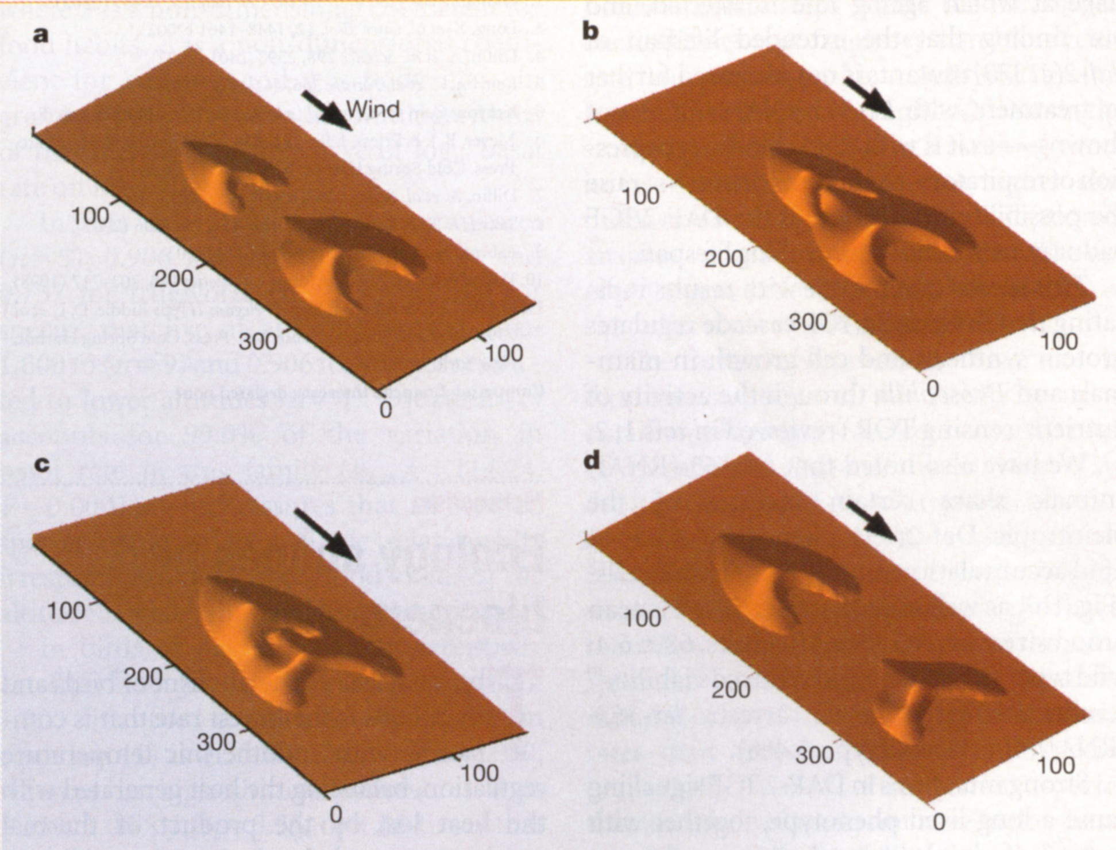
t = 0 yrs
t = 0.48 yrs
t = 0.63 yrs
t = 1.48 yrs
Schwammle & Herrmann (Stuttgart), Nature, 11 December 2003, p.619

Slide 29
But, of course, someone had to actually
go out in the desert
and measure some dunes
So two French physicists sent a
Moroccan geologist graduate student
to the Moroccan Sahara for
for three years to do this study

Slide 30
The report of the study is:
“Field evidence for surface-wave-induced
instability of sand dunes,”
Hicham Elbelrhiti, Philippe Claudin
and Bruno Andreotti,
Nature 437 (29 September 2005)
At least they made the
Moroccan geologist first author!

Slide 31
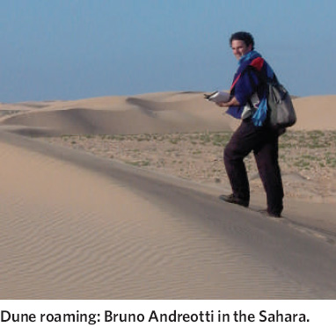
Bruno
Andreotti
In the
Sahara

Slide 32
Mr. Elbelrhiti did this by Placing Sticks
Along One Arm of the Dune and Mapping
The Changes for 35 Months!

Slide 33
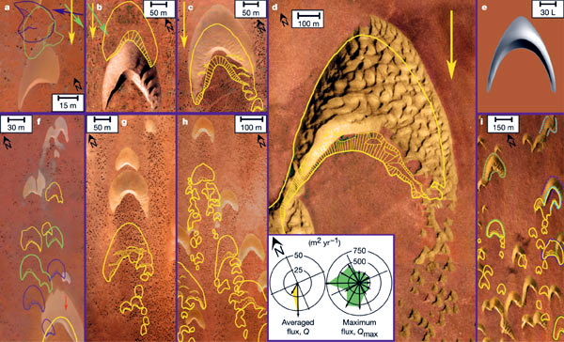
The Photograph Were taken from Planes and Kites.
The Yellow Lines Show The Dune
at Other Times Or Conditions

Slide 35
Moral:
Computer Models Stimulate Science…
But Nothing Substitutes for
Going to the Field and
Actually Looking at the Rocks!

Slide 36
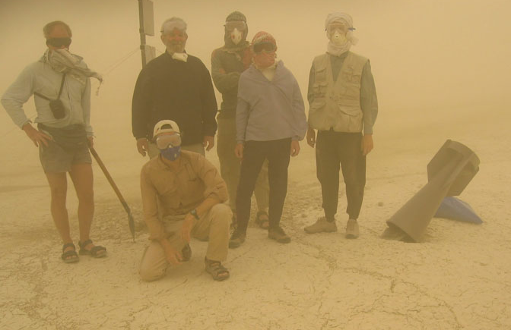
Pieter Vermeesch,
University College London and
His BODEX Team in in 2005 in the
“Dustiest Place on Earth”
the Bodélé Depression in Chad

Slide 37
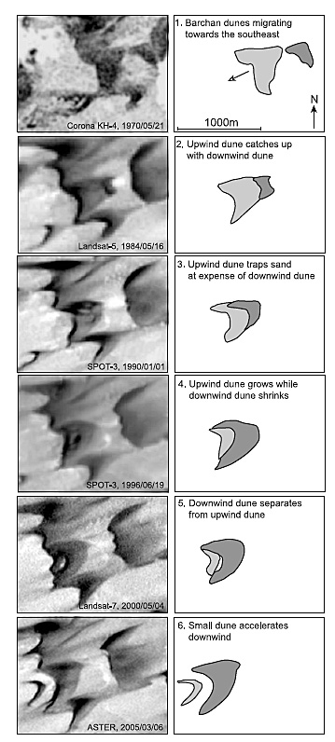
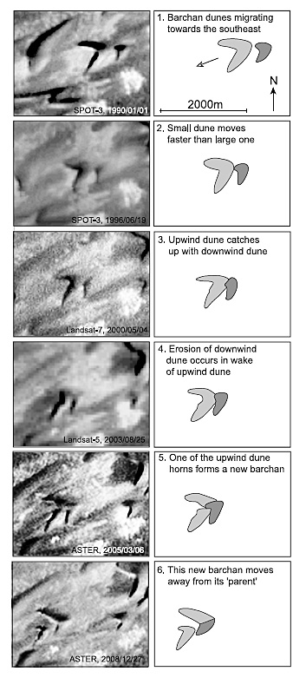
In 2011, a new paper published satellite images
taken over 45 years which confirm the soliton behavior
of barchan dunes in the Bodélé Depression in Chad
20 Years
19 Years
Vermeesch (U of London), Geophys. Res. Letters, 17 November 2011

Slide 38
19 Years

Slide 40
New Moral:
Science is Never Finished
The Latest Results are Always Provisional

Slide 41
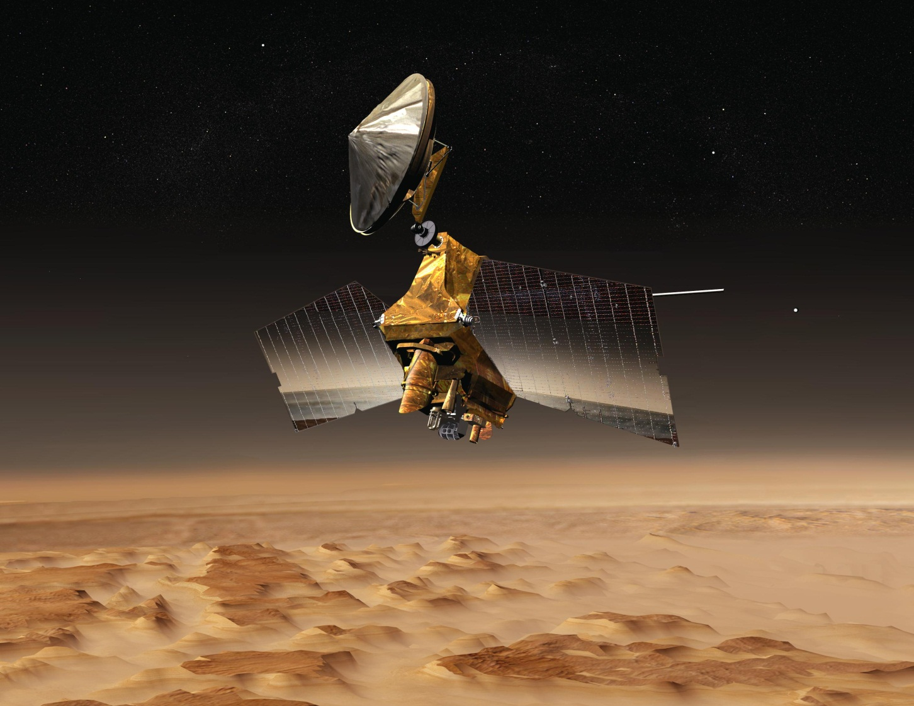
Mars Reconnaissance Orbiter

Slide 42
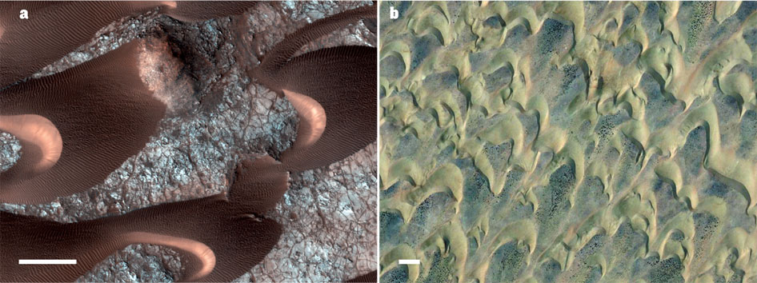
New Results from Mars
Mars Earth
50 m
50 m
Bridges, et al. (J. Hopkins) , Nature 17 May, 2012

Slide 43
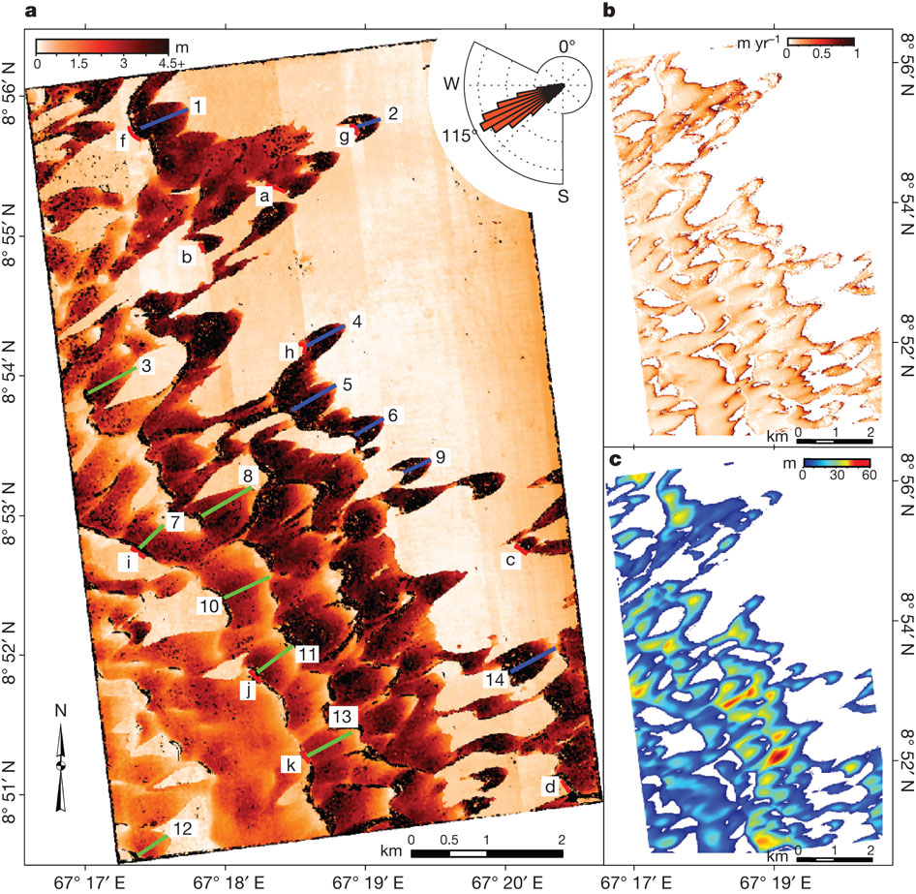
Martian Dunes Move
At nearly the Same
Speeds as Earth Dunes
even though the
Atmosphere
on Mars is 1/100th of
that on Earth
Bridges, et al. (J. Hopkins) Nature, 17 May 1212

Slide 44
Welcome to Boca de Soliton

Slide 45
Welcome to Boca de Soledad

