Slide 1
The Physical Setting and Circulation of the Baltic Sea
by
Jim Kelley

Slide 2
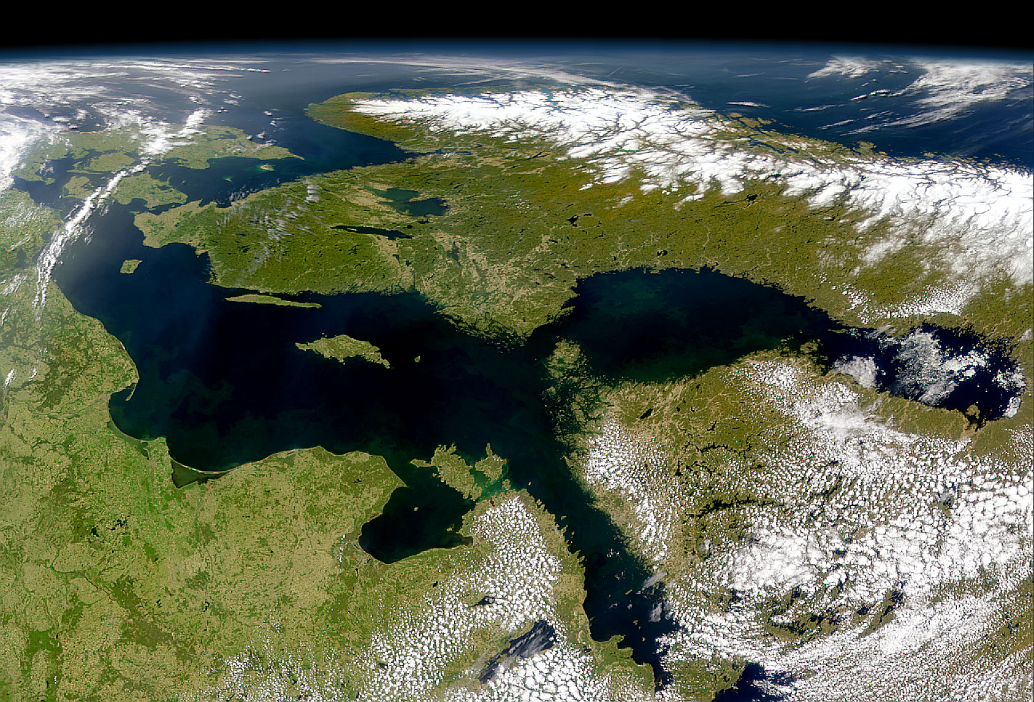
23 May 2011

Slide 3
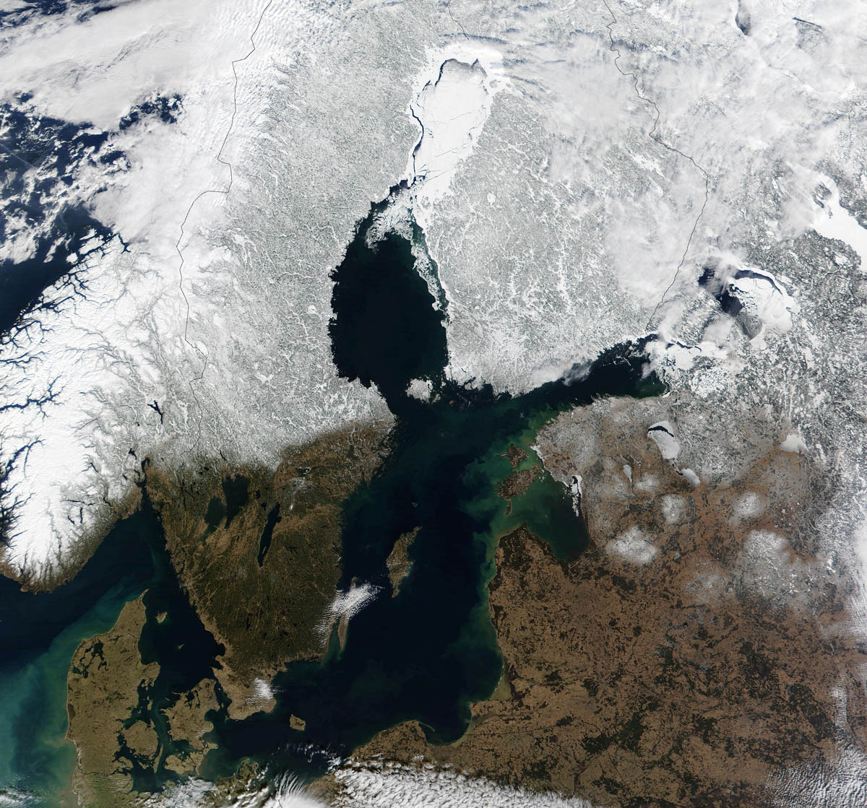
Bay of
Bothnia
Sea of
Bothnia
Gulf of Finland
Baltic
Sea
Skagerrak
Kattegat
15 March 2002

Slide 4
Some Characteristics of the Baltic Sea
Area: ~400,000 sq. km., ~155,000 sq. mi.
Average Depth: 54 m.
Maximum Depth: 459 m. (Landsort Deep)
Water renewal time: 50 years
Salinity: 7‰‰o/oo‰‰ (Normal Seawater is 35 o/oo)
Ice extent 12-100%, Ice Season: 5-7 mos.
Population of the Drainage Basin: 85 million in 14 Countries

Slide 5
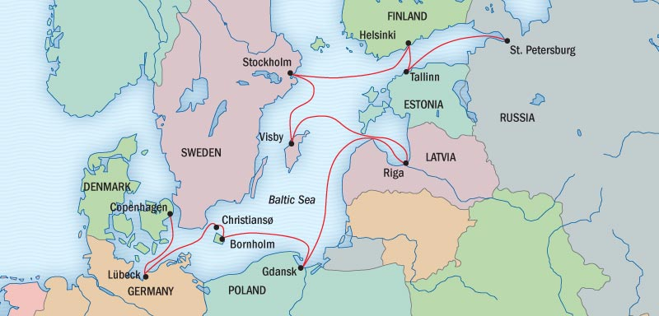
On this Voyage We Will be Sailing Over Some of the Oldest Rocks
in Europe and Through Some of the Most Interesting Waters
Åland
Islands
Gotland
Öland

Slide 6
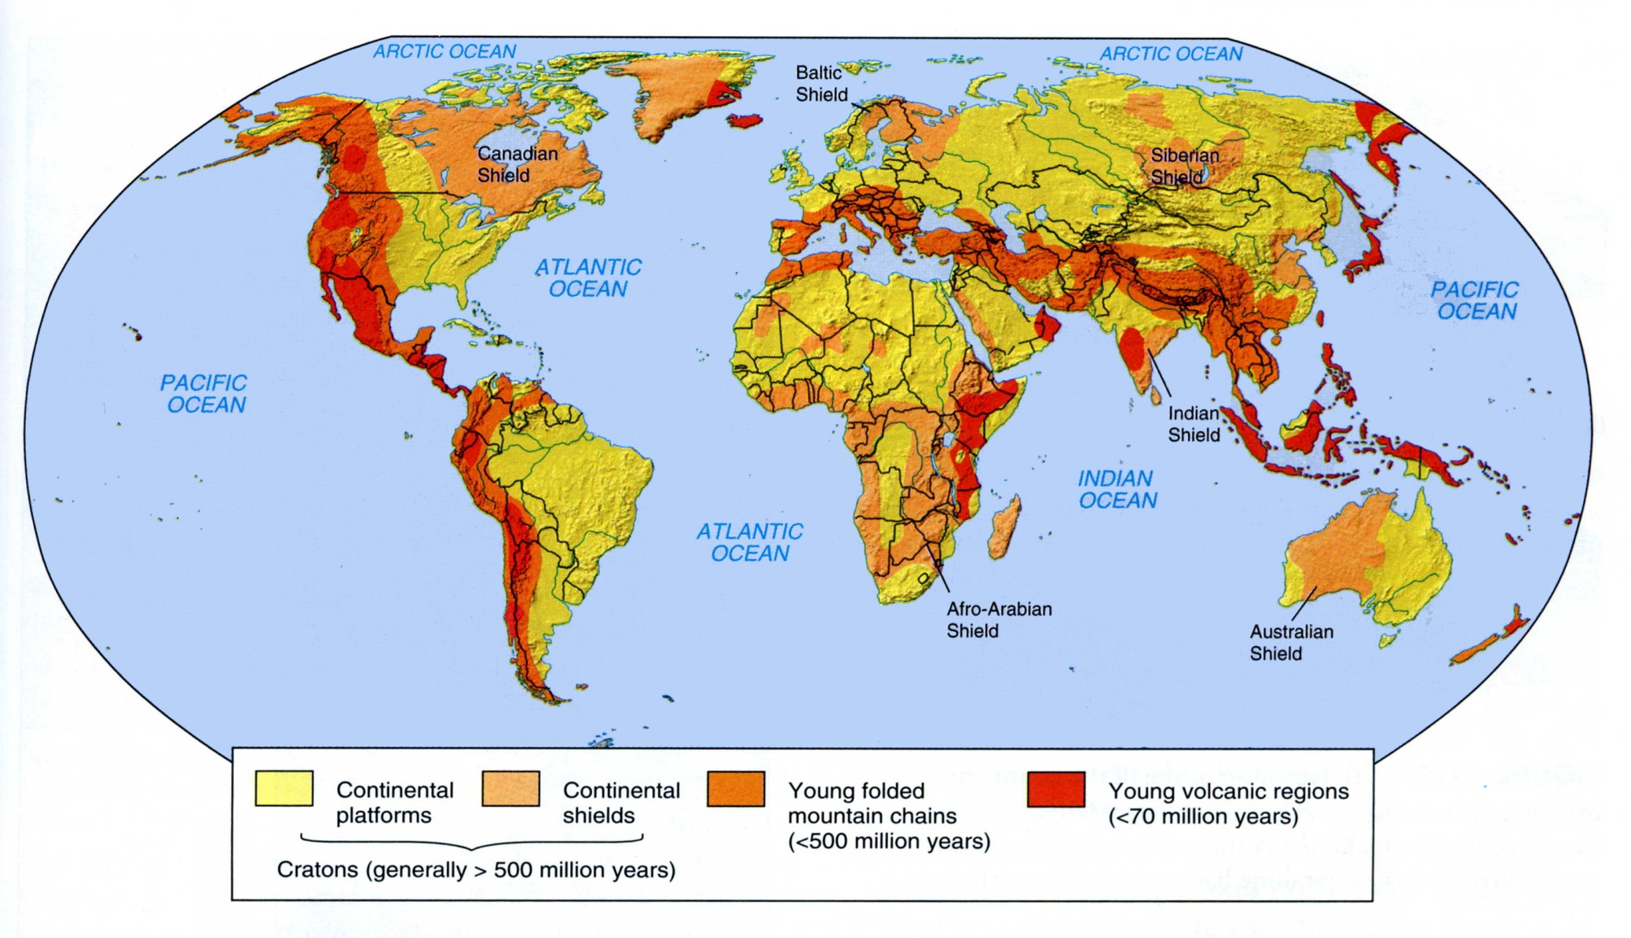
Shield Areas

Slide 7
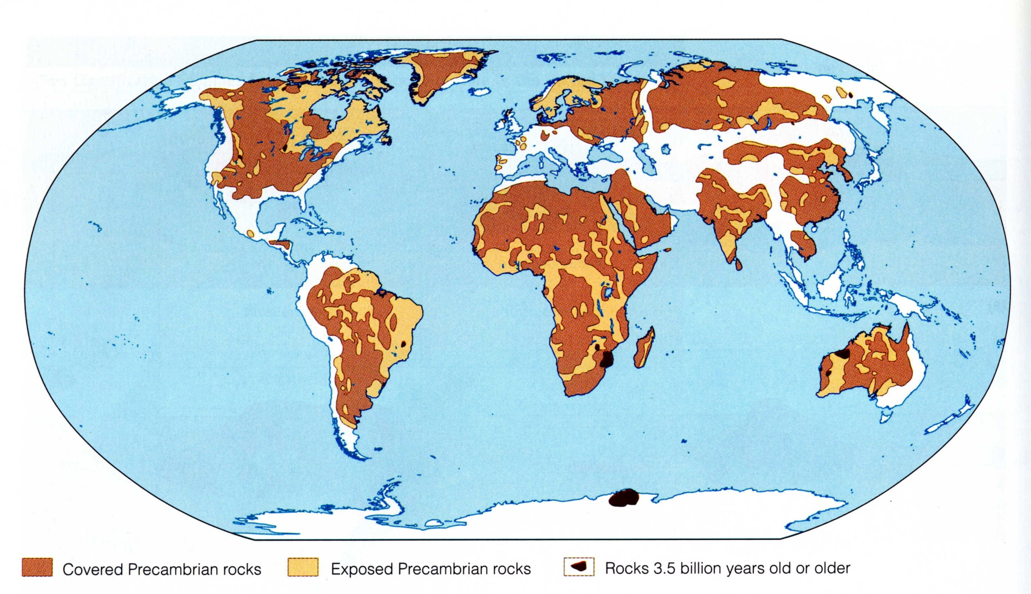
Shield Areas

Slide 8
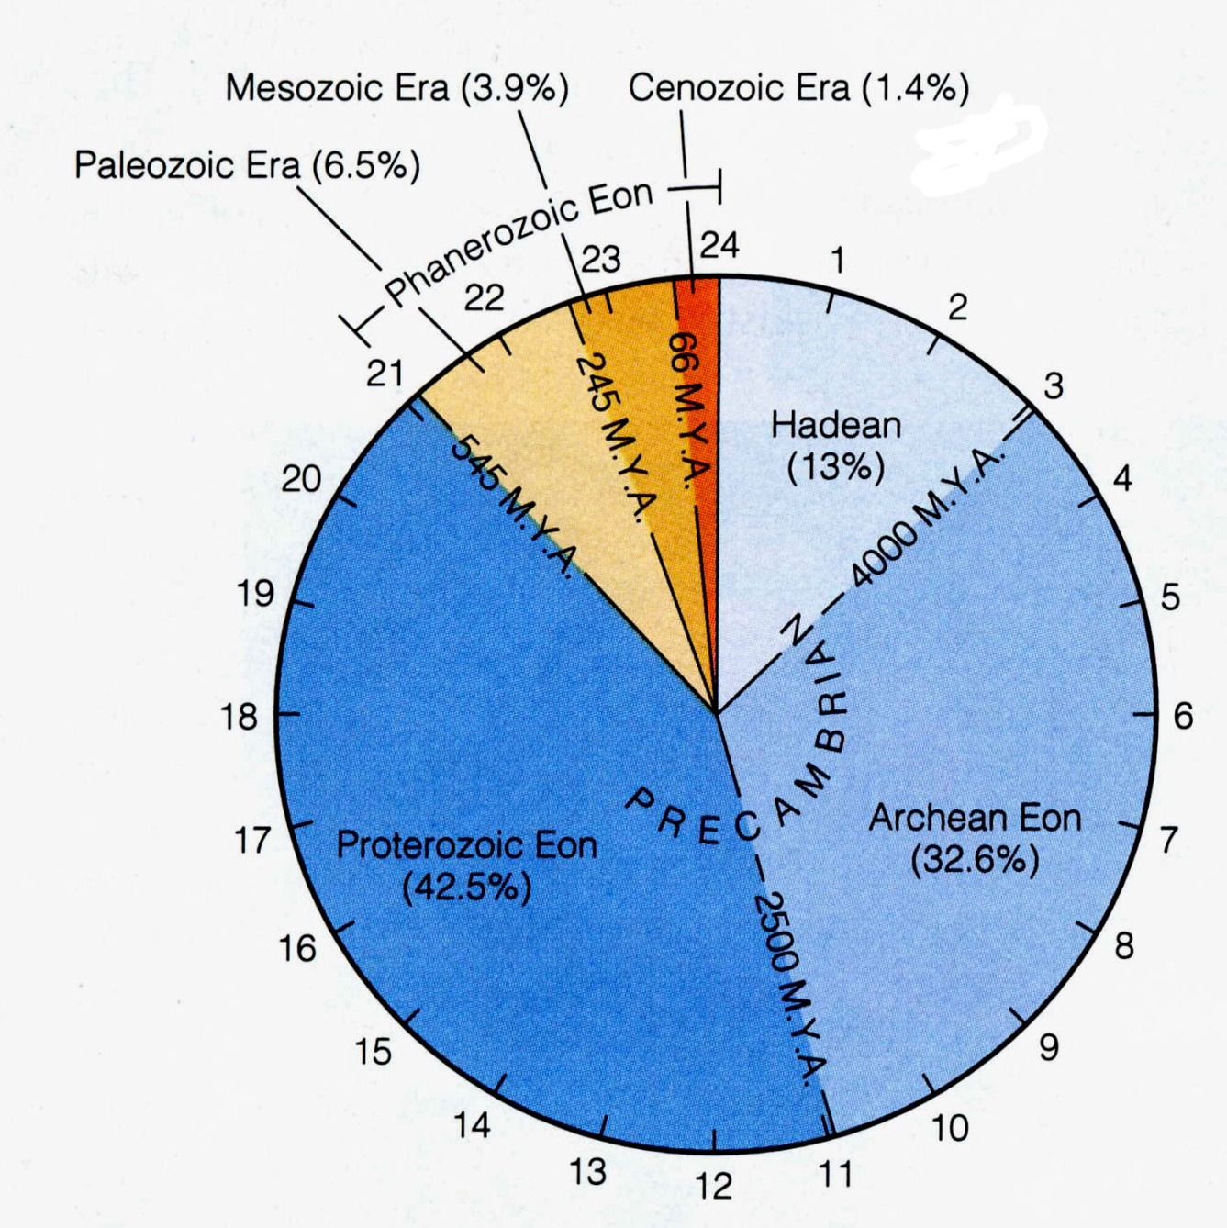
88% of
Geological
Time was
in the
Pre-Cambrian

Slide 9
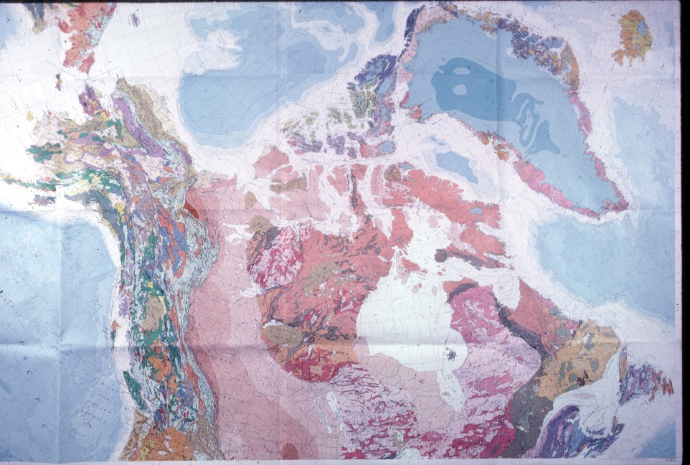
The Canadian Shield

Slide 10
Beginning
With a Shield
Area,
Continents
Grow by
Accretion on
The Margins

Slide 11
Basement Rocks of
the Baltic Region
2500 My
2000 My
1800 My
1200-900 My
Paleozoic Rx
Younger Cover

Slide 12
Amber originated from the tears of the Heliades
shed when their brother, Phaeton, died and fell
from the sky and tumbled into the Eridano
where, “along the green banks of the river Eridano,”
King Cygnus mourned him and was transformed into a swan.
There in the far west, Heracles asked the river nymphs
of Eridano to help him locate
the Garden of the Hesperides.
(Ovid, Metamorphoses II),
The Geological River Eridano
was Larger than the Rhine and
Existed from about 15 Mya until about 0.7 Mya
At the start of the Ice Ages

Slide 13
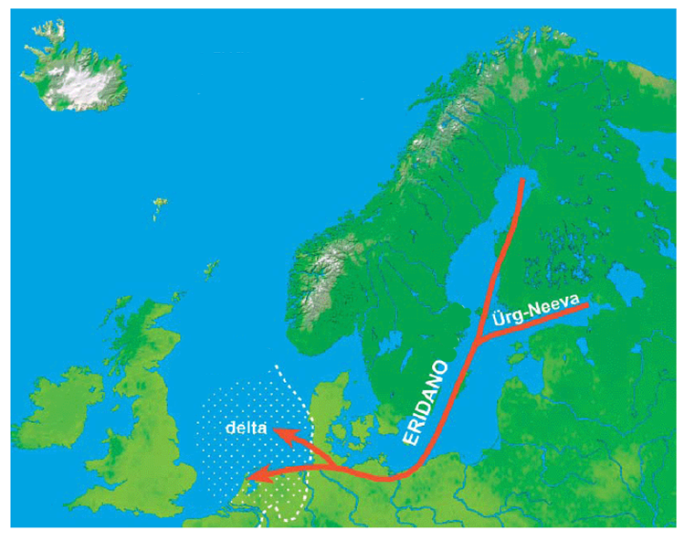
~12 Million
Years Ago

Slide 14
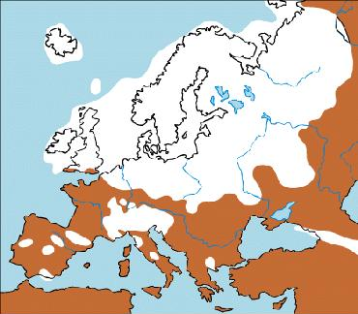
Pleistocene Glaciation in Europe:
~18,000 Years Ago

Slide 15
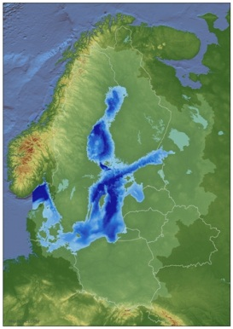
11,500
Years Ago

Slide 16
11,000
Years Ago

Slide 17
10,000
Years Ago

Slide 18
8,000
Years Ago

Slide 19
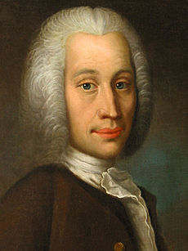
Anders Celsius
(1701-1744)
Measured
“Falling Sea Level”
in
Sweden

Slide 20
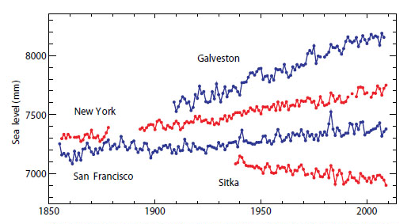
Sea Level Measured at Four
Long Record Stations in the U.S.
Woodworth, et al., (Liverpool, Plymouth, U. of Colo.) Oceanography, June, 2011

Slide 21
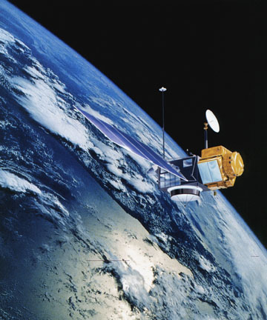
TOPEX/
Poseidon
Launched 1992
Accuracy 5cm

Slide 22
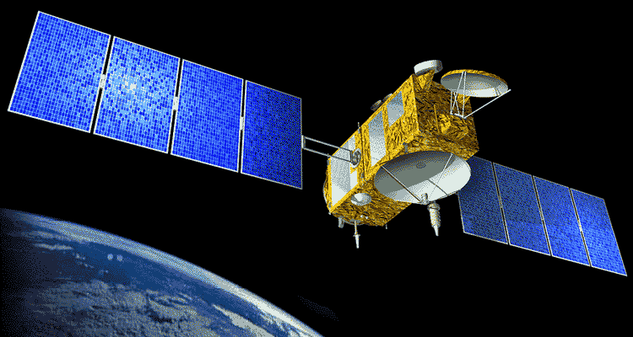
Jason 1
Launched 7 December 2001
Accuracy 3.3cm

Slide 23
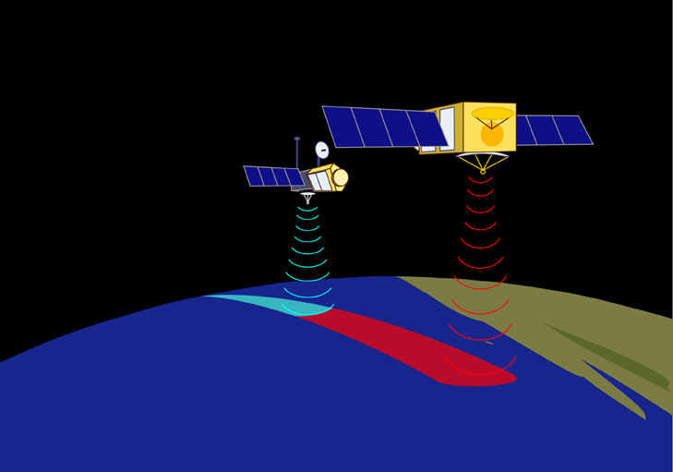
Topex/Poseidon Follows
Jason 1 by about 1 minute = 370km
Altitude = 1336 km

Slide 24
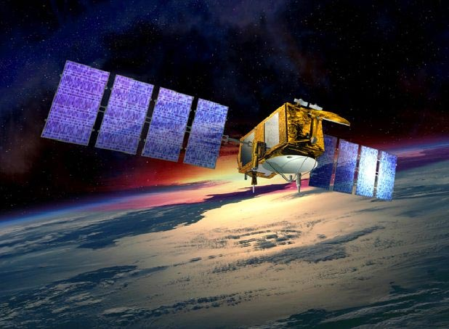
Jason 2
Launched 20 June 2008, Altitude 1336 km
Accuracy 1 cm, Sea Level at 1mm

Slide 25
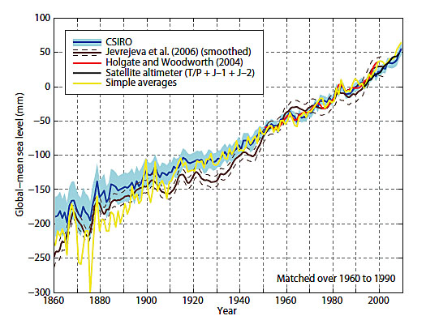
Various Estimates of Sea Level Rise
Average=1.67mm/yr
~6.5”/century
Woodworth, et al., (Liverpool, Plymouth, U. of Colo.) Oceanography, June, 2011

Slide 26
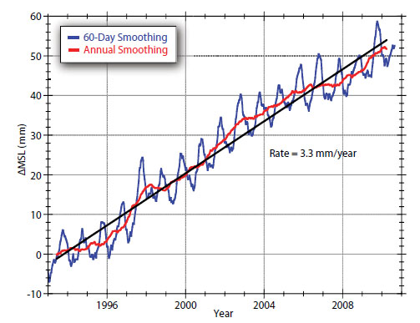
Satellite Measurements of Sea Level
3.3mm/yr
~13”/century
Woodworth, et al., (Liverpool, Plymouth, U. of Colo.) Oceanography, June, 2011

Slide 27
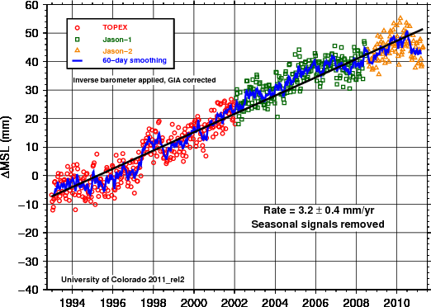
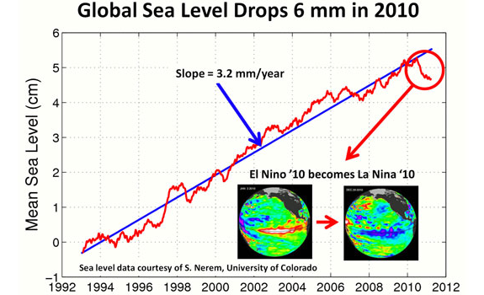
Interesting
University of
Colorado
Analysis of
the 2011 “Pothole”

Slide 28
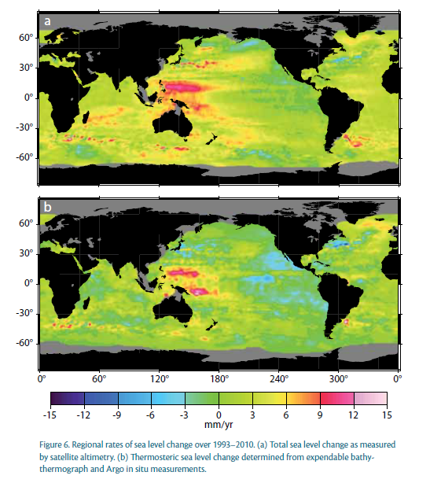
Change in
Sea Level
1993-2010
a. Satellite
b. Thermosteric
Woodworth, et al., (Liverpool, Plymouth, U. of Colo.) Oceanography, June, 2011

Slide 29
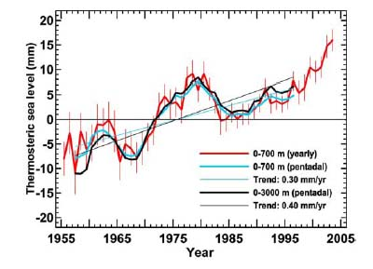
Thermosteric Sea Level Rise (0.5 mm/yr)
J. I. Antonov, et al, (NOAA) Journal of Geophysical Letters, 16 June, 2005

Slide 30
Change in Sea Level, 1993-2010
From Satellite Altimetry
Woodworth, et al., (Liverpool, Plymouth, U. of Colo.) Oceanography, June, 2011

Slide 31
Isostatic Depression

Slide 32
Isostatic Rebound

Slide 33
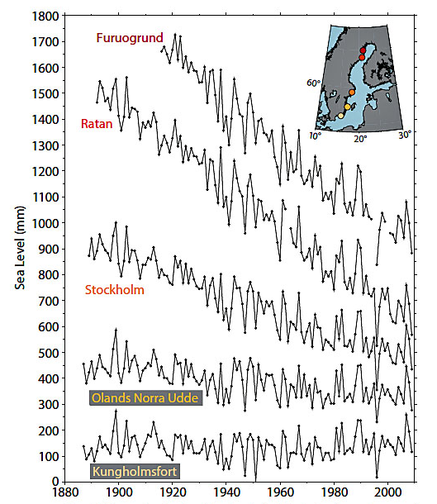
Baltic Tide
Gauges
Showing
Isostatic
Rebound
Tamisiea and Mitrovica
(Liverpool and Harvard)
Oceanography, June, 2011

Slide 34
“Bow Wave” Displacement Under Ice Loading

Slide 35
“Bow Wave” Readjustment After Ice Loading

Slide 36
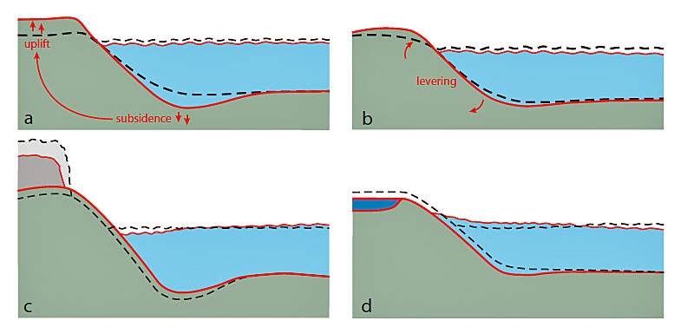
Effects of Isostatic Rebound and
Gravitational Readjustments on Sea Level
Tamisiea and Mitrovica (Liverpool and Harvard), Oceanography, June, 2011

Slide 37
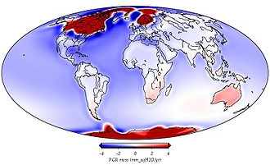
-4 -2 0 2 4
PGR (mm/yr)

Slide 38
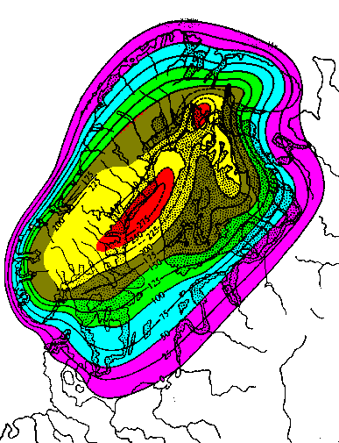
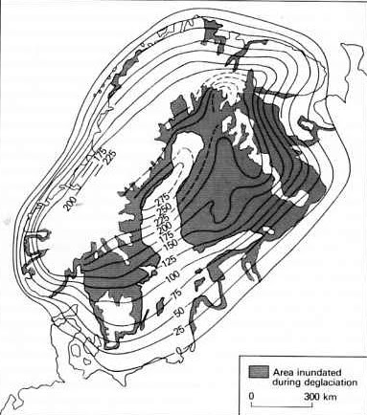
Post Glacial (Isostatic) Rebound in the Baltic

Slide 39
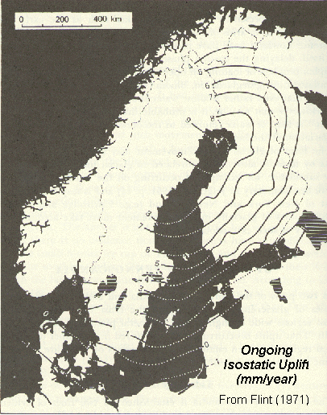
Ongoing
Isostatic
Rebound
in the Baltic
Ongoing
Isostatic Uplift
(mm/yr)

Slide 40
64 Rivers flow into the Baltic Sea
This keeps the salinity low, about 7 o/oo
Especially in the North,
so it freezes easily.
The Baltic Sea is a
Large Estuary

Slide 41
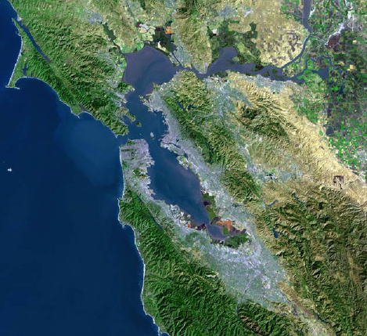
An
Estuary

Slide 42
Before Oceanographers Looked
At San Francisco Bay,
Engineers Assumed
That Since the Tidal Prism is
1/3 of the Volume of the Bay,
The Bay Flushes Every Three Days

Slide 43
The Original Misconception
Tidal Mixing Flushes the
Bay Every Three Days
Bay Water
Day 1
Day 2
Day 3
Ocean Water
Salt Water

Slide 44
If the Bay Flushes Every Three
Days by Tidal Action, You Can
Divert as Much Water as You Like

Slide 45
What Really Happens
The Tidal Prism Just Moves
In and Out Twice a Day
Bay Water
Ocean Water
Salt Water

Slide 46
Estuarine Circulation
Fresh Water
Salt Water

Slide 47
Estuarine Circulation
Fresh Water
Entrainment
Salt Water

Slide 48
Estuarine Circulation
Fresh Water
Salt Water

Slide 49
Estuarine Circulation
Fresh Water
Salt Water

Slide 50
The Salt Water Wedge is not
Flowing “Uphill”
It is Flowing Across a Salinity Gradient
And thus is Flowing “Downhill”
From Higher Salinity to Lower Salinity

Slide 51
Estuaries
Are Places Where a River Meets the Sea
This May Occur in a Bay, for example…
San Francisco Bay
Chesapeake Bay
Bo Hai Gulf of the Yellow River
Thames River Estuary

Slide 52
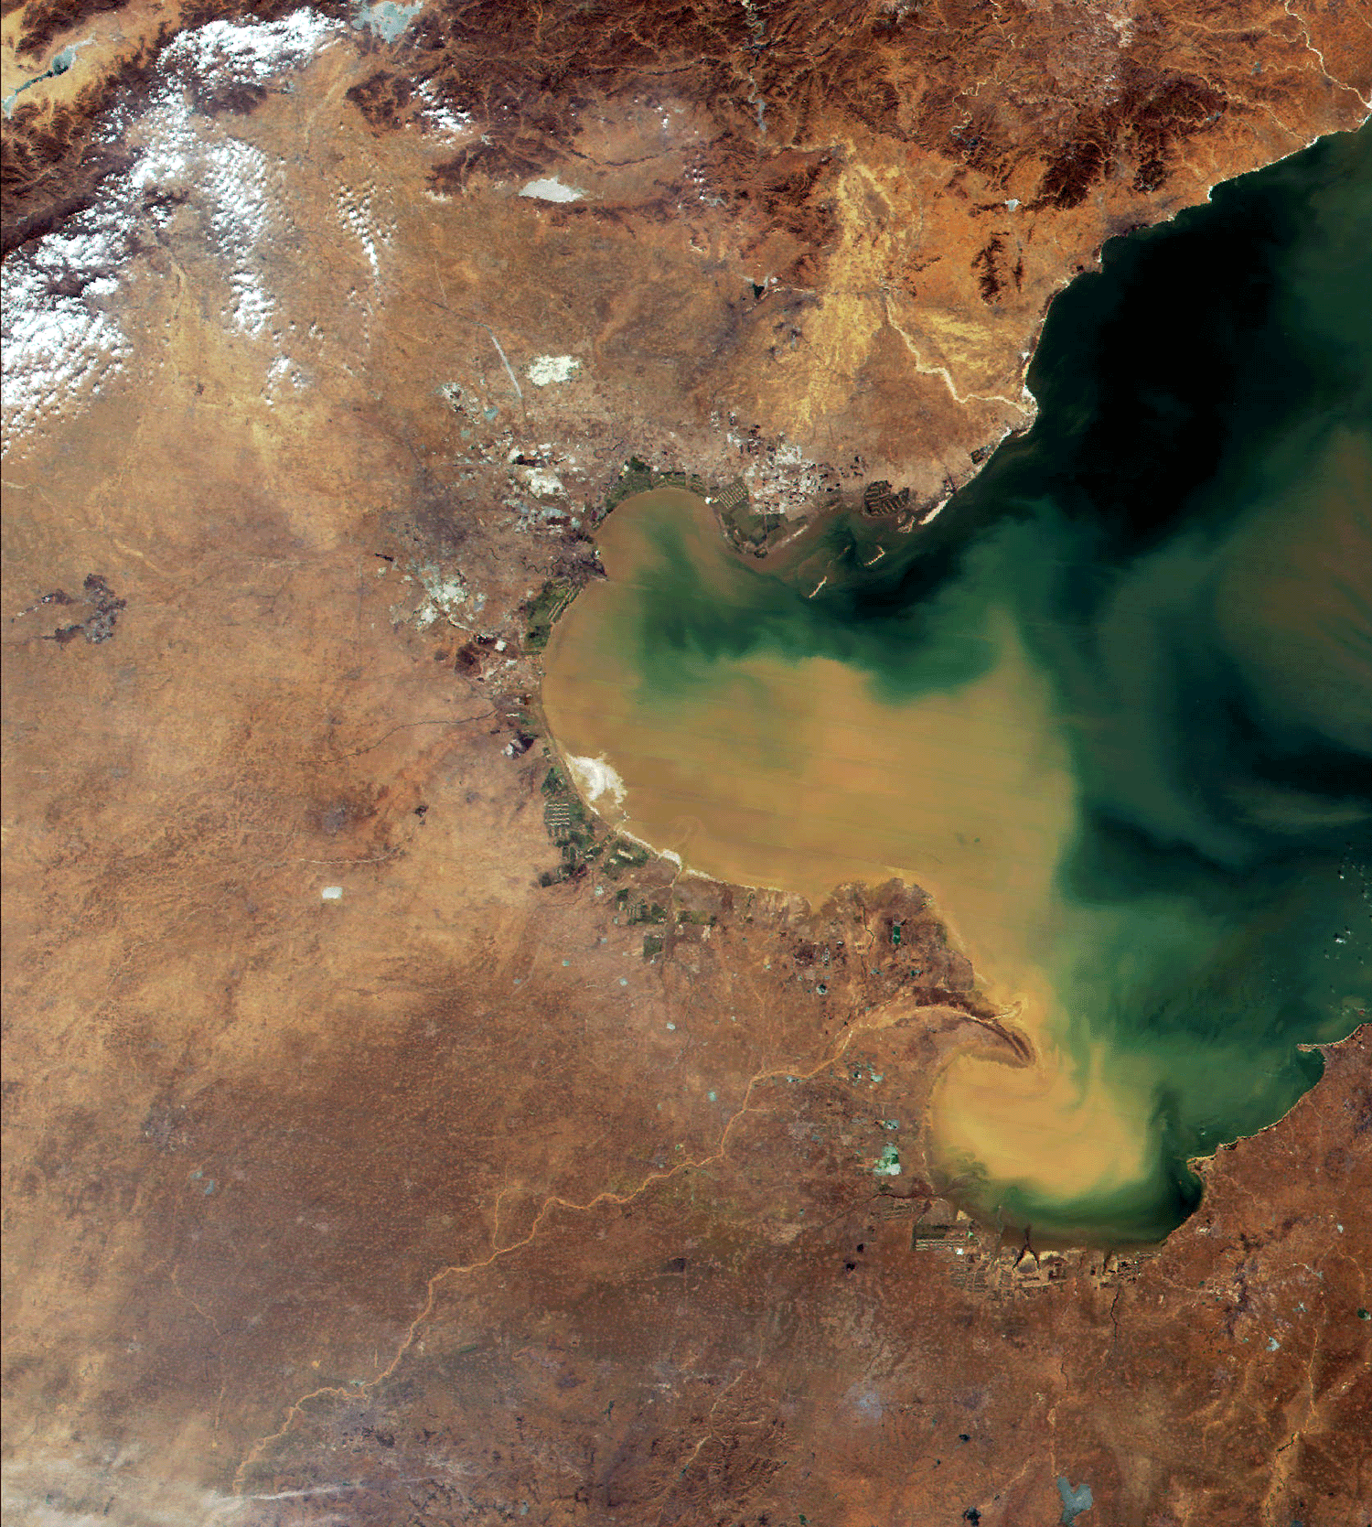
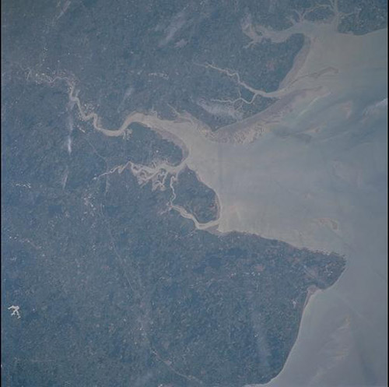
Bo Hai Gulf
Thames
Estuary
Yellow River

Slide 53
Estuaries
Are Places Where a River Meets the Sea
Or It May Occur in a Fjord, for example…
Oslofjord
Puget Sound
Cook Inlet

Slide 54
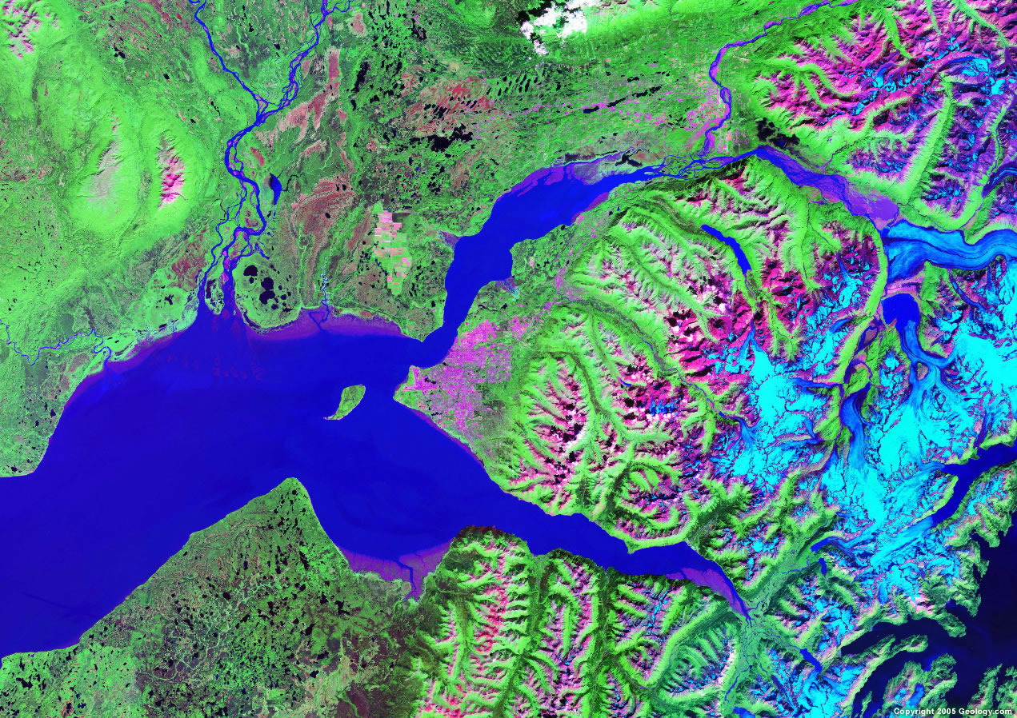
Oslo
Oslofjord
Cook Inlet
Anchorage
Puget
Sound

Slide 55
Estuaries
Are Important Nursery Grounds for the Ocean
Are as Biologically Productive as Irrigated
Agriculture on a per square meter basis
Are Home to Most of the World’s Human Population
The Sites of Most of the World’s Great Cities
Are the Most Heavily Affected Parts of the Ocean

Slide 56
Cities on Estuaries
San Francisco
New York
London
Rangoon
Shanghai
Dhaka
Bombay
Vladivostok
Buenos Aires
Montevideo
Rio de Janeiro
Washington D.C.
Ho Chi Min City
Tokyo
St. Petersburg
Bangkok

Slide 57
10 Largest Rivers by Inflow
River Drainage Area: km² Inflow: km³/yr
Neva (St. Petersburg) 281,000 77.6
Vistula (Gdansk) 194,400 33.6
Daugava (Riga) 87,900 20.8
Neman (Klaipeda) 98,200 19.9
Oder/Odra 118,900 18.1
Göta älv (Kattegat) 50,200 18.1
Kemijoki 51,400 17,7
Ångermanälven 31,900 15.4
Luleåälven 25,200 15.3
Indalsälven 26,200 14.0
250.5
(57% of Total Inflow)

Slide 58
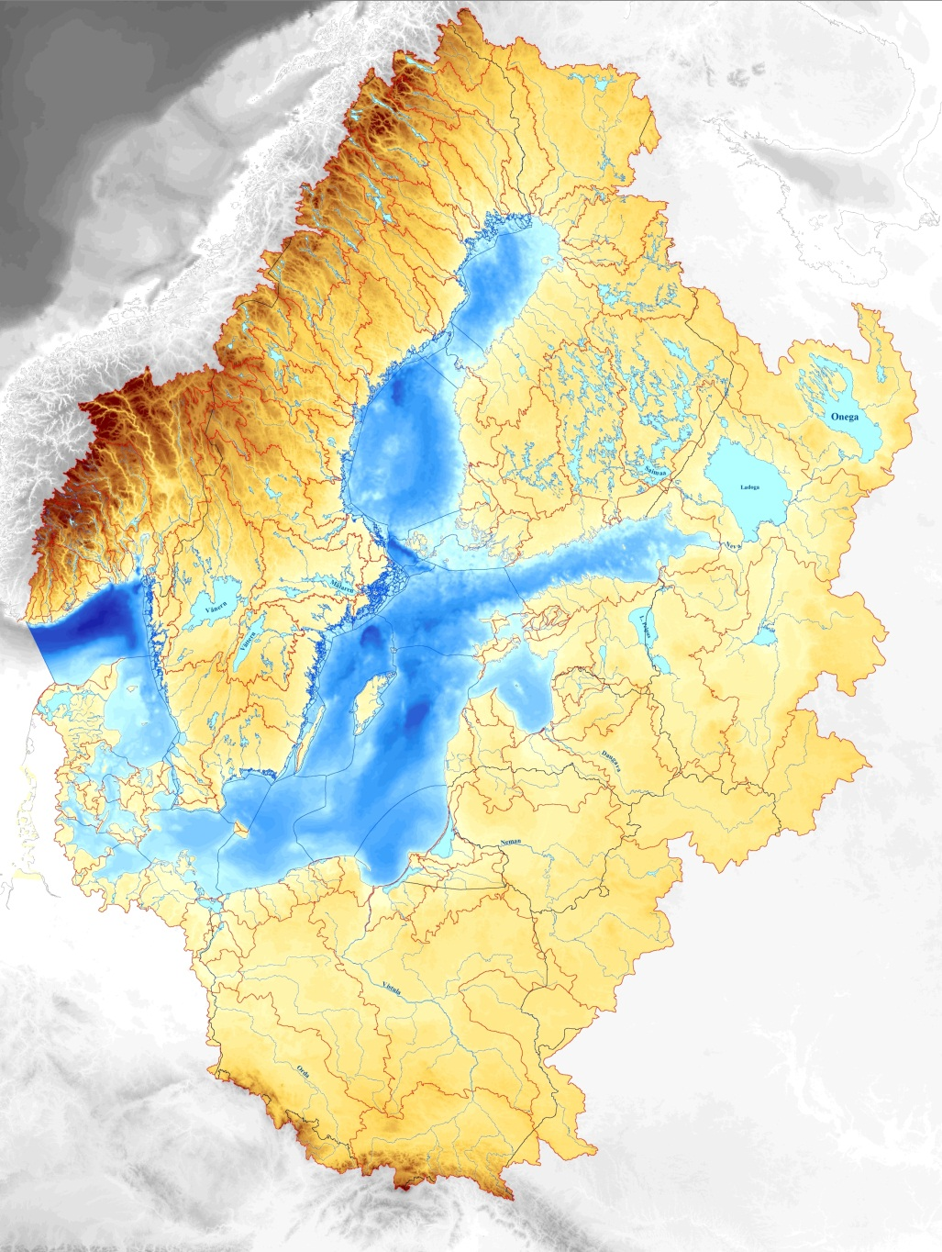
10 Largest Rivers By Drainage Area
Luleåälven
Kemijoki
Ångermanälven
Indalsälven
Neva
Göta älv
Daugava
Oder
Neman
Vistula

Slide 59
10 Largest Rivers By Inflow Volume
Luleåälven
Kemijoki
Ångermanälven
Indalsälven
Neva
Göta älv
Daugava
Oder
Neman
Vistula

Slide 60
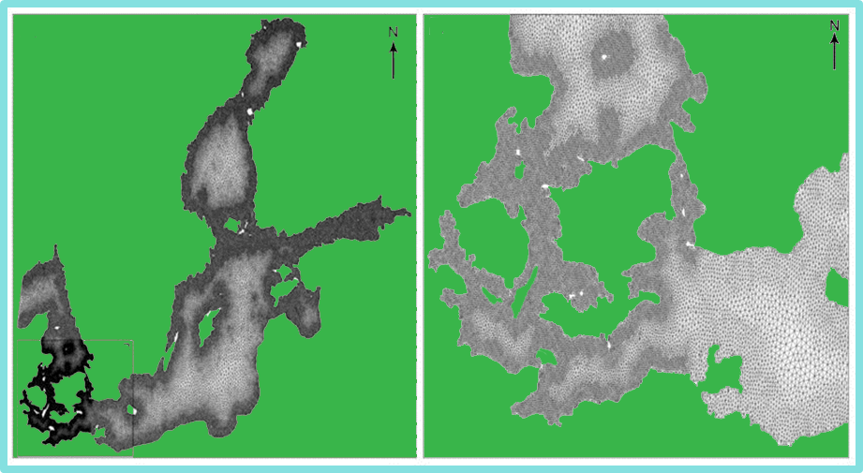
Sill Depths at the Mouth of the Baltic
A
B
Denmark
Sweden
Little Belt
5m
Öresund
8m
Great Belt
18m
B
Germany
Poland

Slide 61
215 km³/a
1660 km³/a
175 km³/a
440 km³/a
21,205 km³
1180 km³/a
Water Budget of the Baltic Sea

Slide 62
N
Elken and Matthäus, 2008

Slide 63
Circulation of the Baltic Sea
Elken and Matthäus, 2008

Slide 64
Circulation of the Baltic Sea
Surface Current
Bottom Current
Entrainment
Entrainment
Elken and Matthäus, 2008

Slide 65
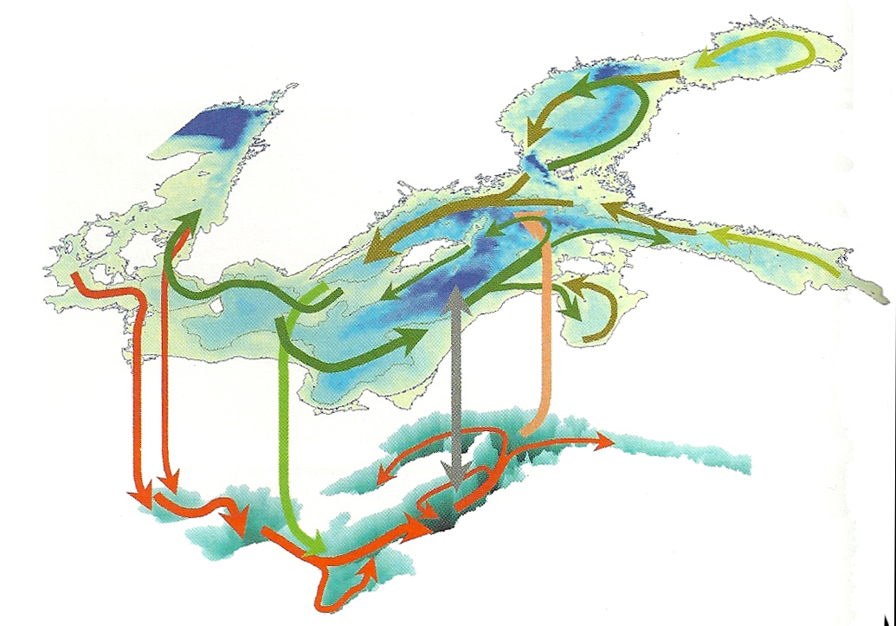
Circulation of the Baltic Sea
Surface Current
Bottom Current
Entrainment
Entrainment
Elken and Matthäus, 2008

Slide 66
For the Baltic To Flush,
Requires a Quite
Unusual Chain of Events
This Sequence Only Occurs
About Every 4 Years
Often in November-January
These are Called “Major Baltic Inflows”

Slide 67
If the Wind Blows From the East for 10 Days,
The Baltic Water Piles Up In the West Near the Kattegat
W
Wind
E
Darss
Sill
Bornholm
Deep
Gotland
Deep

Slide 68
If the Wind Then Reverses and Blows From the West for 10 Days,
The North Sea Water Flows over the Darss Sill, into the Baltic,
Replacing the Deep Anoxic Bottom Water
W
Wind
E
Darss
Sill
Bornholm
Deep
Gotland
Deep

Slide 69
These Events ,
the “Major Baltic Inflows”
Are Extremely Rare,
So the Residence Time
for Water in the Baltic
Is About 50 Years

Slide 70
Baltic Tides!
10 cm at the Danish Straits
2-5 cm in the Baltic Sea

Slide 71
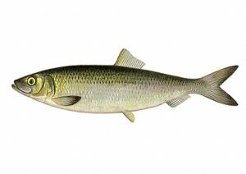
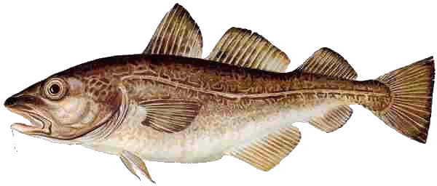
Cod
Sprat
Herring
600
500
400
300
200
100
0
Metric Tons: x1000
64 68 72 76 80 84 88 92 96 00
Year
Major Baltic Fisheries
1/3 Human Consumption, 2/3 Fish Meal and Oil, Animal Feed

Slide 72
In Summary:
The Baltic is a unique oceanic basin
It is one of four major brackish water basins in the world:
The others are:
The Black Sea
The Gulf of Ob in the Kara Sea
Chesapeake Bay
The Baltic Sea is slightly brackish, nearly fresh water
It occupies a valley originally carved by the Eridano River
It is an estuary, so its circulation is driven by the many
rivers that flow into the Baltic
It is partly to fully frozen in winter
It is historically important for its trade and its fisheries
Thank You

Slide 73
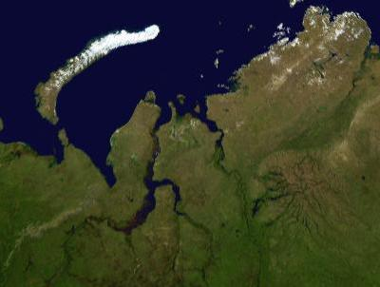
Kara Sea
1000 Km
The Gulf of Ob

