Slide 1
Water, Water Everywhere, Nor Any Drop to Drink
by
Jim Kelley

Slide 2
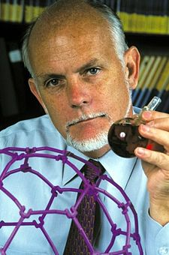
Humanity’s Top Ten Problems for next 50 years
ENERGY
WATER
FOOD
ENVIRONMENT
POVERTY
TERRORISM & WAR
DISEASE
EDUCATION
DEMOCRACY
POPULATION
Richard Smalley
(1943-2005)
1996 Nobel
Laureate in
Chemistry
Rice University
2004 6.5 Billion People
2050 ~ 10 Billion People

Slide 3
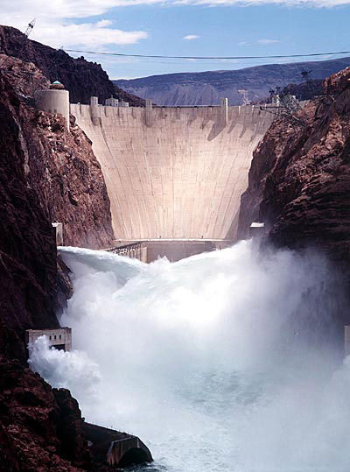
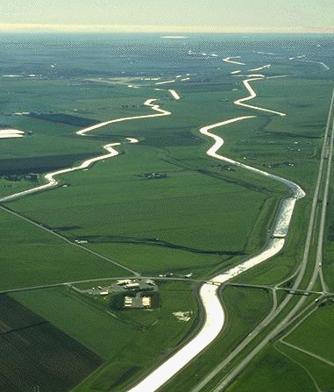
It Is Helpful to Think of Water as Power

Slide 4
Consider the Commodities
Which Have Shaped Human
History.
Once it was Salt
Later it was Spices
Today it is Oil
In the Future it will be Fresh Water

Slide 5
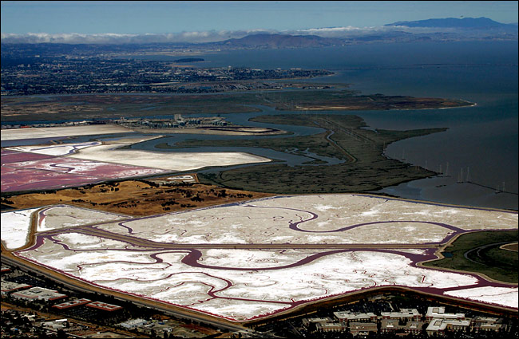
Salt Has Long Been an Important Commodity

Slide 6
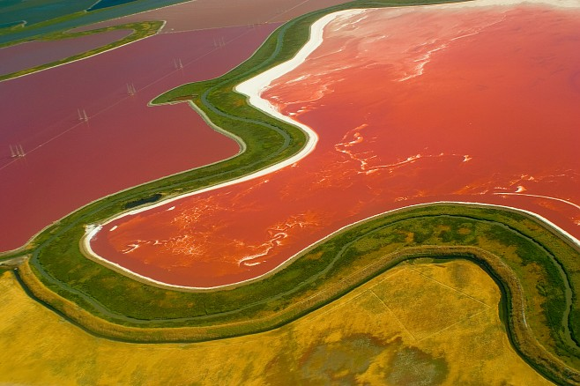

Slide 7
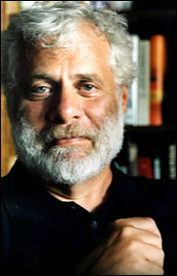
Salt Is A
Commodity That
Has Shaped
Global
Commerce and
Politics From
The Earliest
Times

Slide 8
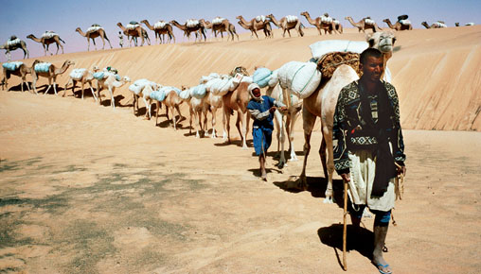
Timbuktu Salt Caravan

Slide 9
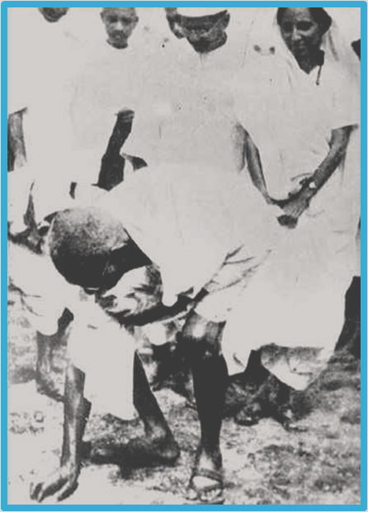
Mohandas Gandhi
Led the 25 Day
Salt March,
Ending at Dandi on
5 April, 1930,
Where He Publically
Violated British Law
By Picking up a
Piece of Salt
And Starting a
National Movement

Slide 10
By the Middle Ages.
Spices Began to
Drive Global Politics

Slide 11
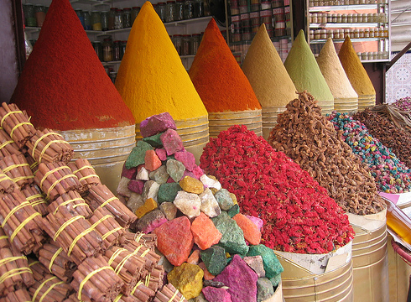
Spice Market--Morocco

Slide 12
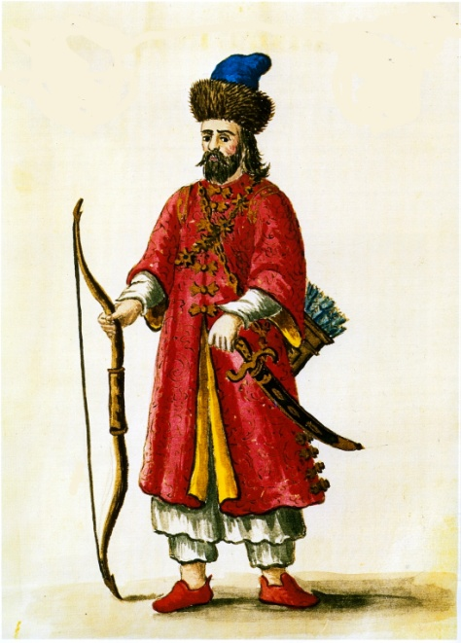
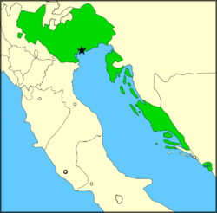
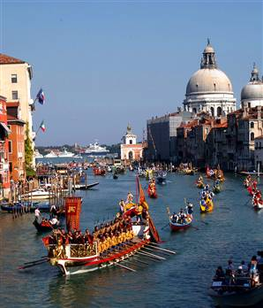
Marco Polo Helped
Venice Rise to
Dominance with
Its Control of the
Spice Routes
Polo’s Trip to
Cathay--1274-1291

Slide 13
Spice Routes

Slide 14
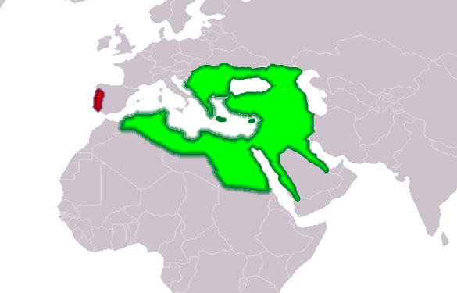
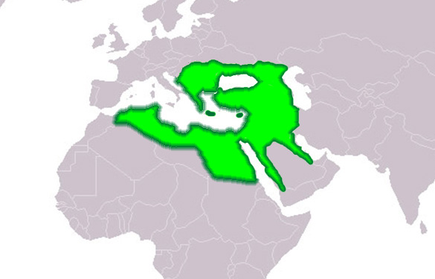
By the Fifteenth Century, The Ottoman Empire
Had Taken Control of the Spice Routes
Ottoman Empire
In the 16th Century
Portugal

Slide 15
This Led
Prince Henry
The Navigator
To Send
Portuguese Explorers
Around Africa
To the Spice Islands,
Changing
The Map of
the World

Slide 16
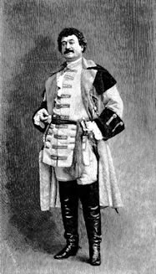
Bartolomeu Dias Sailed to
The Cape of Good Hope,
1487-1488

Slide 17
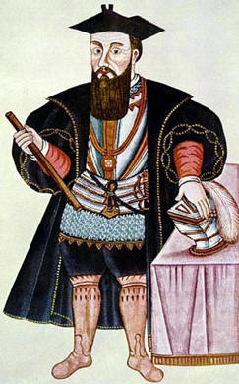
Vasco da Gama Sailed to
Calicut in 1497-1499

Slide 18
For Hundreds
Of Years,
Salt and
Other Spices,
Especially
Pepper,
Drove
Global
Commerce

Slide 19
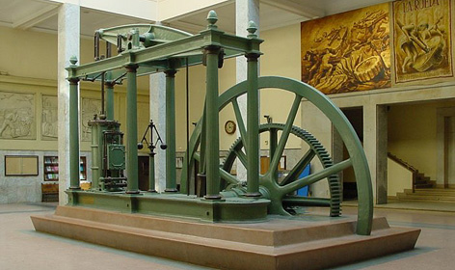
In the 19th Century, Coal Began
To Drive Global Politics
Through the Industrial Revolution
James Watt’s
Steam Engine

Slide 20
Today, of course, Petroleum Drives
International Trade and Global Politics

Slide 21
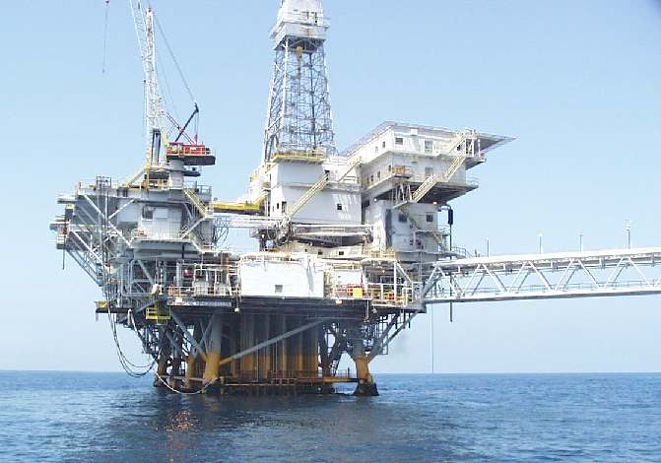
Santa Barbara Channel

Slide 22
So, After Salt, Spices, and Oil,
What Will be the Next
Commodity to Drive Global Politics?
It Will Almost Certainly Be
Fresh Water
So, Let’s Look at Water…

Slide 23
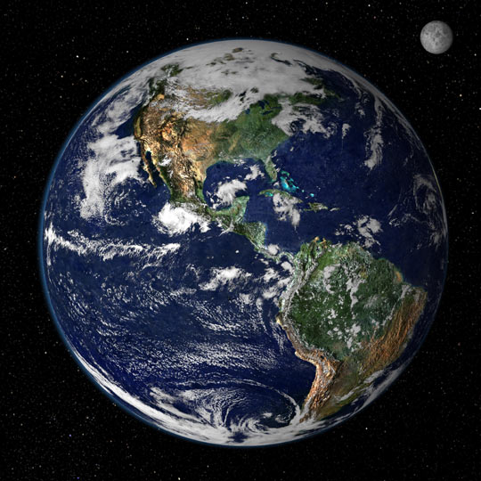

Slide 24
But Even With All
this Water
We Still Have
Inadequate Supplies
of Safe Fresh Water

Slide 25
97% of the
Earth’s
Water is
Salt Water
Total
Water
Salt
Water

Slide 26
Even Taking
Only the Fresh
Water Portion
Total
Fresh Water

Slide 27
Available
Fresh Water
~~~~~~~
Equal to
1% of Total
Fresh Water,
Or
~0.007%
of All Water
on Earth
Deep Groundwater
And Soil Moisture
30.1%
Total
Fresh Water
Ice
68.7%

Slide 28
Of the
6.7 Billion
People in
the World

Slide 29
2.6 Billion
(40%)
Lack
Basic
Sanitation

Slide 30
And 1 Billion
Use
Unsafe
Drinking
Water

Slide 31
There Are Many Places
In the World Where the
Demand for Fresh Water
Is Already Producing Intense
Re-Adjustment of Political
Priorities
--Let’s Look at Three

Slide 32
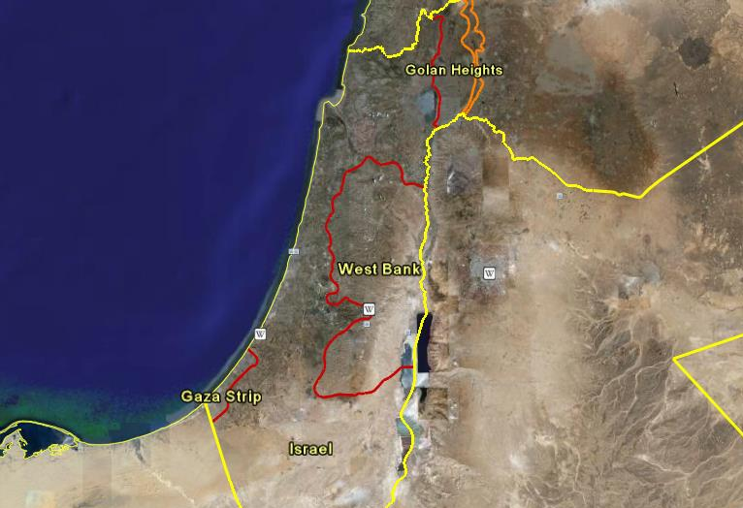

Slide 33
Mediterranean
Sea
Lebanon
Nearly All
Of Israel’s
Water Comes
From the
Jordan River
And Two Large
Aquifers
Syria
Golan Heights
(1967)
Israel
West Bank
(1967)
Jordan
Aquifers
Gaza Strip

Slide 34
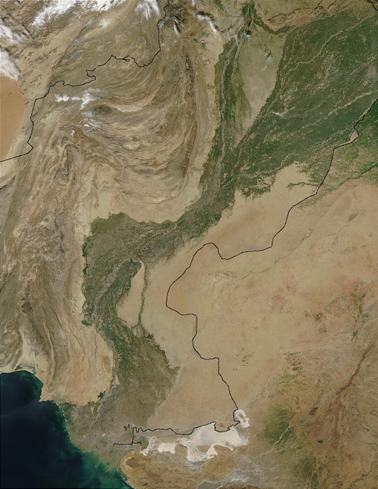
Afghanistan
The Indus
River Provides
Nearly All
The Agricultural
Water to Pakistan
--Its Headwaters
Are in Kashmir
Pakistan
India

Slide 35
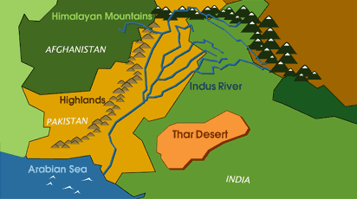
Baglihar Dam

Slide 36
The Baglihar Hydropower
Project, was inaugurated
by Indian Prime Minister
Mahmohan Singh on
17 October, 2008
“This [issue…is] inextricably linked to the
Jammu and Kashmir dispute.
Unless this issue is settled …the matter of
normalization of relations between India
And Pakistan would remain a pipedream.”
Pakistan Observer, 20 Oct. 2008

Slide 37
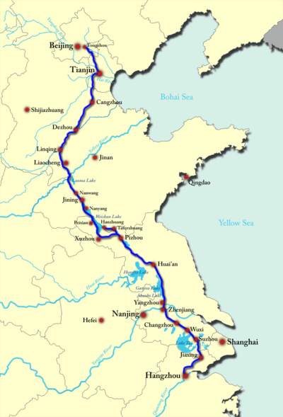
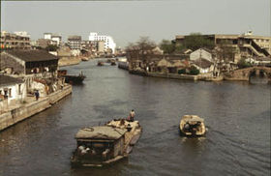
Beijing
The 1200-Mile Long
Grand Canal, Completed
During The Sui Dynasty
(581–618 AD), Will Soon be
Joined by Two New
North-South Waterways
Nanjing
Hangzhou

Slide 38
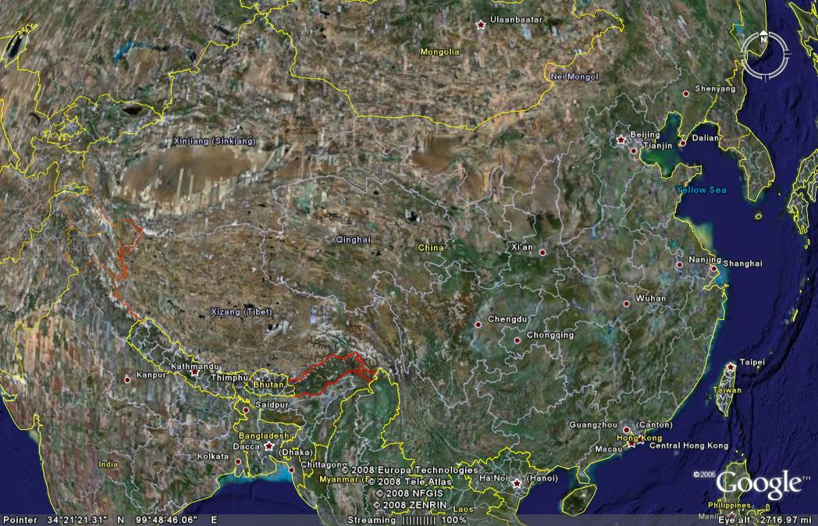
In China, Most of the Water is in the South
Beijing
Shijiazhuang
?
Western
Routes
?
Danjiangkou
Hangzhou

Slide 39
Now Let’s Look
A Bit Closer to Home

Slide 40
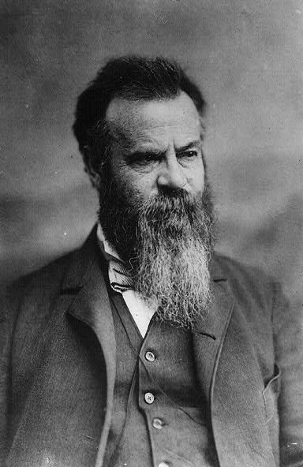
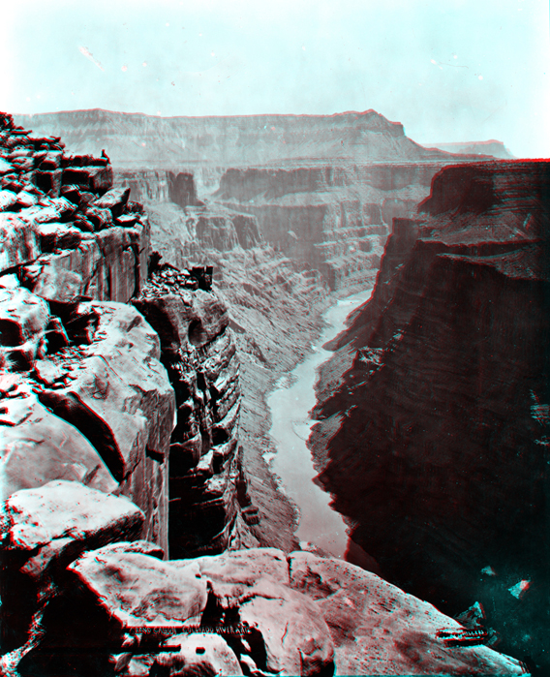
Major
John Wesley Powell
(1834-1902)

Slide 41
“The Arid Region is the
great Rocky Mountains
Region Of the United
States, and it embraces
more than four-tenths
of the country,
excluding Alaska.
In all this region the
mean annual rainfall
is insufficient
for agriculture”
John Wesley Powell
p. 15, Emphasis added

Slide 42
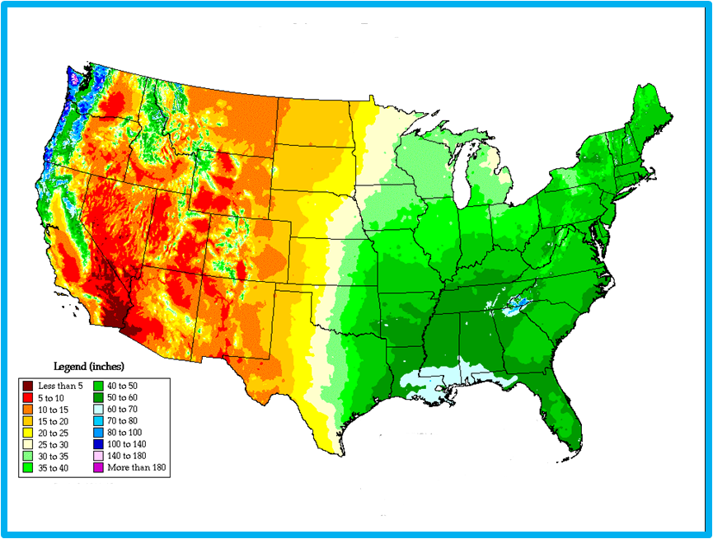
Average Annual Precipitation
100th Meridian
20” Isohyet

Slide 43
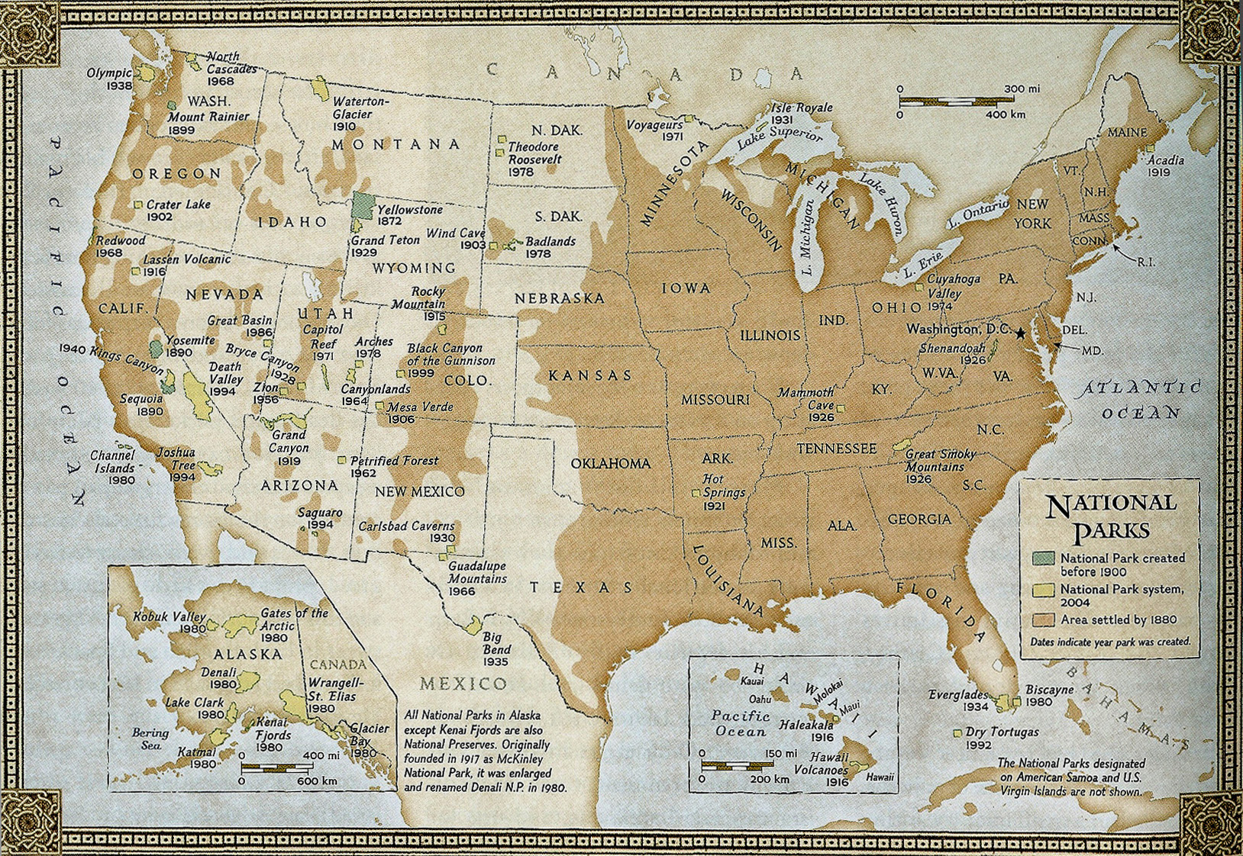
Of course, at the time of Powell’s Report,
Most of the Population Lived in the East
Settled
Areas
1880

Slide 44
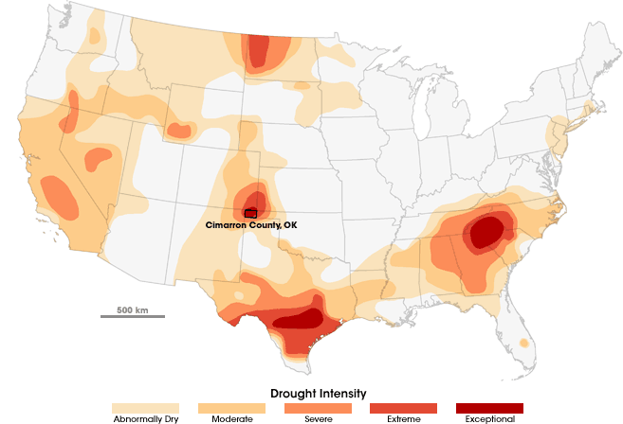
The Current Drought as of 22 July, 2008

Slide 45
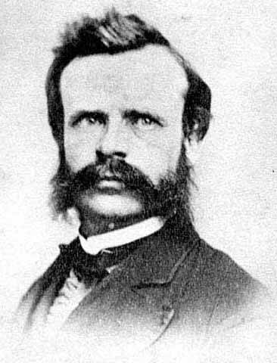
Many droughts will
occur, many seasons
in a long series will be
fruitless; and it may
be doubted whether,
on the whole, agriculture
will prove remunerative.
--John Wesley Powell
Arid Lands Report, p. 13

Slide 46
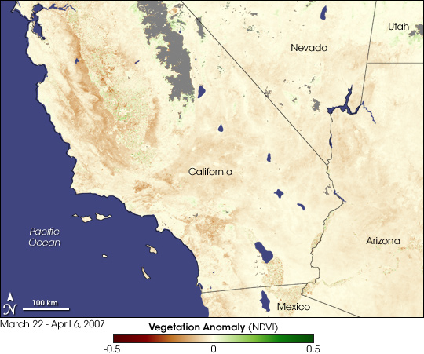
22 March--6 April 2007

Slide 47
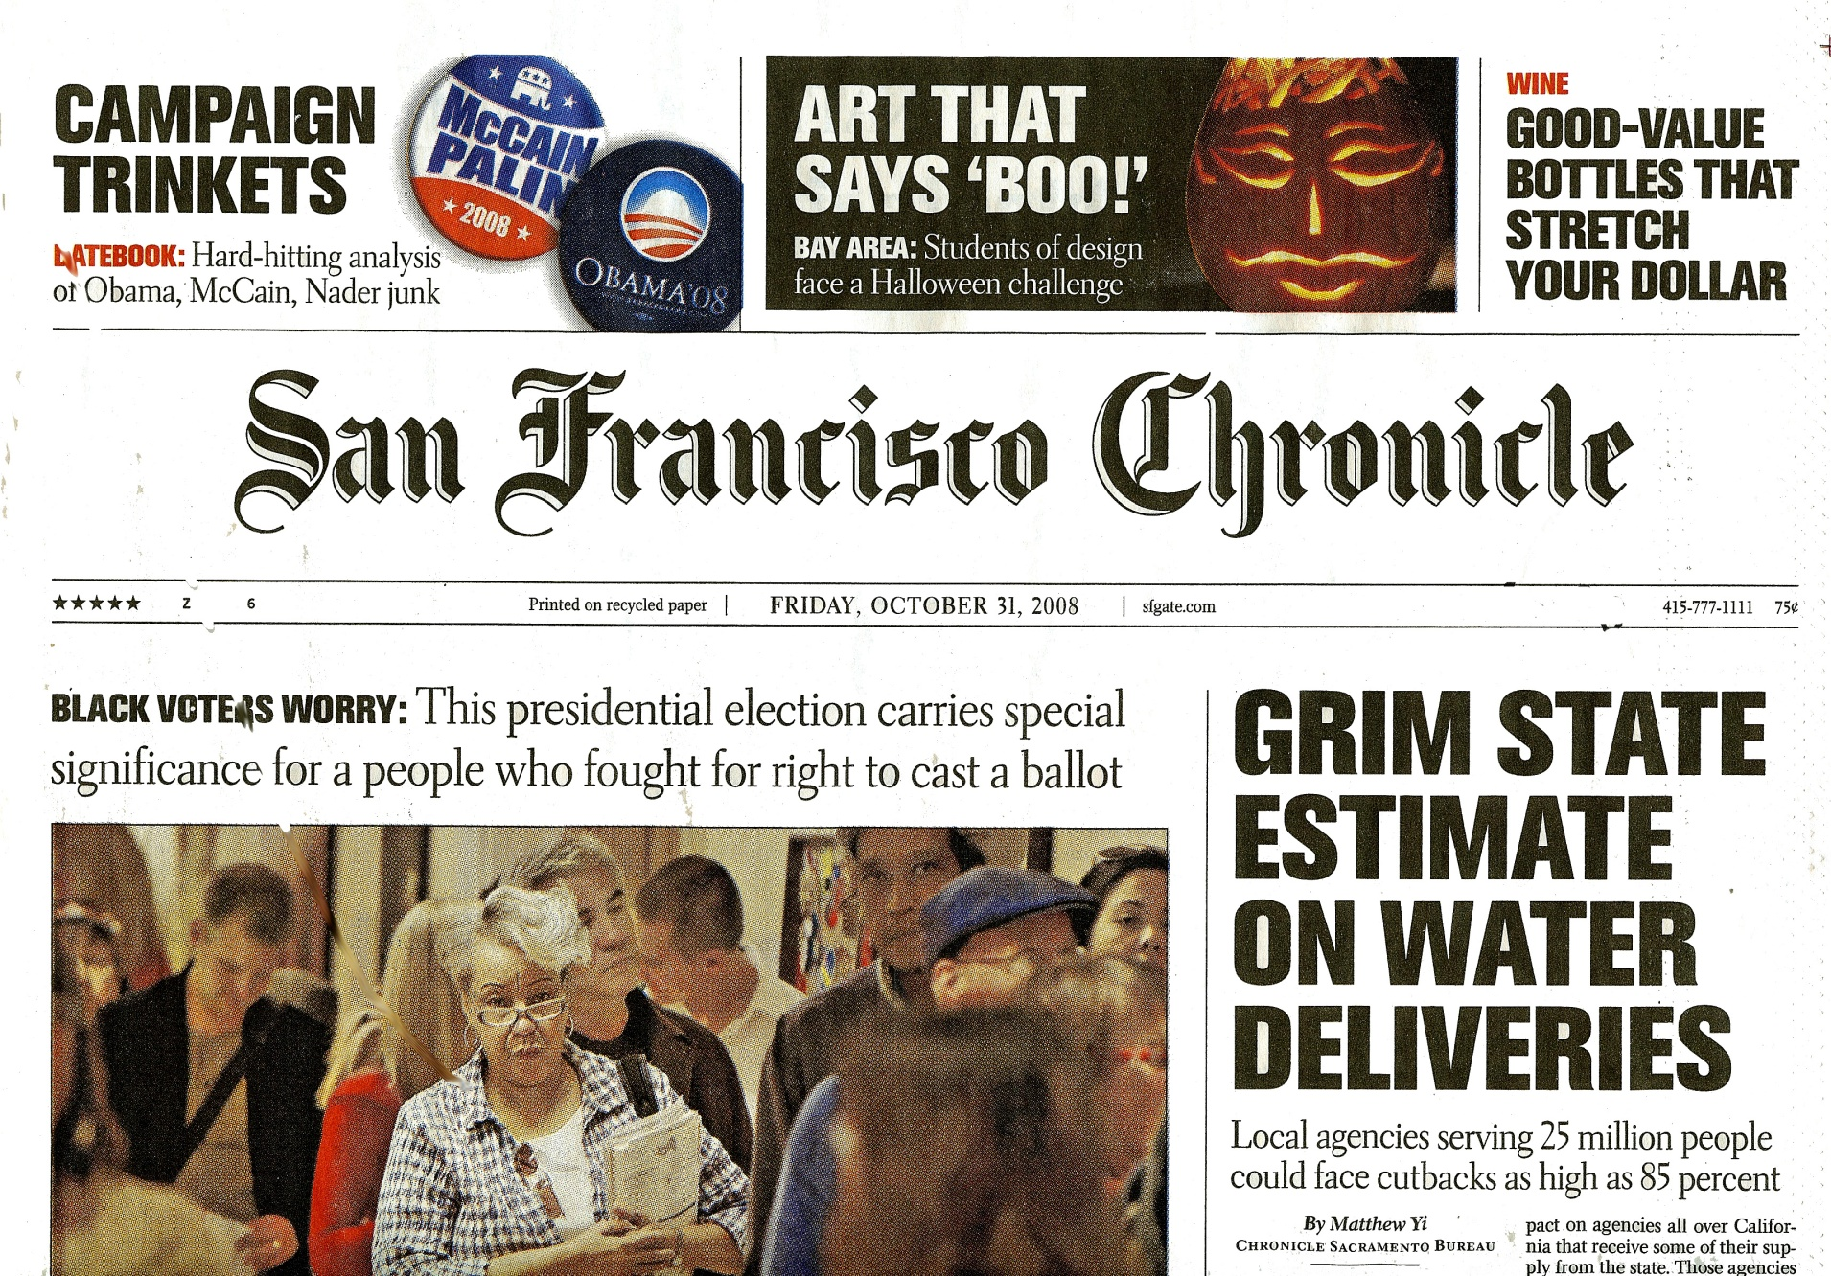
San Francisco Chronicle 31 October, 2008

Slide 48
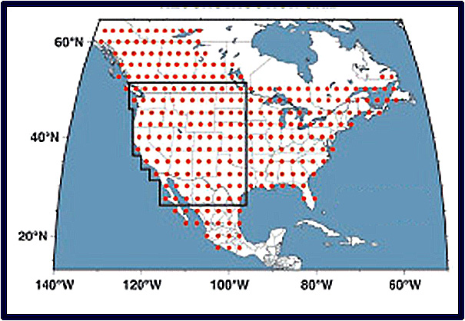
Record of Drought in the West
In a Comprehensive 2004 Study of Western Drought,
Ed Cook of Lamont (Columbia U.)
and Colleagues
Studied Records
from Across the
“Arid Lands”
Examining 286
2.5’ x 2.5’
Grid Points

Slide 49
Record of Drought in the West
100
80
60
40
20
0
Drier
Wetter
220 yr
140 yr
% Drought Area
Historical Period
800 1000 1200 1400 1600 1800 2000
Cook, (Lamont) et al., Science, 5 Nov. 2004

Slide 50
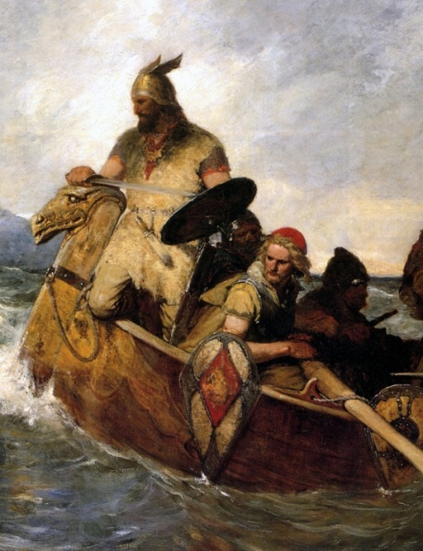
History of Temperature in Europe
1
0
-1
Little
Ice Age
Temperature Change ºC
Medieval
Warm Period
1000AD 1500AD 2000AD
Figure 22 in the Intergovernmental Panel
On Climate Change Report Climate Change, 1995

Slide 51
Public--11%, Domestic--<1%
Irrigation—34%
Livestock--<1%
Extractive Uses
Of Water in the
United States
in 2000
--USGS
Industrial—5%
Thermal Power
Generation—48%

Slide 52
So What Can We Do About It?
We Can Develop Two Resources
Which We Have in Abundance;
Salt Water and Solar Energy…
And Develop Them Together

Slide 53
First A Look at Desalination
Of Seawater and Brackish Water

Slide 54
“If we could ever competitively—at a cheap rate—get
fresh water from salt water, that would be in the
long-range interest of humanity, and would really dwarf any
other scientific accomplishment.”
--John F. Kennedy, April 12, 1961
Global Installed Desalination Capacity
50
40
30
20
10
0
Capacity (Million m³/day)
1970 1980 1990 2000 2010

Slide 55
San Francisco Uses About
100 Million Gallons of Water per Day
This is About 300 Acre-Feet per Day
Or About 380,000 cubic meters per day
So Let’s Define
380,000 cubic meters/day
As 1 SFU

Slide 56
“If we could ever competitively—at a cheap rate—get
fresh water from salt water, that would be in the
long-range interest of humanity, and would really dwarf any
other scientific accomplishment.”
--John F. Kennedy, April 12, 1961
Global Installed Desalination Capacity
50
40
30
20
10
0
1000 SFU
Capacity (Million m³/day)
1970 1980 1990 2000 2010

Slide 57
“If we could ever competitively—at a cheap rate—get
fresh water from salt water, that would be in the
long-range interest of humanity, and would really dwarf any
other scientific accomplishment.”
--John F. Kennedy, April 12, 1961
Global Installed Desalination Capacity
50
40
30
20
10
0
40
30
20
10
0
Capacity
(Thousand acre-feet/day)
1970 1980 1990 2000 2010

Slide 58
Primer on Desalination
There a Basically Two Types of
Desalination Methods
1. Thermal Techniques
2. Membrane Techniques

Slide 59
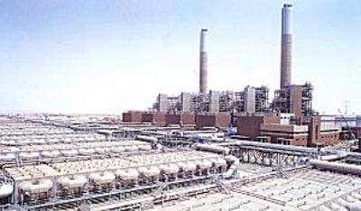
Thermal Techniques involve distillation of
fresh water from saline water. These methods require
a large amount of energy as heat
There are several methods. The most commonly used are:
1. Multistage Flash Distillation: Involves several
evaporation stages in which pressure is
relieved to produce flash evaporation
Saudi Arabia

Slide 60
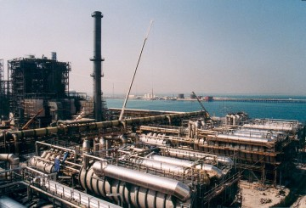
2. Multi-Effect Distillation (MED): Involves several
stages (effects) of boiling saline water each using
waste heat from the preceding stage
Bahrain

Slide 61
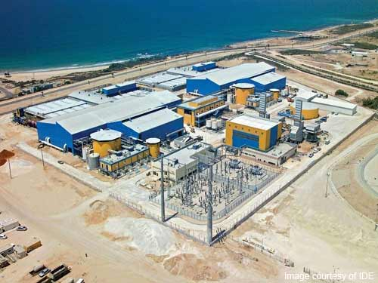
Membrane Techniques Involve Forcing Brine Under
Pressure Through an Osmotic Membrane to
Remove Salt and Other Large Molecules
The Most Commonly used Method is Reverse Osmosis
which Requires Energy to Pressurize the Brine
Ashkelon
Desalination
Plant, Israel

Slide 62
Membrane Techniques are
Capturing an Increasing Share
Worldwide Installed Capacity
Millions of Cubic Meters per Day
70
60
50
40
30
20
10
0
Membrane
1000 SFU
Thermal
1980 85 90 95 2000 05 10 15

Slide 63
It Is Useful to Compare the
True Costs of Transported Water
With Desalinated Seawater
More Than
Half of
Southern
California’s
Water
Colorado River Aqueduct
California Water Project
Seawater Reverse Osmosis
kWh/kgal 2 4 6 8 10
Affordable Desalination Collaborative, 27 March, 2008

Slide 64
It Is Useful to Compare the
True Costs of Transported Water
With Desalinated Seawater
More Than
Half of
Southern
California’s
Water
Colorado River Aqueduct
California Water Project
Seawater Reverse Osmosis
kWh/m³ 0.4 0,8 1.2 1.8 2.0
Affordable Desalination Collaborative, 27 March, 2008

Slide 65
The Affordable Desalination Collaboration (ADC) is a non-profit organization
comprised of the following group of leading companies, state and government
agencies:
California Department of Water Resources
California Energy Commission
Corollo Engineers
City of Santa Cruz Water Department
Energy Recovery, Inc.
FilmTec corporation
GE Zenon
Hydranautics—A Nitto Denko Company
Koch Membranes
Metropolitan Water District of Southern California
Naval Facilities Engineering Service Center
Pentair Water Treatment—Code Line Division
Poseidon Resources
Sandia National Laboratories
Toray Membranes
U. S. Bureau of Reclamation
West Basin Municipal Water District

Slide 66
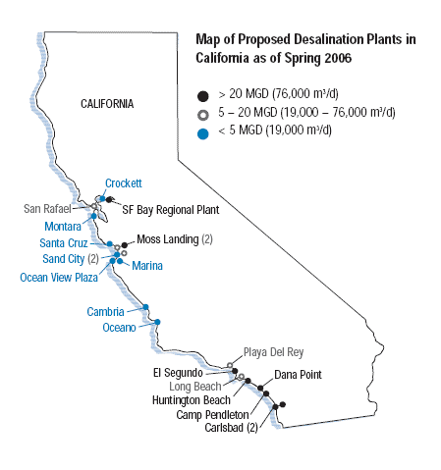
We Currently
Have 21
Desalination
Plants Proposed
Or Approved
In California
Approved,
6 August, 2008

Slide 67
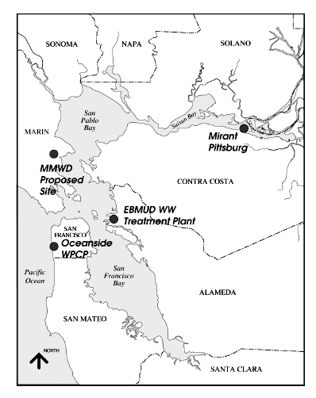
Several Sites
Have been under
Consideration
For Desalination
Plants in the
Bay Area
BCDC, 2005

Slide 68
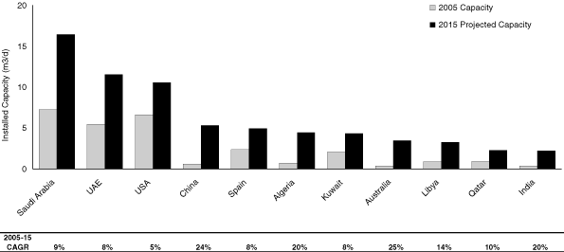
2006 Installed Capacity and
Projected (2015) Installed Capacity
Of Desalination Plants by Country
20
15
10
5
0
2005 Capacity
2050 Projected Capacity
3000 SFU
Capacity (Million m³/day)
Saudi UAE USA China Spain Algeria Japan Aust. Libya Qatar India
Arabia
SEC, IPO for Energy Recovery, Inc.
San Leandro, CA, 24 March, 2008

Slide 69
And The Final
Piece of the Puzzle
…How to Power All
This Desalination

Slide 70
World Energy
Millions of Barrels per Day (Oil Equivalent)
300
200
100
0
1860 1900 1940 1980 2020 2060 2100
Source: John F. Bookout (President of Shell USA) ,“Two Centuries of Fossil Fuel Energy”
International Geological Congress, Washington DC; July 10,1985.
Episodes, vol 12, 257-262 (1989).
R. E. Smalley
Rice University

Slide 71
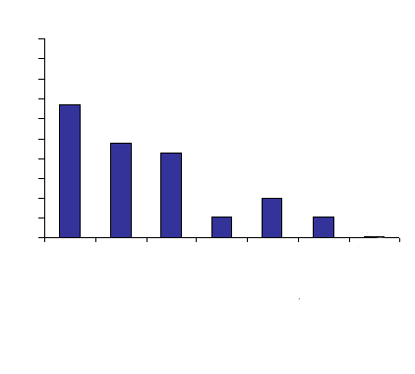
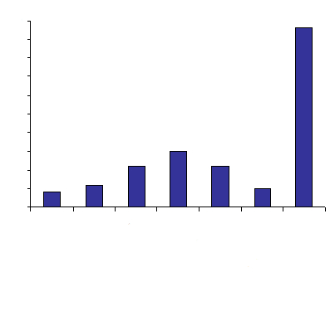
The Energy Revolution
(The Terawatt Challenge)
%
50
40
30
20
10
0
%
50
40
30
20
10
0
2004
2050
14.5 Terawatts
220 M BOE/day
30 -- 60 Terawatts
450 – 900 MBOE/day
Oil
Coal
Gas
Oil
Coal
Gas
Fission
Fission
Biomass
Biomass
Hydroelectric
Hydroelectric
Solar, Wind, Geothermal
Solar, Wind, Geothermal
R. E. Smalley
Rice University

Slide 72
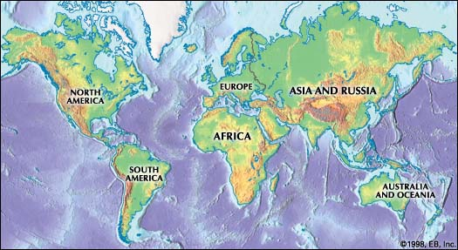
Solar Cell Land Area Requirements
6 Boxes at 3.3 TW Each = 20 TW
Nate Lewis
Cal. Tech

Slide 73
In California we have two things in abundance:
1. Salt water
2. Sunshine
We Need More Water
Water is Energy
Fossil fuel costs continue to rise
Solar energy cost continues to fall
Desalination is becoming cheaper than transported water
Conclusion:
We should be developing solar as fast as possible
We should use solar for desalination

Slide 74
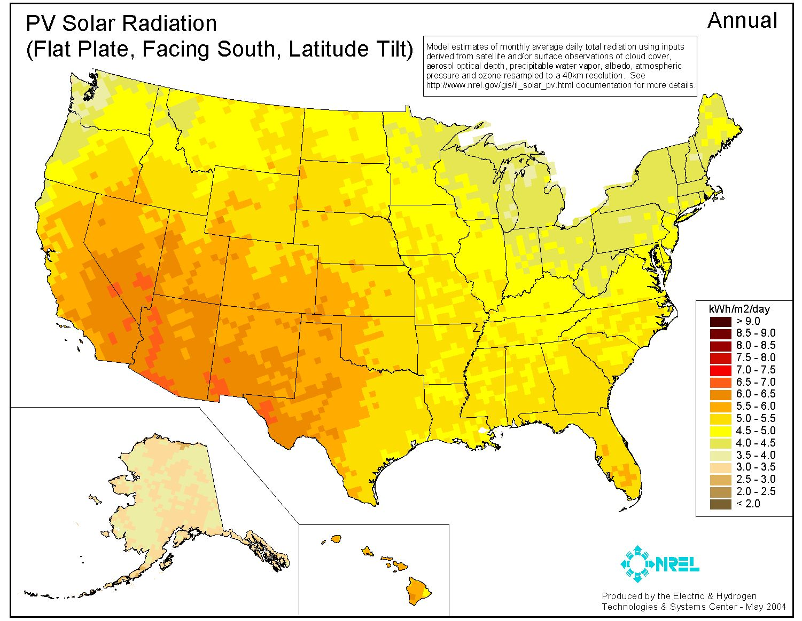
Perhaps Not Surprising, Solar Radiation is Related to Aridity

Slide 75
Installed Desalination Capacity
in the Middle East-North Africa (MENA)
Region and Worldwide
40
30
20
10
0
1000 SFU
Worldwide
Capacity (Millions m³/day
MENA
1960 1970 1980 1990 2000

Slide 76
At This Time, Less Than
0.2% of Desalination is
Done Directly With
Solar Energy

Slide 77
Spain’s Planned Teatro de Aqua Solar Deslanation Plant
Las Palmas, Canary Islands

Slide 78
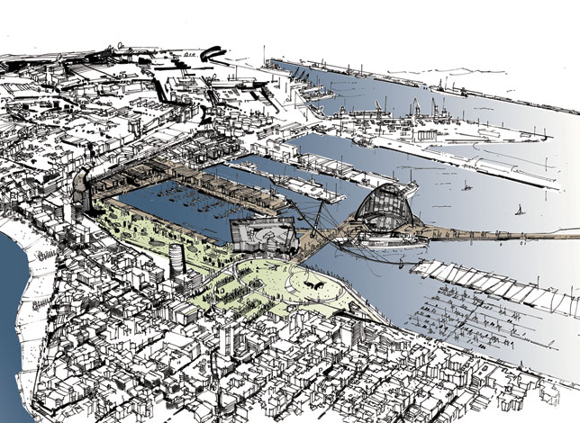
Teatro de Aqua in the Harbor of Las Palmas

Slide 79
Summary:
There is not enough water in the West
Population growth will continue to increase demand;
conservation can only help a little
An obvious source of new water is available:
Desalination
Solar power is one of only two substitutes for fossil fuels
and the technology is improving rapidly
Solar desalination is becoming cheaper and more practical

Slide 80
“You can’t solve a problem with
the same thinking that created it.”
Albert Einstein

Slide 81
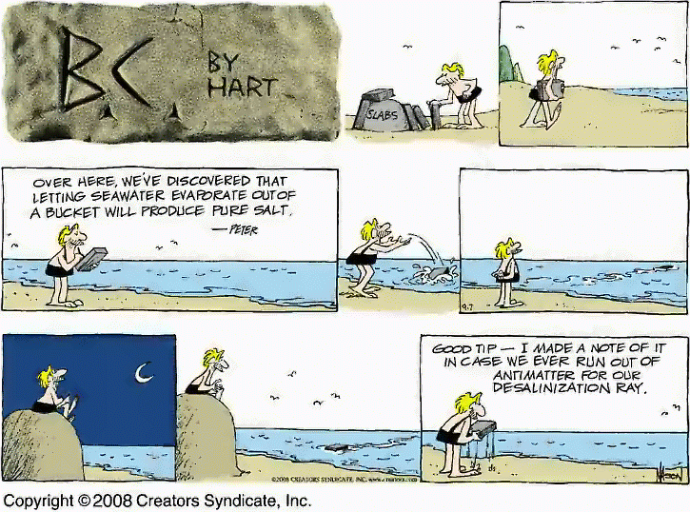

Slide 82
And There Is a Nice Symmetry
Solar Desalination Started with Salt Production
and Will End with Water Production
We Used to Keep the Salt; Now We’ll Keep the Water

Slide 83
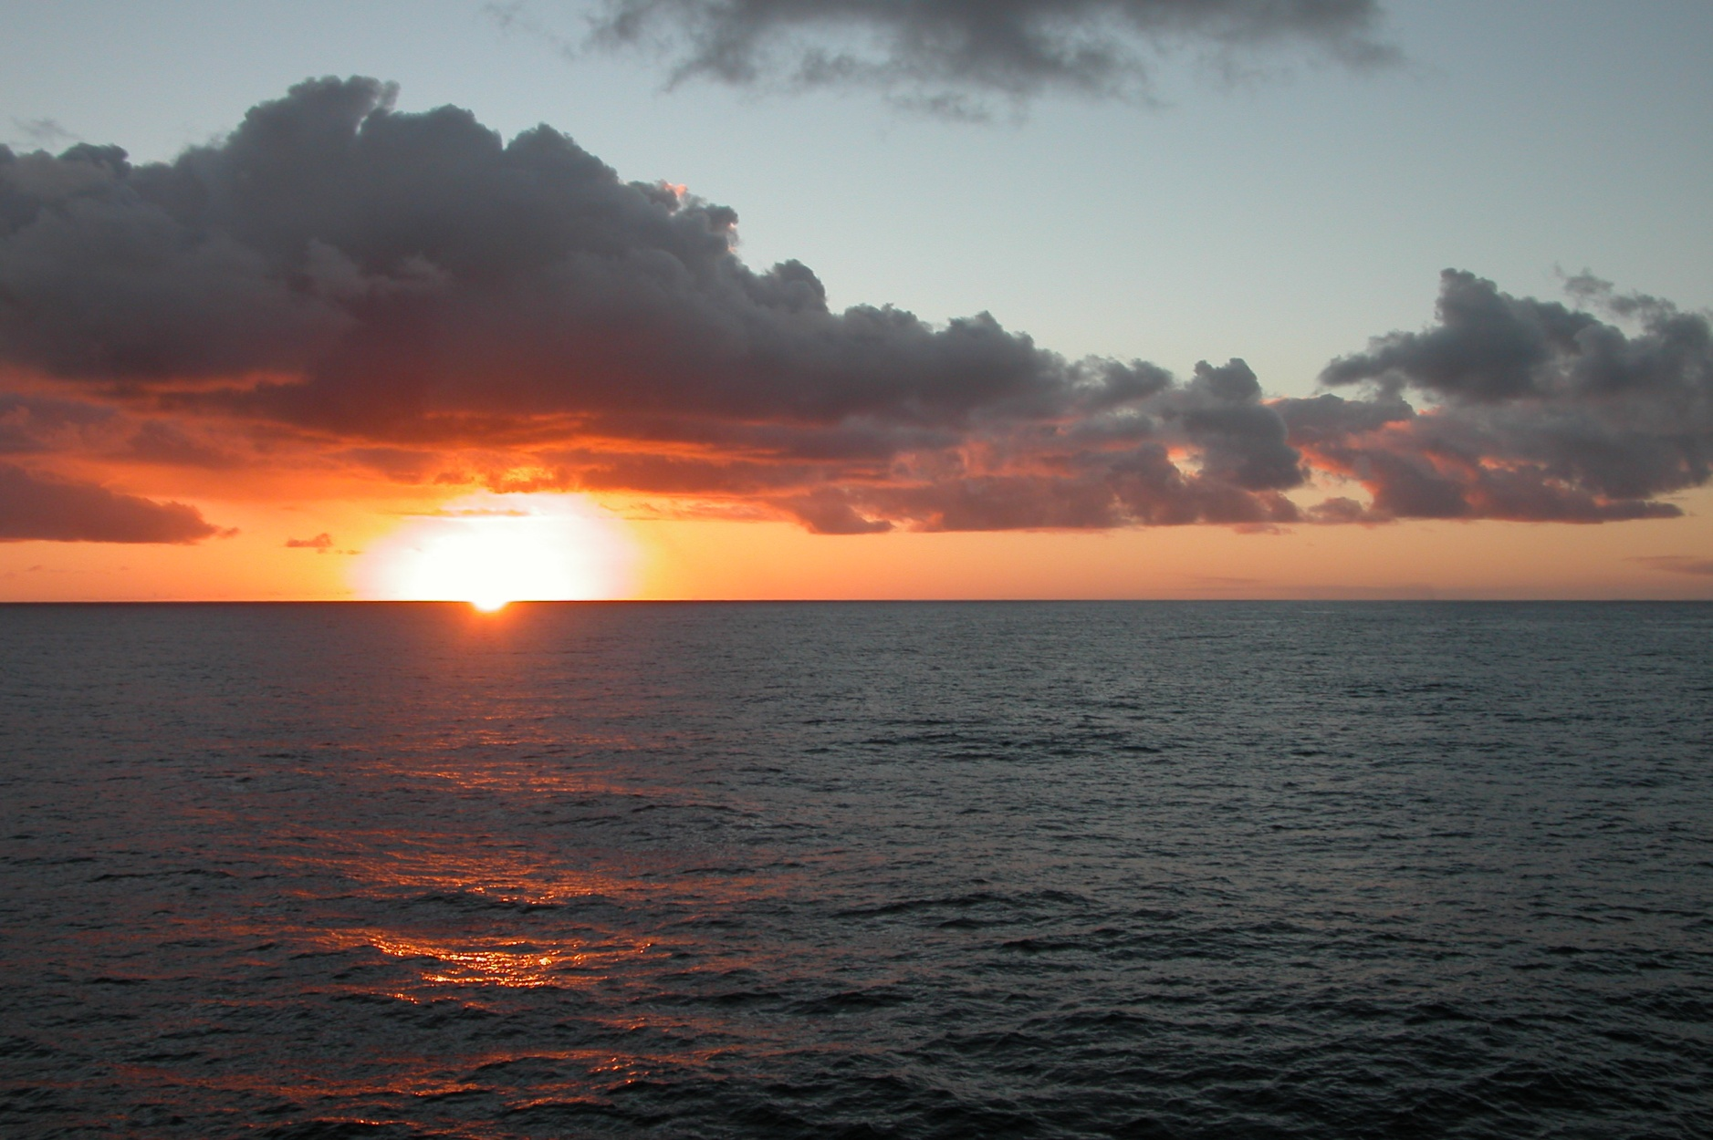
Thank You

