Slide 1
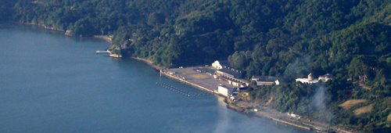
The Romberg Tiburon Center
for Environmental Studies
Why is it Here ?
by
Jim Kelley

Slide 2
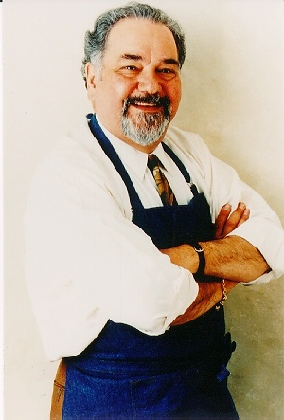

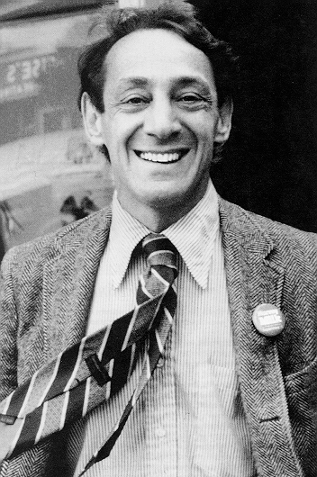

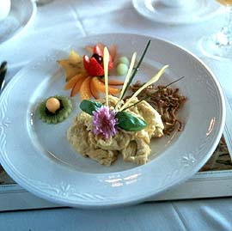
Why Do We Live in the Bay Area?

Slide 3
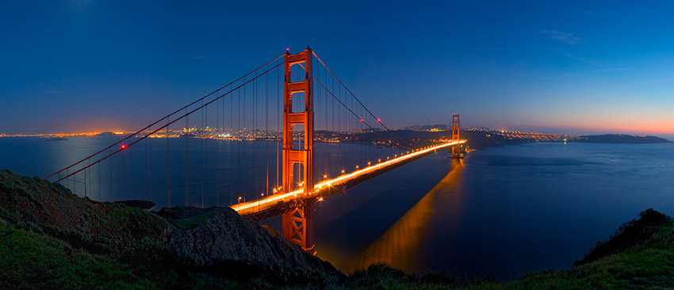
I Would Argue that it is
San Francisco Bay Which Makes
Life in the Bay Area What It Is

Slide 4
What Do You Think
Of When You Hear
“San Francisco Bay?”

Slide 5
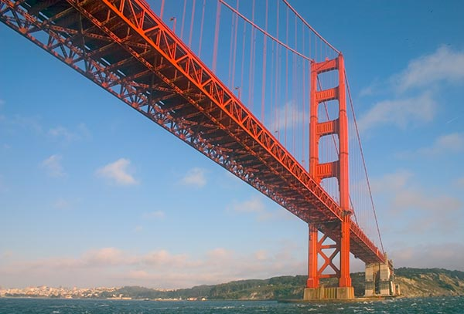
A Famous Bridge?

Slide 6
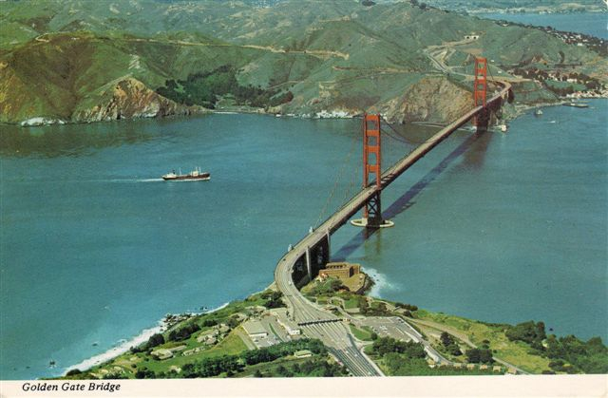
A Beautiful Landscape?

Slide 7
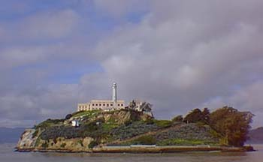
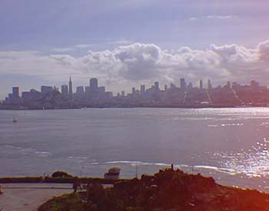
Alcatraz?

Slide 8
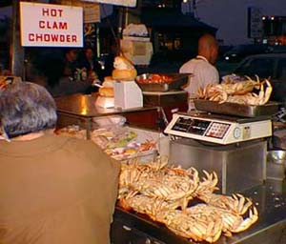
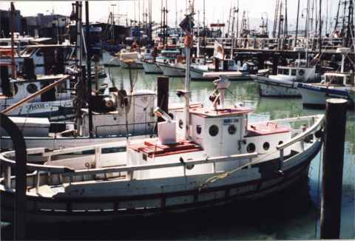
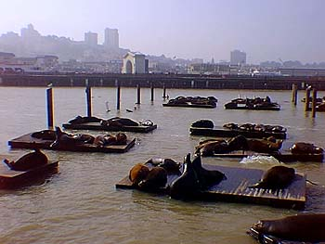
Fisherman’s
Wharf?

Slide 9
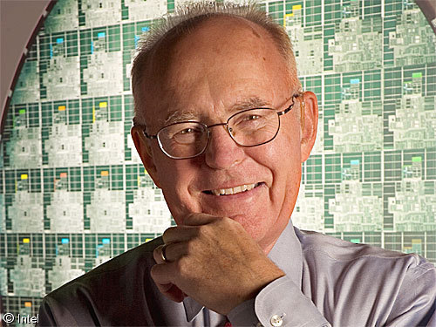
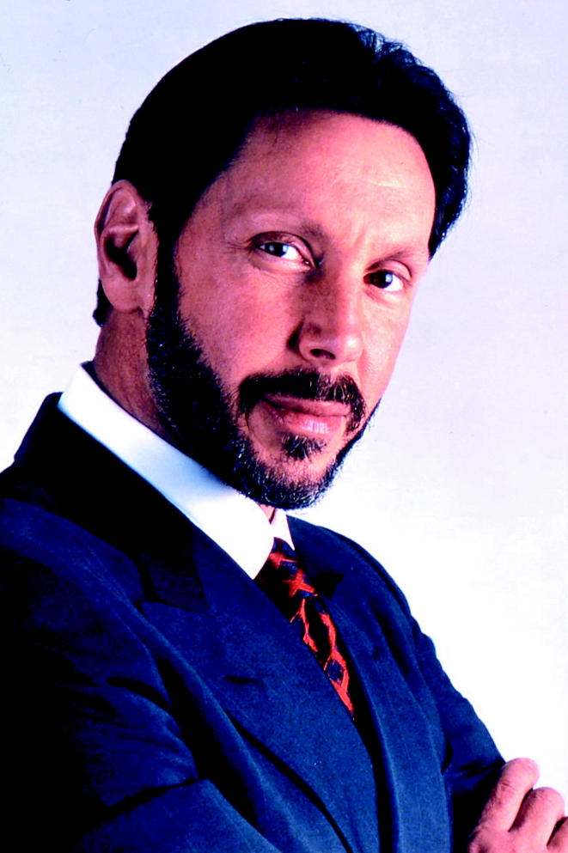
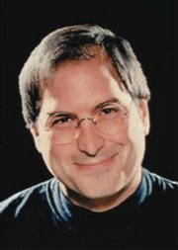
Silicon Valley?

Slide 10
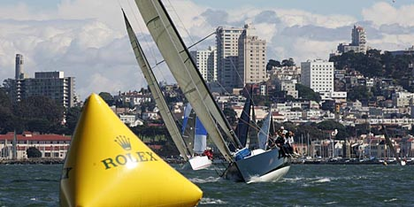
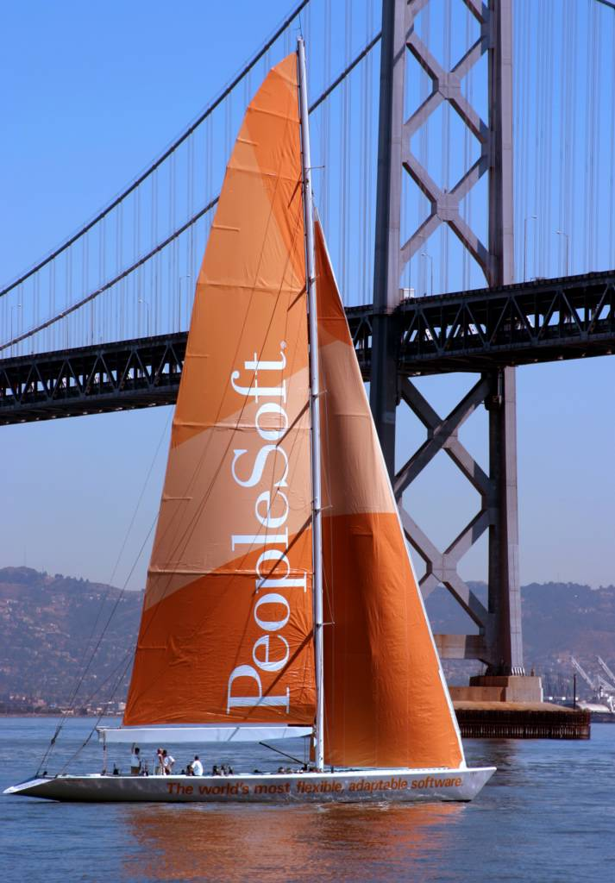
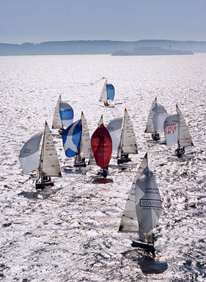
Big Boat
Races?

Slide 11
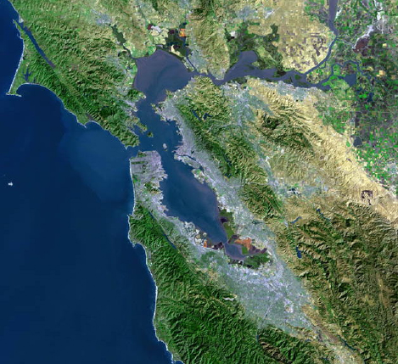
An
Urbanized
Estuary?

Slide 12
Estuaries
Are Places Where a River Meets the Sea
This May Occur in a Bay, for example…
San Francisco Bay
Chesapeake Bay
Bo Hai Gulf of the Yellow River
Thames River Estuary

Slide 13
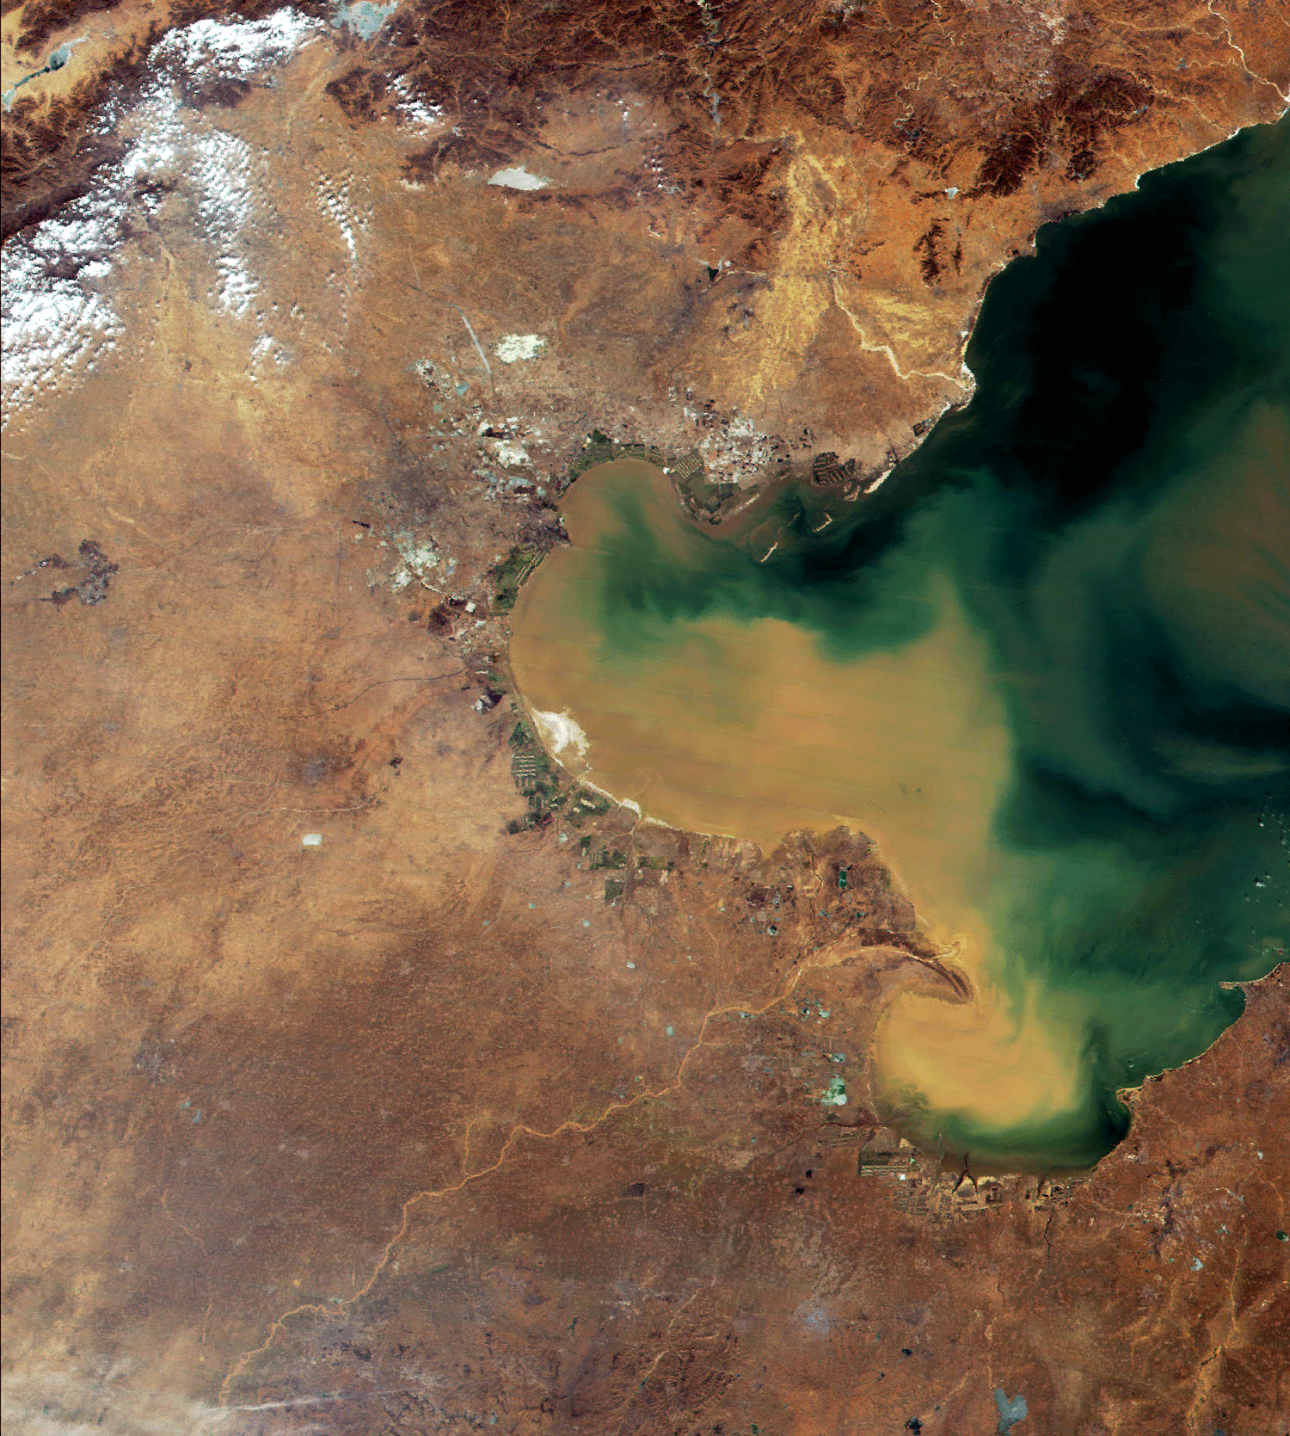
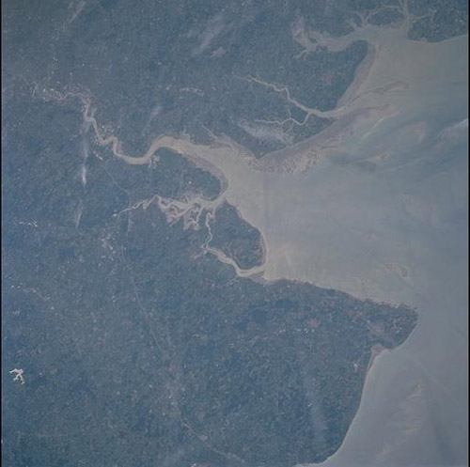
Bo Hai Gulf
Thames
Estuary
Yellow River

Slide 14
Estuaries
Are Places Where a River Meets the Sea
Or It May Occur in a Fjord, for example…
Oslofjord
Puget Sound
Cook Inlet

Slide 15
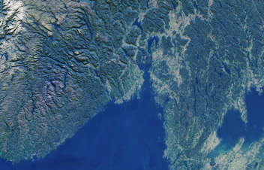
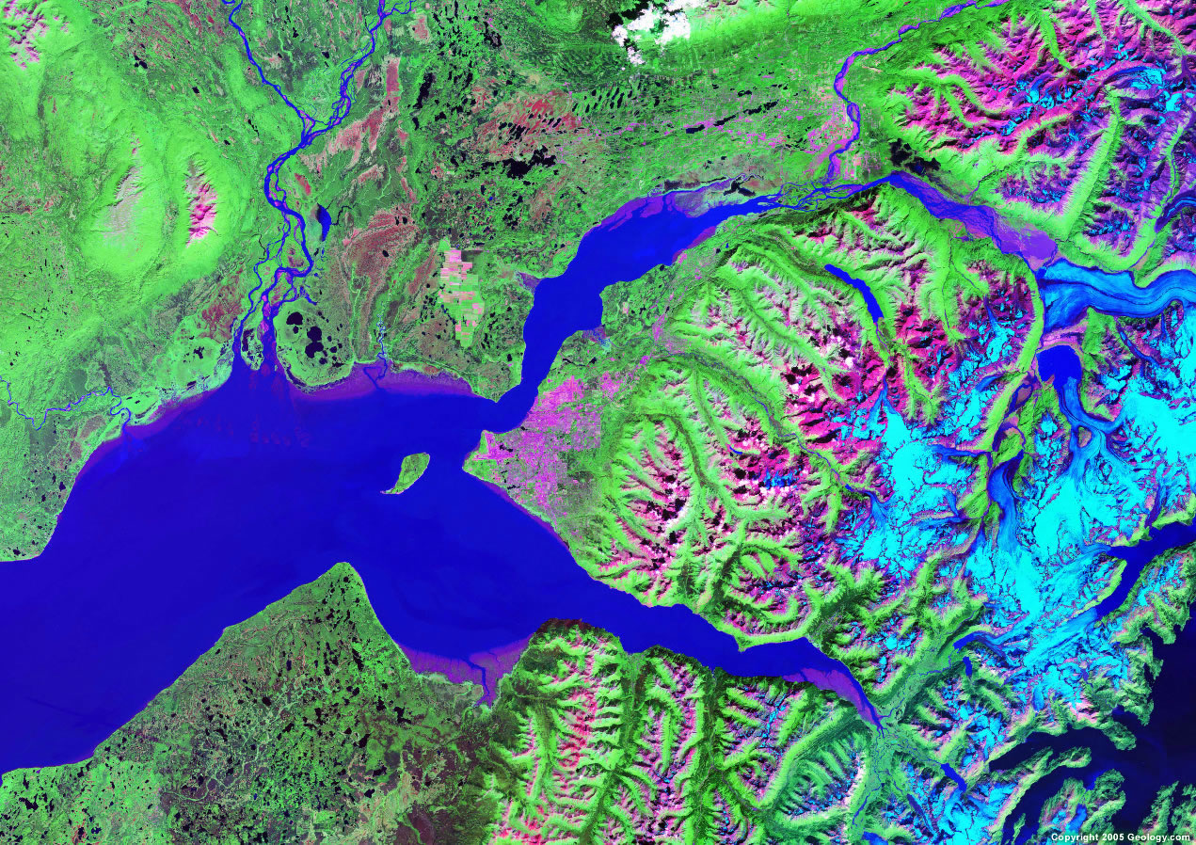
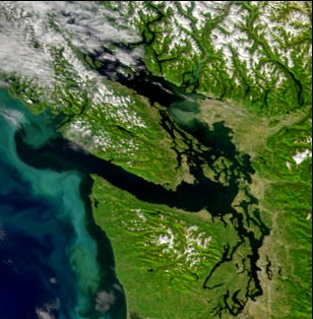
Oslo
Oslofjord
Cook Inlet
Anchorage
Puget
Sound

Slide 16
Estuaries
Are Important Nursery Grounds for the Ocean
Are as Biologically Productive as Irrigated
Agriculture on a per square meter basis
Are Home to Most of the World’s Human Population
The Sites of Most of the World’s Great Cities
Are the Most Heavily Affected Parts of the Ocean

Slide 17
Cities on Estuaries
San Francisco
New York
London
Rangoon
Shanghai
Dhaka
Bombay
Vladivostok
Buenos Aires
Montevideo
Rio de Janeiro
Washington D.C.
Ho Chi Min City
Tokyo
St. Petersburg
Bangkok

Slide 18
Until the Founding of the
Romberg Tiburon Center
There Had Been Very Little
Scientific Attention Paid to
San Francisco Bay

Slide 19
Joel Hedgepeth, University of the Pacific,
Did Some Important Early Work on
San Francisco Bay and Remained.
Throughout His Long Life, One of the
True Experts on the
Marine Biology of the Bay

Slide 20
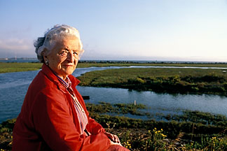
Sylvia Mc Laughlin, Founded
Save the Bay in 1961

Slide 21
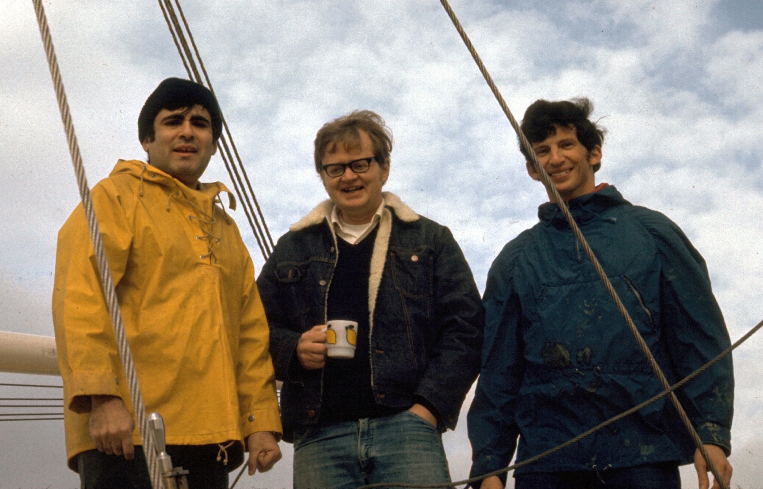
John Conomos Dave Peterson Fred Nichols
Beginning in 1968, Three Young Oceanographers, From the
University Of Washington, Went to Work for the
USGS in Menlo Park. There They Began the
San Francisco Bay and Delta Research Program.

Slide 22
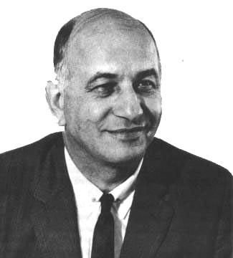
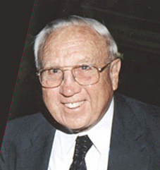
Bill Pecora
Director, USGS
Bill Gianelli
Director DWR
When Bill Gianelli, Who Worked Both for the Corps of Engineers
And the State Department of Water Resources Heard that the
Survey Scientists Had Shown that Water Diversion Affects the
Water Quality of the Bay, He Ordered Bill Pecora to Stop
Publication of the Results. Pecora Threatened to Pull the Survey
Out of California if Gianelli Tried to Suppress the Work.
Pecora Won.

Slide 23
How Did RTC Come About?
In 1975, 23 Acres of the Naval Net Depot
Property was Declared Surplus by GSA
In 1976, SFSU Received Permission to
Begin Development of a Center for
Environmental Studies on the Site
In 1978, The Property Was
Transferred to the CSU

Slide 24
The Three Leading Proposals
for the Future of the Site Were:
SFSU’s Center Proposal
American Youth Hostel’s Proposal
for a Hostel on Paradise Drive
Marin County’s Proposal for a Boat Park

Slide 25
One Would Expect, in
Comparing the Nation’s
Two Largest Estuaries,
That San Francisco Bay
Would be Simpler to Manage
than Chesapeake Bay

Slide 26
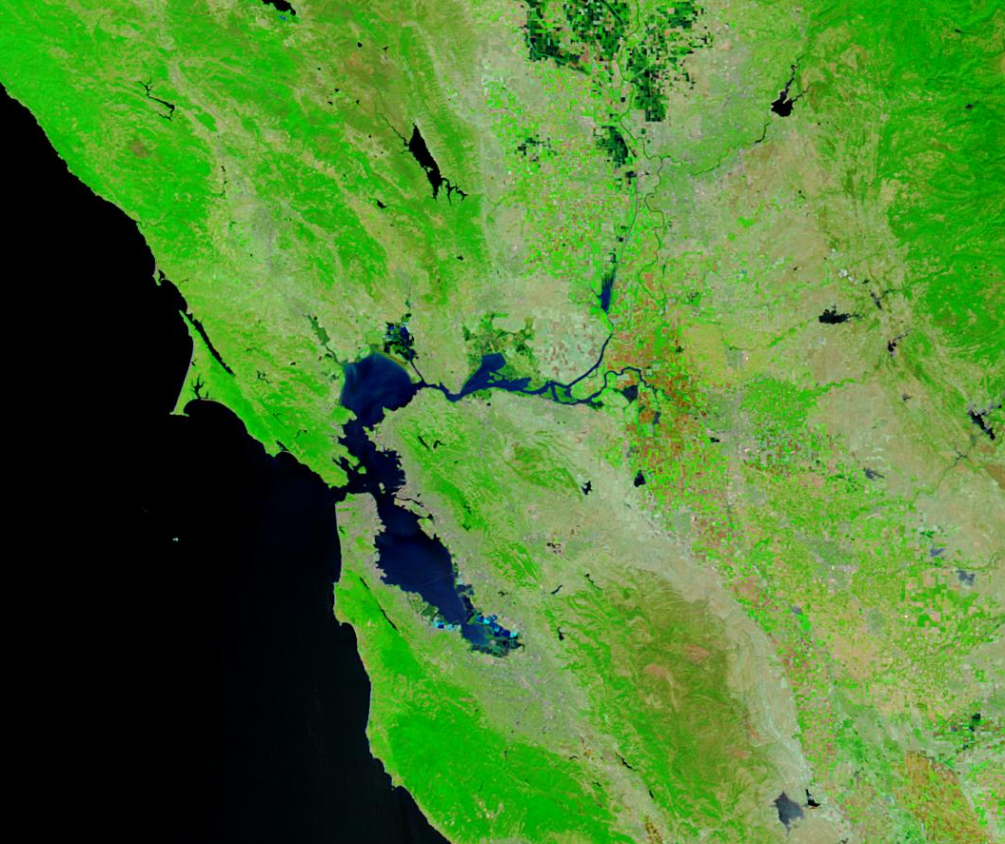
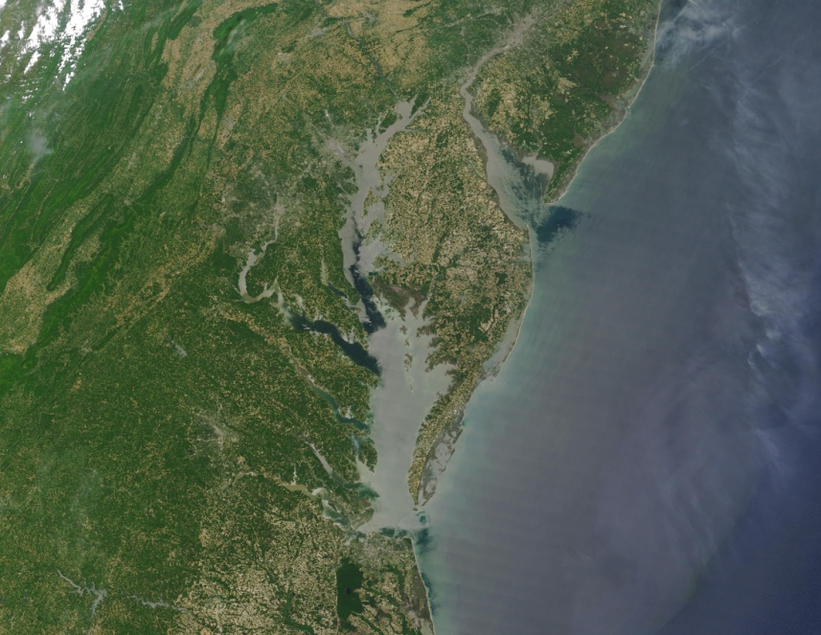
San Francisco Bay
Chesapeake Bay
Essentially All
of the Drainage
is in California
Drains 6 States and
the District of Columbia
Bordered by
Maryland
and Virginia
Bordered only
by California

Slide 27
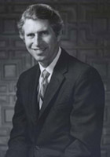
In 1984, The Center Was
Named in Honor of
Paul F. Romberg Who
Had Led the Effort to
Acquire the Property and
Build the Center

Slide 28
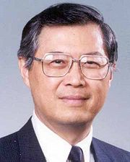
President Chia-Wei Woo
Continued the Legacy
of Presidential Support
for RTC, Once
Famously Threatening to
Resign if the Chancellor’s
Office Would Not Stop
Trying to Shut RTC Down

Slide 29
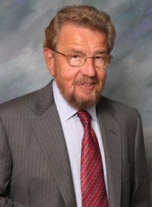
President Robert A. Corrigan
Has Been a Great Supporter
Of RTC, and has Brought the
Full Power of His Considerable
Political Influence to Bear ,
To Effect the Early Conveyance
Of the Original Property and
The Conveyance of the
NOAA Property
(The Remaining 11 Acres)
Directly to the University

Slide 30
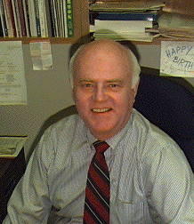
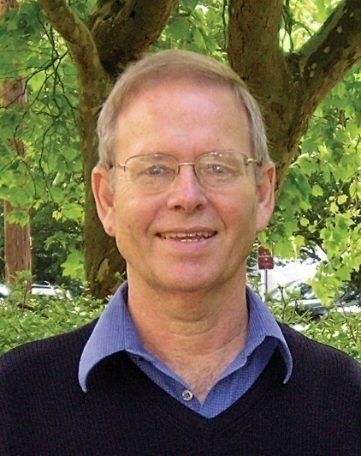
The Center Has Been Led by a Succession
Of Dedicated and Talented Directors:
Erwin Seibel: 1978-1980
Curt Davis: 1980-1982
Mike Josselyn: 1982-1989
Franz Andersen: 1989-1991
Tim Hollibough: 1991-1995
Alissa Arp: 1995-2005
Toby Garfield: 2005-

Slide 31
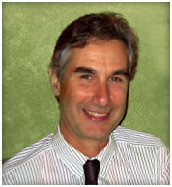
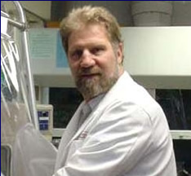
The Center Has Been Led by a Succession
Of Dedicated and Talented Directors:
Erwin Seibel: 1978-1980
Curt Davis: 1980-1982
Mike Josselyn: 1982-1989
Franz Andersen: 1989-1991
Tim Hollibough: 1991-1995
Alissa Arp: 1995-2005
Toby Garfield: 2005-

Slide 32
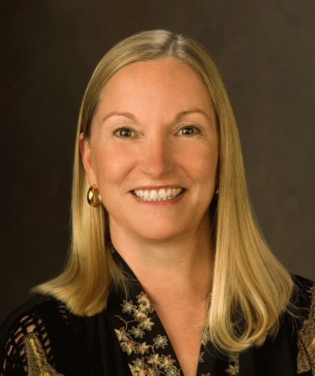
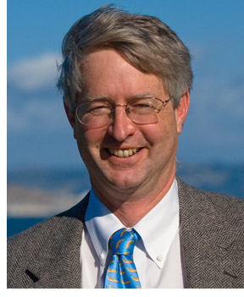
The Center Has Been Led by a Succession
Of Dedicated and Talented Directors:
Erwin Seibel: 1978-1980
Curt Davis: 1980-1982
Mike Josselyn: 1982-1989
Franz Andersen: 1989-1991
Tim Hollibough: 1991-1995
Alissa Arp: 1995-2005
Toby Garfield: 2005-

Slide 33
Now Let’s Talk
About Estuaries
And the Threats
To Their Health

Slide 34
Often Estuaries are “Tidal”
~~~~~~~~~~~~~~~~~~~~~~
The Salt Water Wedge moves
Landward on the Flood Tide
And Seaward on the Ebb Tide
~~~~~~~~~~~~~~
At the Golden Gate this Daily
Flow is 6 Times the Volume
Of the Mississippi River

Slide 35
Before Oceanographers Looked
At the Bay, Engineers Assumed
That Since the Tidal Prism is
1/3 of the Volume of the Bay,
The Bay Flushes Every Three Days

Slide 36
The Original Misconception
Tidal Mixing Flushes the
Bay Every Three Days
Bay Water
Day 1
Day 2
Day 3
Ocean Water
Salt Water

Slide 37
If the Bay Flushes Every Three
Days by Tidal Action, You Can
Divert as Much Water as You Like

Slide 38
What Really Happens
The Tidal Prism Just Moves
In and Out Twice a Day
Bay Water
Ocean Water
Salt Water

Slide 39
Estuaries are threatened by:
1. Water Diversion
2. Wetland Loss
3. Invasive Species
4. Pollution

Slide 40
Estuaries are threatened by:
1. Water Diversion

Slide 41
In Estuaries
Fresh Water Flows Seaward, Floating on the Salt Water
Salt Water is Entrained at the Bottom of the Fresh Water Lens
The Fresh Water Lens Becomes Saltier as it Moves Seaward
The Salt Water “Wedge” Flows Landward, Against the Salinity Gradient

Slide 42
Estuarine Circulation
Fresh Water
Salt Water

Slide 43
Estuarine Circulation
Fresh Water
Salt Water

Slide 44
Estuarine Circulation
Fresh Water
Salt Water

Slide 45
Estuarine Circulation
Fresh Water
Salt Water

Slide 46
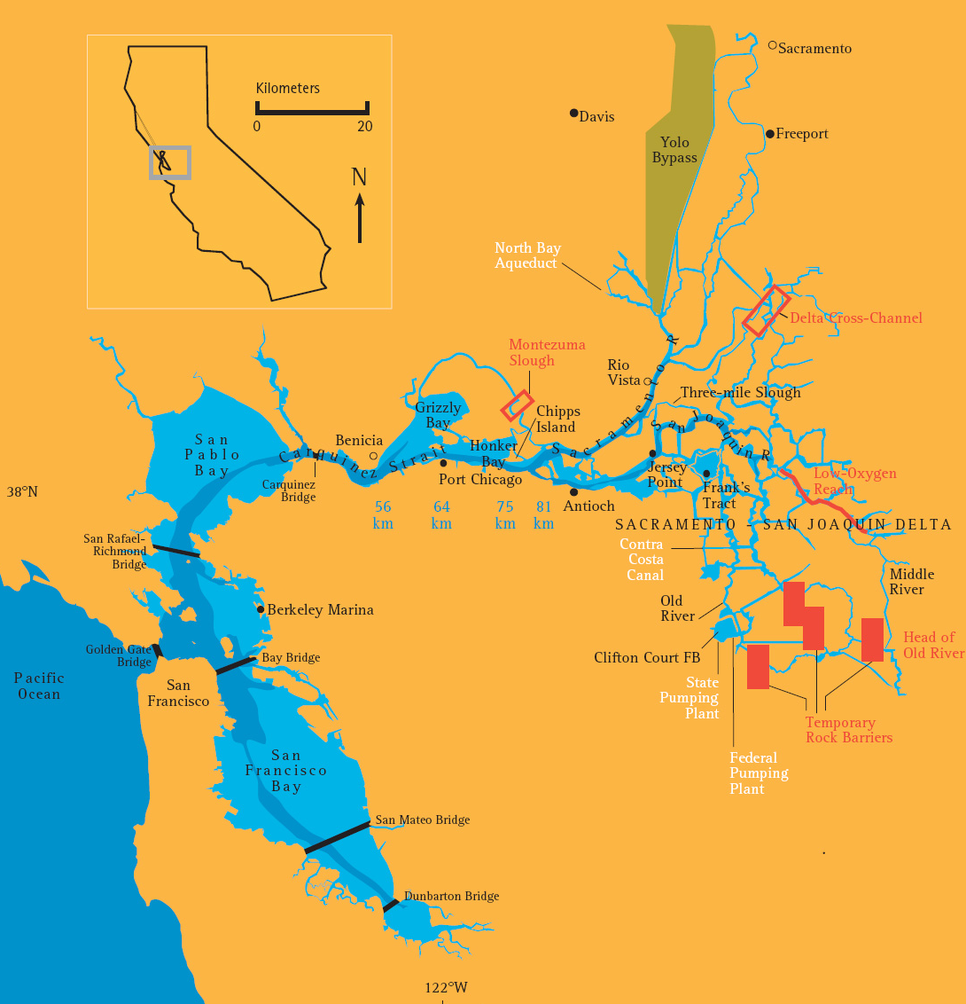
Most of the
Estuarine
Circulation
Is in the
North Bay
(San Pablo Bay)
And the
Central Bay

Slide 47
The Salt Water Wedge is not
Flowing “Uphill”
It is Flowing Across a Salinity Gradient
And thus is Flowing “Downhill”
From Higher Salinity to Lower Salinity

Slide 48
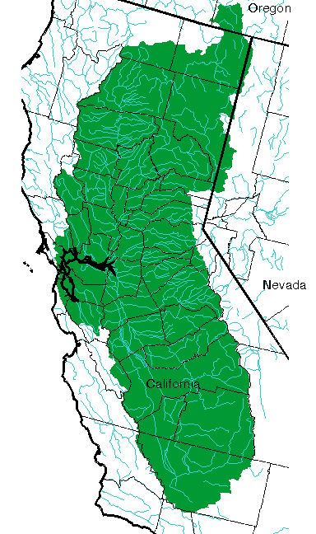
San Francisco Bay
Is Fed by the
Sacramento and
San Joaquin Rivers
~~~~~~~~~~~
Together the
Drain 43% of
The Land Area of
California
Sacramento
Valley
San
Joaquin
Valley

Slide 49
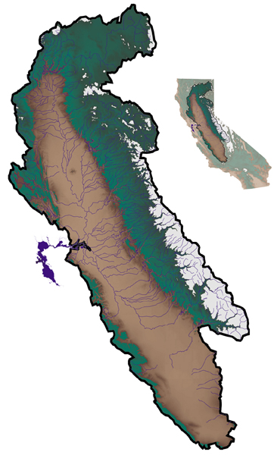
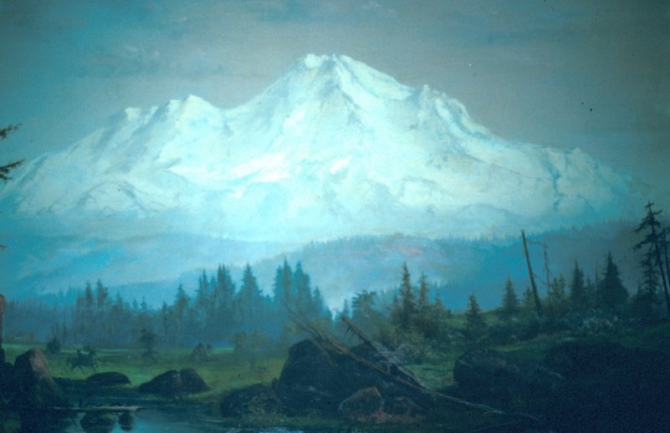
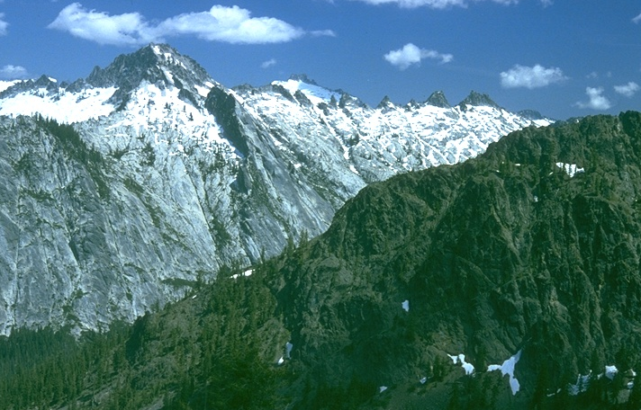
Most of the Water
First Falls as
Snow in the
Sierra Nevada
And the
Siskiyou Mountains
Siskiyous
Sierra
Nevada

Slide 50
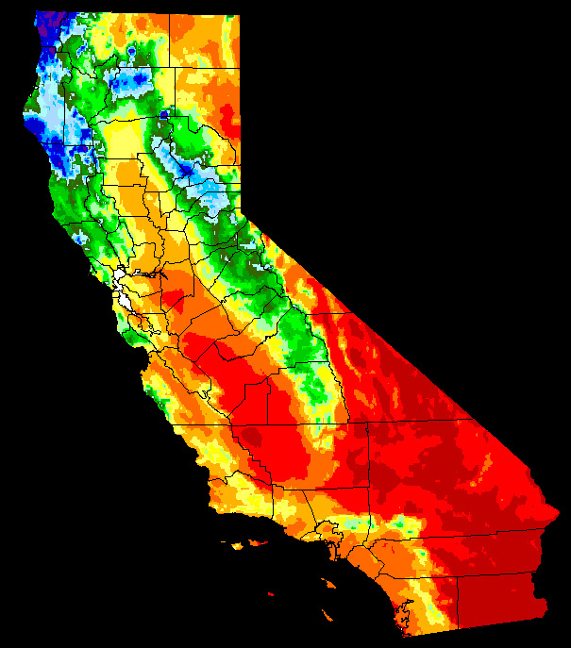
Siskiyou
Mountains
Most of the Water
First Falls as
Snow in the
Sierra Nevada
And the
Siskiyou Mountains
Sierra
Nevada

Slide 51
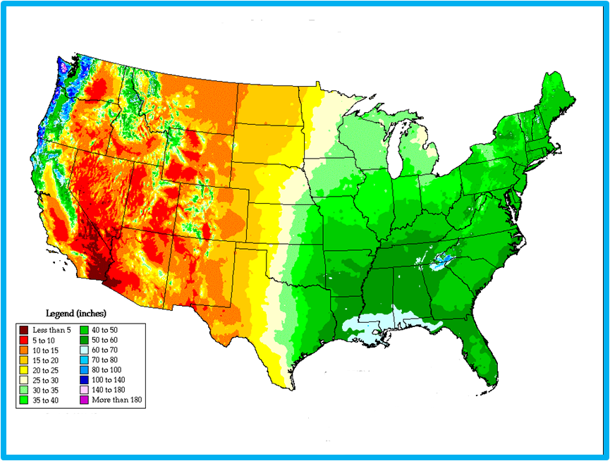
Average Annual Precipitation
100th Meridian
20” Isohyet

Slide 52
So, in California,
The Water is in the
North (Green), but
The People are in
the South (Brown)
~~~~~
This Makes
California Politics
even more
Interesting the
They would be
Otherwise

Slide 53
So, in California,
The Water is in the
North (Green), but
The People are in
the South (Brown)
~~~~~
This Makes
California Politics
even more
Interesting the
They would be
Otherwise

Slide 54
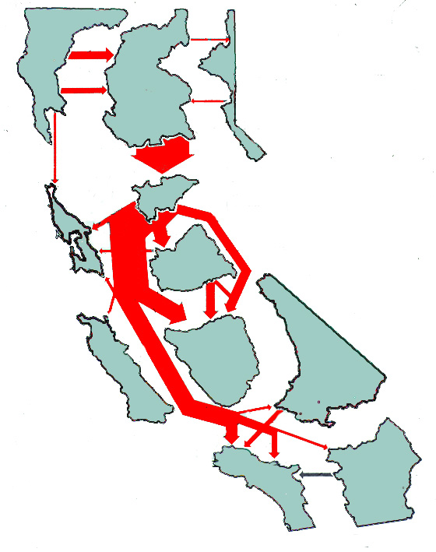
A 1990 Map From
The State Department
Of Water Resources
Showing the California
Water Plan

Slide 55
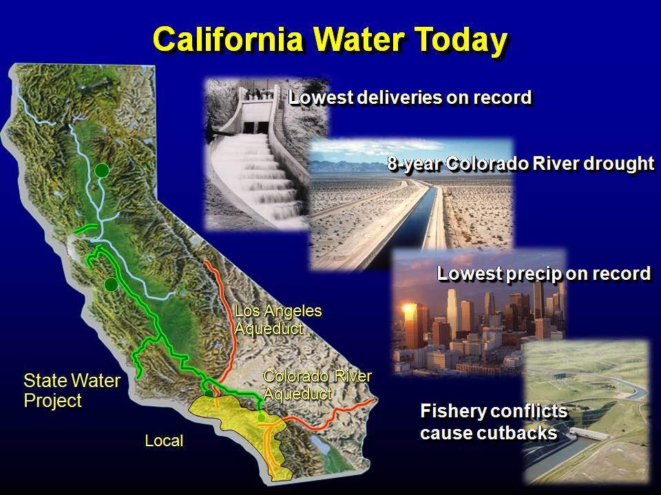
Figure from a Metropolitan Water District
Of Southern California Presentation

Slide 56
Actually, Only 15 %
Of the Water
Diverted From
San Francisco Bay
Goes to Los Angeles
~~~~~~~~
85 % Is Used By
Central Valley
Agriculture

Slide 57
8
6
4
2
0
60
40
%
20
0
Export Flow (km³/year)
Percent Flow Diverted
1960 1970 1980 1990 2000
Water Year

Slide 58
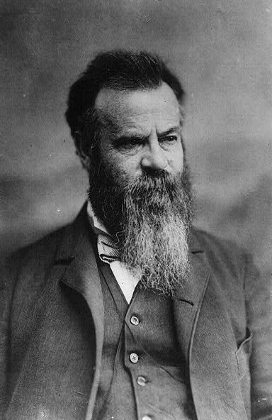
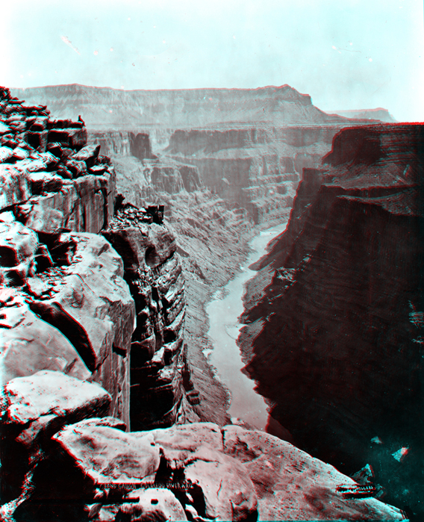
Major
John Wesley Powell
(1834-1902)
Notes:
"Water Rep"
So this Department of Water Resources representative
stops at a Texas ranch and talks with an old rancher.
He tells the rancher, I need to inspect your ranch for
your water allocation.
The old rancher says, "Okay, but don't go in that field
over there."
The Water representative says, "Mister, I have the
authority of the Federal Government with me. See this
card? This card means I am allowed to go WHEREVER
I WISH on any agricultural land. No questions asked
or answered. Have I made myself clear? Do you
understand?"
The old rancher nods politely and goes about his chores.
Later, the old rancher hears loud screams and spies
the Water Rep running for his life and close behind is
the rancher's bull. The bull is gaining with every step.
The Rep is clearly terrified, so the old rancher immediately
throws down his tools, runs to the fence and yells at the
top of his lungs.....
"Your card! Show him your card!"

Slide 59

“The Arid Region is the
great Rocky Mountains
Region Of the United
States, and it embraces
more than four-tenths
of the country,
excluding Alaska.
In all this region the
mean annual rainfall
is insufficient
for agriculture”
John Wesley Powell, 1878
p. 15, Emphasis added

Slide 60
Average Annual Precipitation
100th Meridian
20” Isohyet

Slide 61

Of course, at the time of Powell’s Report,
Most of the Population Lived in the East
Settled
Areas
1880

Slide 62

The Current Drought as of 22 July, 2008

Slide 63

Many droughts will
occur, many seasons
in a long series will be
fruitless; and it may
be doubted whether,
on the whole, agriculture
will prove remunerative.
--John Wesley Powell
Arid Lands Report, p. 13

Slide 64

Record of Drought in the West
In a Comprehensive 2004 Study of Western Drought,
Ed Cook of Lamont (Columbia U.)
and Colleagues
Studied Records
from Across the
“Arid Lands”
Examining 286
2.5’ x 2.5’
Grid Points
Ed Cook, et al., Science,
5 Nov. 2004

Slide 65
Record of Drought in the West
100
80
60
40
20
0
Drier
Wetter
220 yr
140 yr
% Drought Area
Historical Period
800 1000 1200 1400 1600 1800 2000
Ed Cook, (Lamont) et al., Science, 5 Nov. 2004

Slide 66

Drier
Wetter
300 yrs
Lynn Ingram (UCB), et al., Geology, April 1996

Slide 67


San Francisco Chronicle 31 October, 2008

Slide 68
Estuaries are threatened by:
1. Water Diversion
2. Wetland Loss

Slide 69


Wetlands in 1848
Wetlands Today
San Francisco
Bay Has
Lost 95%
Of Its
Natural
Wetlands
In the Past
160 Years

Slide 70
Wetlands in 1848
Wetlands Today

Slide 71

Hydraulic Mining in the Sierra Raised the Seabed Of
San Francisco Bay 1 Meter Before it was Stopped in 1884

Slide 72

Grove Karl Gilbert
Studied the Effects
Of Hydraulic Mining
On The Bay and Delta

Slide 73


The California Academy of Sciences
Was Founded in 1853 by 7 Men Concerned
About the Effects of Hydraulic Mining
Andrew Randall

Slide 74


A Testament to the Rich
Diversity of Government
Organizations and NGOs in
The Bay Area, Is the Fact that
It Took 15 Years to Establish
The San Francisco Bay National
Estuarine Research Reserve,.
Designated in 2003, It Now
Operates Under the
Leadership
Of Jaime Kooser

Slide 75
The San Francisco Bay National
Estuarine Research Reserve
Seeks to Answer the Question:
When You Are Trying to
Restore a Wetland to
Its Original Condition,
How do You Know
When You’re Done?

Slide 76
Estuaries are threatened by:
1. Water Diversion
2. Wetland Loss
3. Invasive Species

Slide 77

Invasive Species…

Slide 78

Often Out-compete Native Species

Slide 79

If Native Species Evolve Without Competition…

Slide 80

Invasive Species Can Easily Take Over
Gaspar de Portolá Marching on Monterey

Slide 81



Usually the Native
Species Suffer
Declines
In Numbers
and Diversity

Slide 82

In Estuaries
Invasive, or Exotic,
Species
Typically Come In
As Larvae in the Ballast
Water Of Ships

Slide 83


Although Sometimes Pets Escape,
As Do Animals From Live Fish Markets

Slide 84

The Chinese
Mitten Crab
First discovered
In San Francisco Bay
in 1992
However it had been
Seen in fish markets
In the 1980’s
A native of
The Yellow Sea
For Example…

Slide 85


Mitten Crabs Simply
Eat Many of The Native
Species of the Bay

Slide 86

Tiny Asiatic Clams, However, Filter All the
Available Food and Starve Native Species
1 cm
Introduced Prior to 1986

Slide 87


Spartina alterniflora is
an Invasive Cordgrass
From the East Coast and
Just Crowds Natives Out
Introduced in 1973
By the U.S. Army
Corps of Engineers

Slide 88
Invasive organisms account for 40-90%
of the common species, up to 97%
of the total number of organisms,
and up to 99 % of the biomass.
Cumulative Number of Invasive Species
250
200
150
100
50
0
Number of Species
1850 1870 1890 1910 1930 1950 1970 1990
Year

Slide 89
Estuaries are threatened by:
1. Water Diversion
2. Wetland Loss
3. Invasive Species
4. Pollution

Slide 90

Pollution is
Roughly
Proportional to
Population
1850
1900
Urban Areas
Tidal Wetlands
Major Earthquakes
1940
1990

Slide 91



Although Pollution
Has Decreased Since
The 60’s and 70’s,
There Is Still Work
to be Done

Slide 92
Estuaries are also threatened by:
Ignorance
1. Accidental
2. Planned

Slide 93



John Reber

Slide 94

Opening Slide from a Presentation by the
Metropolitan Water District of Southern California
(Metropolitan Serves 18 Million People)
Notes:
eople

Slide 95
So Who Cares
About Estuaries?
Almost Everybody!
Although Sometimes
They Don’t Know It

Slide 96
In Summary: Estuaries
Are Important Nursery Grounds for the Ocean
Are as Biologically Productive as Irrigated
Agriculture on a per share meter basis
Are Home to Most of the World’s Human Population
The Sites of Most of the World’s Great Cities
Are the Most Heavily Affected Parts of the Ocean

Slide 97
At the Romberg Tiburon Center,
Scientists are Addressing These Threats
to the Health of San Francisco Bay
And Finding Solutions to Each One

Slide 98

The Traditional Symbol of a
Thirtieth Anniversary is the Pearl
It is also the One Precious Stone
Born of the Ocean

Slide 99
So Happy Anniversary to
Our Own Pearl, Born of the Ocean,
The Romberg Tiburon Center!

Slide 100

Thank You

