Slide 1
The
North Atlantic Ocean:
Weather Maker of Europe
(But Not the World)
by
Jim Kelley

Slide 2
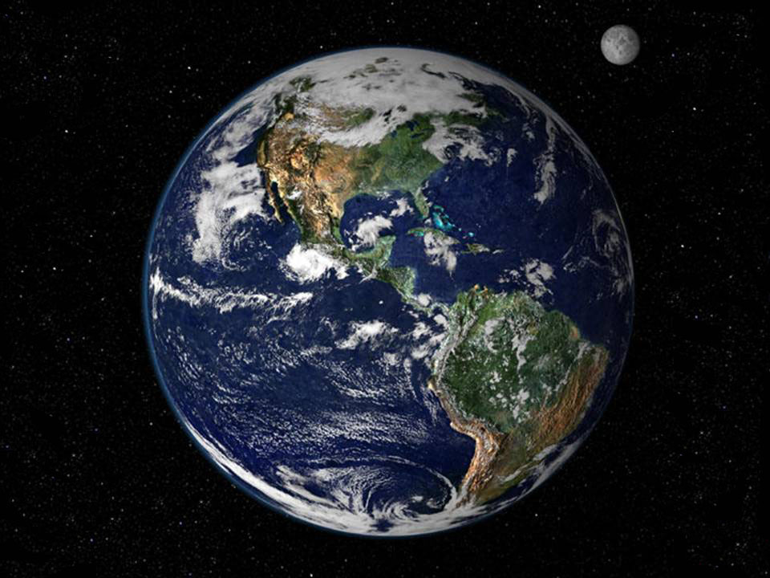

Slide 3
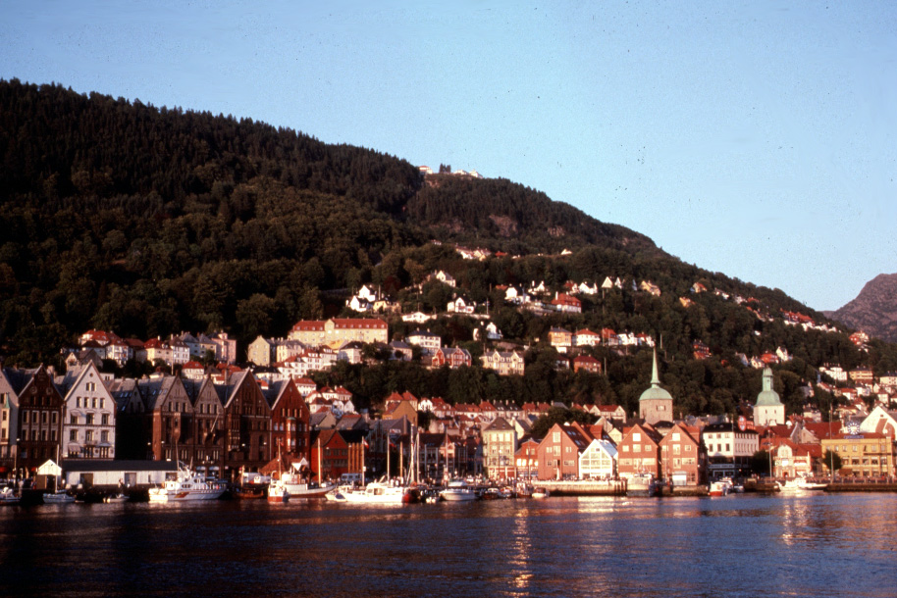
Bergen

Slide 4
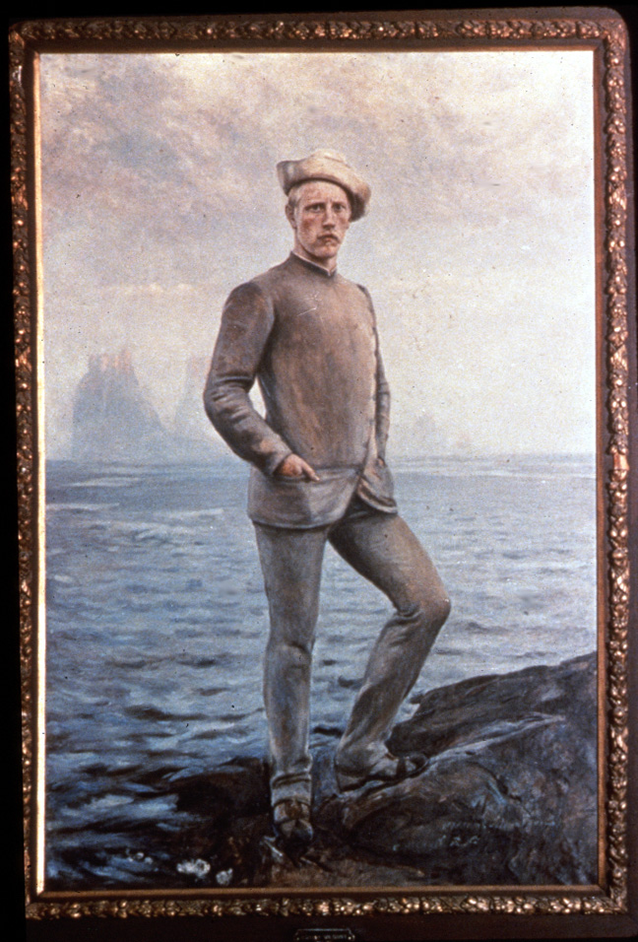
Fritdjof Nansen
-----
Father of Modern
Oceanography

Slide 5
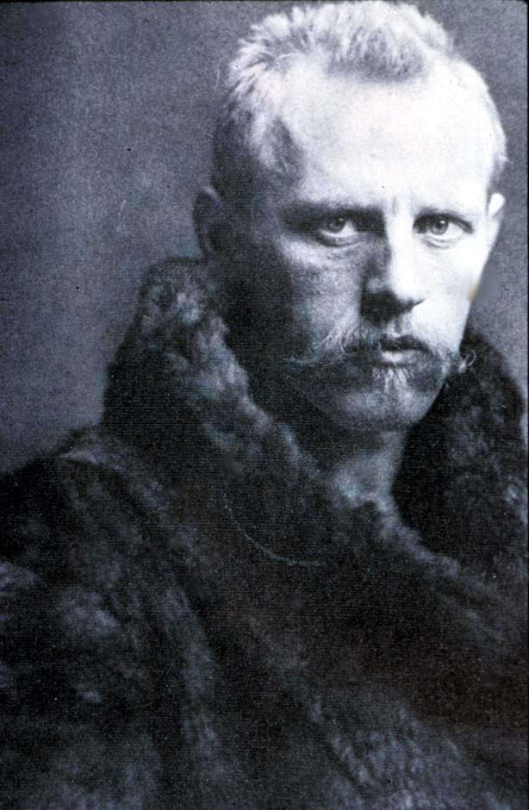
Fridtjof Nansen
1861-1930

Slide 6
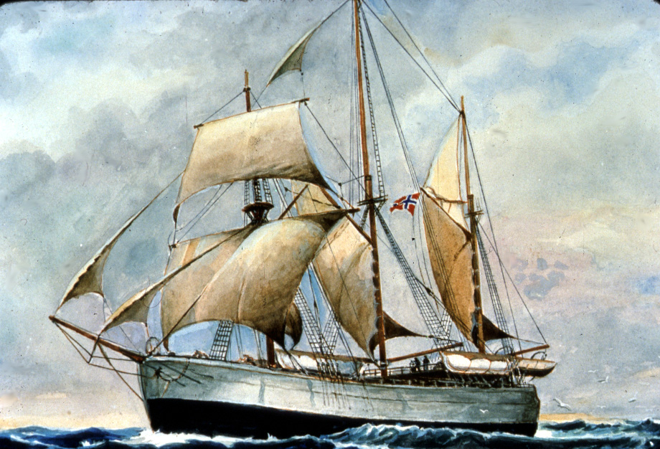
Fram

Slide 7
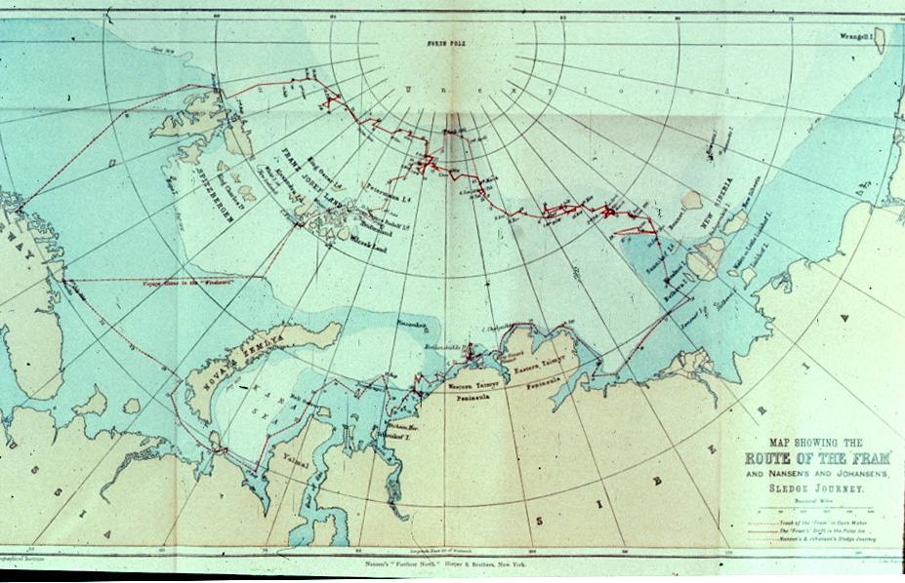
Aug. 13, 1896
March 1895
Sept. 10, 1893
Aug. 13, 1896
July
1893
Fram’s Farthest North 85˚57’N
Nansen’s 86˚14’ N

Slide 8
Nansen Observed that Ice Moved
at 45˚ to the Right of the Wind Direction
45˚
Wind

Slide 9
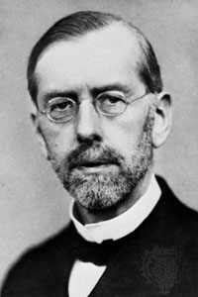
One of Nansen’s Students
Vagn Walfrid Ekman
1874-1954
Developed the Theory
of the Wind-Driven Circulation

Slide 10
Ekman Realized That the Surface Water
Was Entrained by Surface Friction and Diverted
By the Coriolis Effect
45˚
Wind

Slide 11
The Ekman Spiral
Net Water Transport
45˚
Wind
Ekman Realized That the Surface
Water Entrains the Water Below
It Which Moves at an Ever Higher
Angle to the Wind

Slide 12
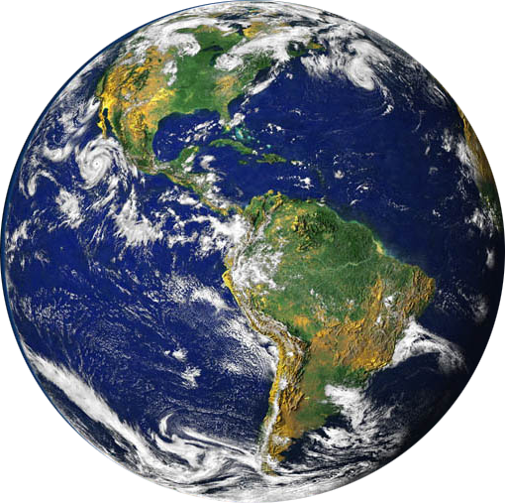
Incident Solar Radiation

Slide 13
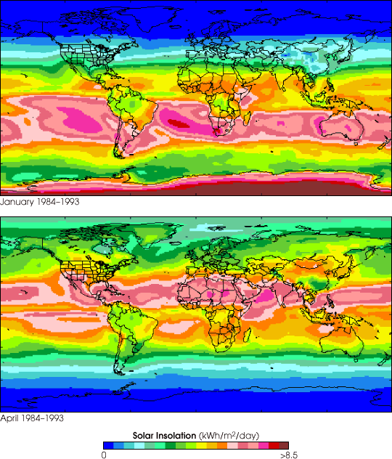
Total Solar
Radiation
at the Earth’s
Surface
--------
1984-1993
January
April

Slide 14
Imagine an Earth Covered
Completely by Water
And See What Happens
When the Equatorial
Region is Warmed by the Sun

Slide 15
Hot Air Rises

Slide 16
As the Air Rises,
It Cools, Condenses
and Moves
Poleward

Slide 17
At About 30˚
Latitude,
the Dense Air
Falls Back to
The Surface

Slide 18
On Reaching the
Surface, This Air
Spreads Both
Equatorward and
Poleward

Slide 19
This Falling Air
Produces the
Subtropical
High Pressure
Areas at
30˚ N and 30˚ S
Latitudes
On Reaching the
Surface, This Air
Spreads Both
Equatorward and
Poleward

Slide 20
And the Spreading Air
Produces Surface Winds
Blowing
Equatorward
And Poleward
On Reaching the
Surface, This Air
Spreads Both
Equatorward and
Poleward

Slide 21
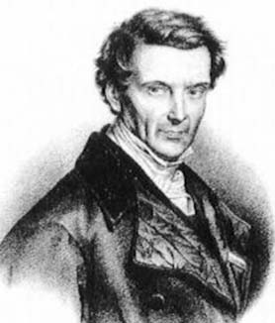
Gaspard
Gustave
De Coriolis
-----
1792-1843
«Sur les
équations du
mouvement
relatif des
systèmes de
Corps», 1835

Slide 22

An Example of the Coriolis Effect :

Slide 23
So the Equatorward Winds Become the NE and SE Trades
60˚ N
Subpolar Low
30˚ N
Subtropical
High
NE Trades
Equator—
Doldrums
SE Trades
Subtropical
High
30˚ S
60˚ S

Slide 24
The Poleward Winds Become the Westerlies
60˚ N
Subpolar Low
Westerlies
30˚ N
Subtropical
High
NE Trades
Equator—
Doldrums
SE Trades
Subtropical
High
30˚ S
Westerlies
60˚ S
Subpolar Low

Slide 25
The Equatorward Polar Winds Become the Polar Easterlies
Polar Easterlies
60˚ N
Subpolar Low
Westerlies
30˚ N
Subtropical
High
NE Trades
Equator—
Doldrums
SE Trades
Subtropical
High
30˚ S
Westerlies
60˚ S
Subpolar Low
Polar Easterlies

Slide 26
Major Wind Zones on an Earth with No Land
Polar Easterlies
60˚ N
Subpolar Low
Polar Front
Westerlies
30˚ N
Subtropical
High
Horse Latitudes
NE Trades
Inter-Tropical Convergence Zone
Equator—
Doldrums
SE Trades
Subtropical
High
Horse Latitudes
30˚ S
Westerlies
Polar Front
60˚ S
Subpolar Low
Polar Easterlies

Slide 27
In the Northern Hemisphere, Coriolis
Moves Things in Motion to the Right
In the Southern Hemisphere, Coriolis
Moves Things in Motion to the Left

Slide 28
Major Wind Zones on an Earth with No Land
Polar Easterlies
60˚ N
Subpolar Low
Polar Front
Westerlies
30˚ N
Subtropical
High
Horse Latitudes
NE Trades
Inter-Tropical Convergence Zone
Equator—
Doldrums
SE Trades
Subtropical
High
Horse Latitudes
30˚ S
Westerlies
Polar Front
60˚ S
Subpolar Low
Polar Easterlies

Slide 29
Now Let’s Look at the Real Earth,
With Continents Which Interrupt
This Air Flow

Slide 30
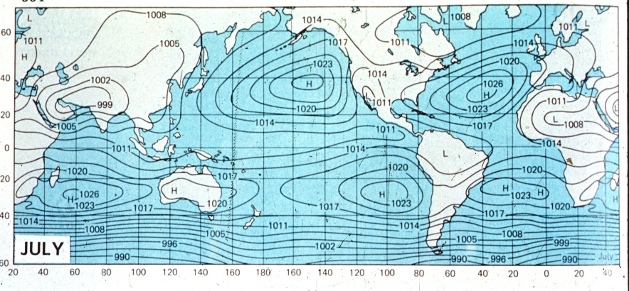
Average Surface Barometric Pressure Field
Showing the Location of the Subtropical Highs
H
H
H
H
H

Slide 31
Remember that in the
Northern Hemisphere,
Coriolis moves things to the Right

Slide 32
Average Surface Barometric Pressure Field
H
H
H
H
H
Surface Wind

Slide 33
Average Surface Barometric Pressure Field
H
Surface Wind

Slide 34
Average Surface Barometric Pressure Field
H
Surface Wind

Slide 35
Average Surface Barometric Pressure Field
H
H
H
H
H
Surface Wind

Slide 36
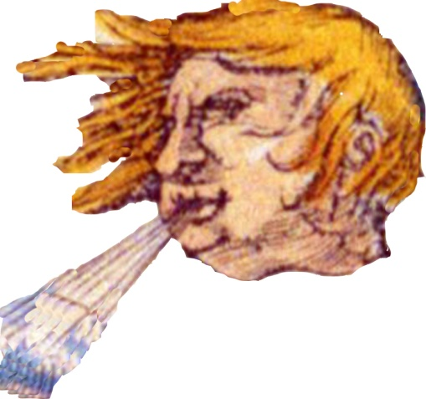
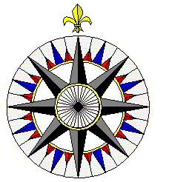
And Let’s Introduce Aeolus
The God of Wind
Who, of course,
Can Blow From
All Points of the
Compass Rose

Slide 37
Average Surface Barometric Pressure Field
H
H
H
H
H
July
Surface Wind

Slide 38
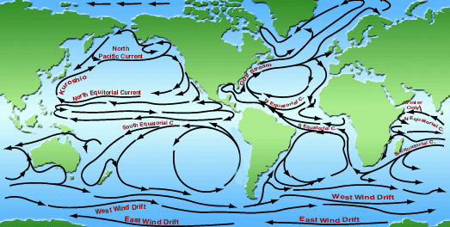
The Major Current Gyres of the Global Ocean
California
Current
Canary
Current
Peru
Current
Benguela
Current

Slide 39
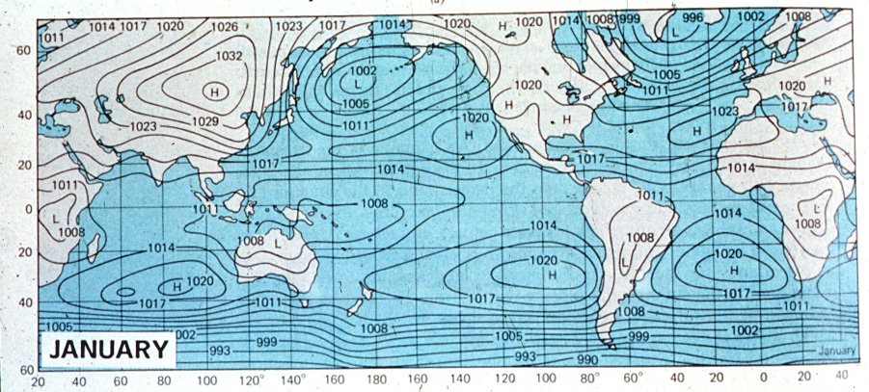
Average Surface Barometric Pressure Field
L
L
H
H
H
H
H

Slide 40
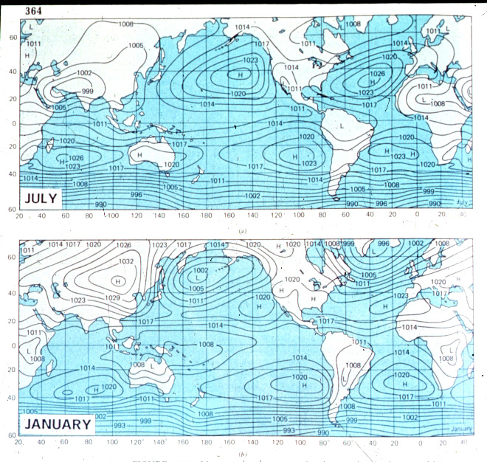
Average Surface Barometric Pressure Field
H
H
H
H
H
L
L
H
H
H
H
H

Slide 41
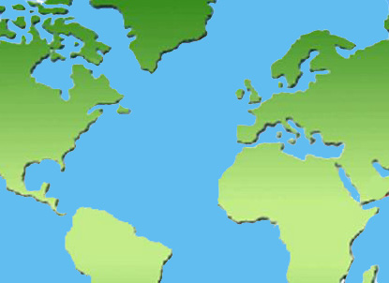

Slide 44
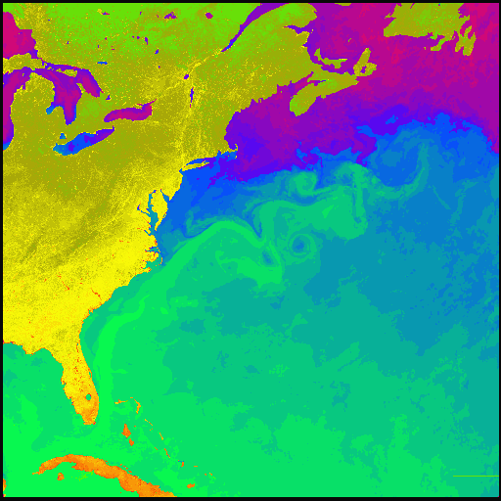
The Gulf Stream
------
Sea Surface
Temperature

Slide 47
The North Atlantic Gyre

Slide 48
East
Greenland
Current
Currents
Of the
North
Atlantic
Labrador
Current
North Atlantic Drift
Gulf
Stream
Canary Current
North Equatorial Current
Guinea
Current

Slide 49
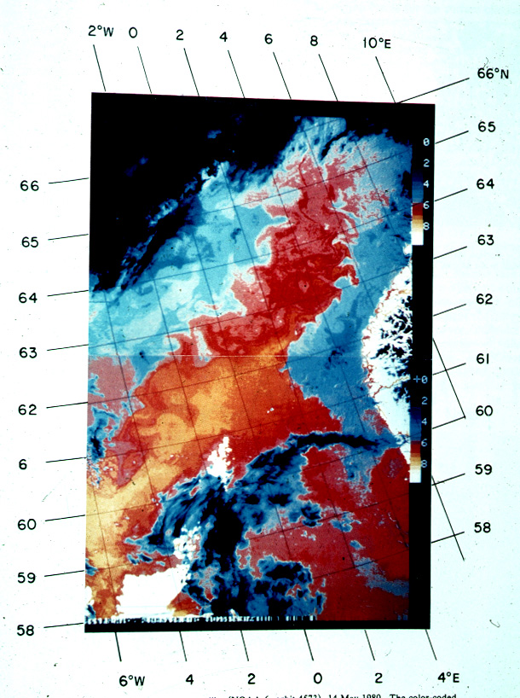
The Extension
Of the
North Atlantic
Drift off the
Coast
Of Norway

Slide 50
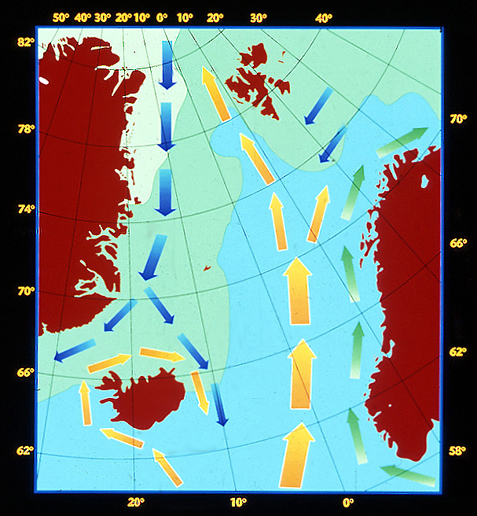
Nordic
Sea
Circulation
Irminger
Current

Slide 51
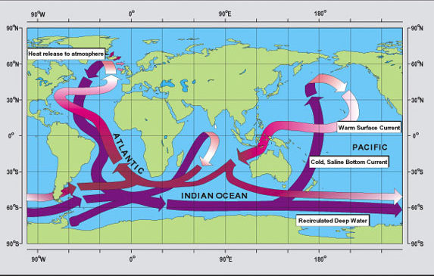
Wally Broecker’s Ocean “Conveyer Belt””

Slide 52
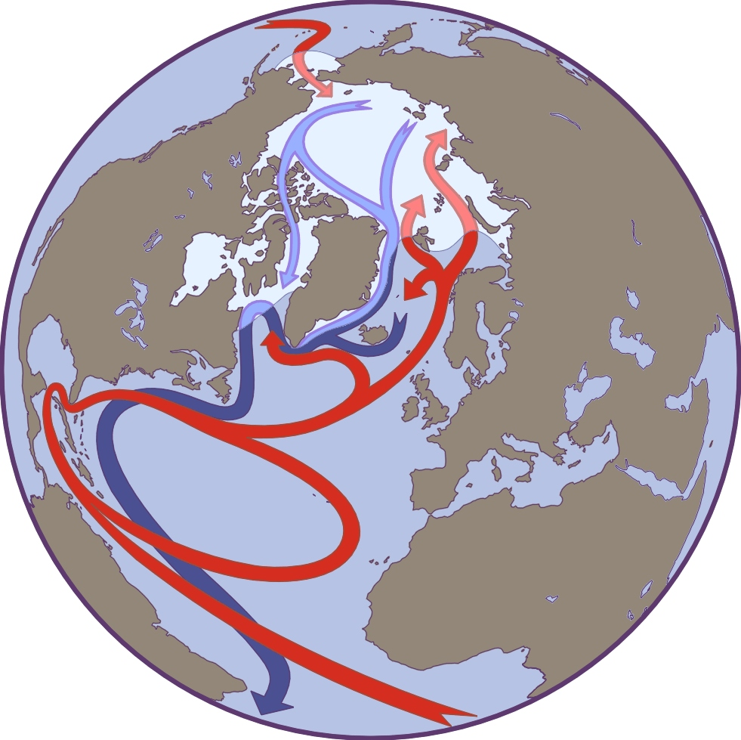
Arctic
Ocean
Exchange
Inflows
Outflow

Slide 53
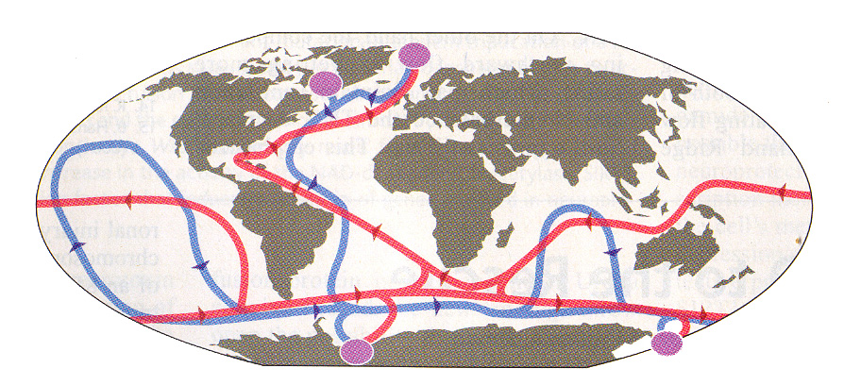
Wally Broeker’s “Conveyor Belt” Circulation
These are the “Ventilation” Areas
Where New Deep Water is Formed
Hansen, et al., Science, 13 August, 2004

Slide 54
Water Masses Involved in the
Thermohaline Circulation In the Atlantic
Nordic Sea
Equator
Antarctica
Mediterranean
Water
Subtropical Water
Antarctic Intermediate
Water
NADW
AABW

Slide 55
Water Masses Involved in the
Thermohaline Circulation In the Atlantic
Nordic Sea
Equator
Antarctica
Antarctic Intermediate
Water
Mediterranean
Water
Subtropical Water
MOC
NADW
AABW

Slide 56
In August 2004)
A Paper Appeared in Science Entitled
“Already the Day After Tomorrow?”
Written by Bogi Hansen, Svein Østerhus,
Detlef Quadfasel and William Turrell
From Faroes, Norway, Germany and
Scotland, respectively,
which summarizes the state of the issue
of Climate Change which might result
from a decline of the
Atlantic Meridional
Overturning Circulation (MOC)

Slide 57
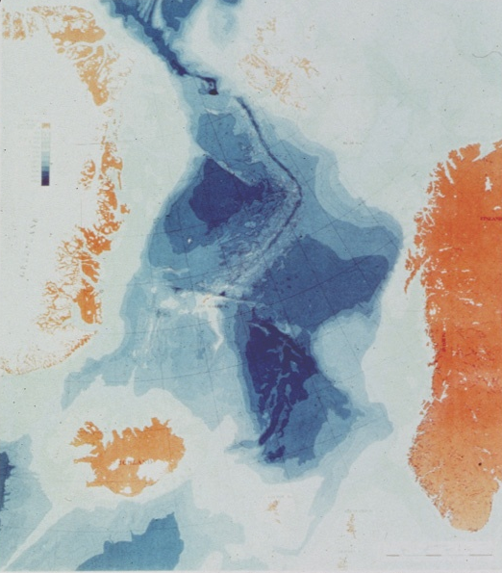
Iceland-
Faroes
Ridge

Slide 58
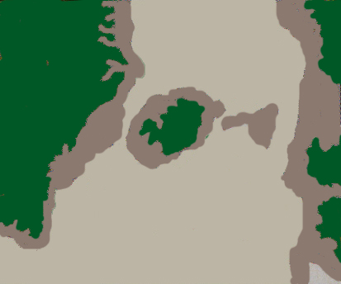
Bottom Depth
<500m
Denmark
Strait
Overflow
Faroes Bank
Channel
Overflow
>500m
Compensating
Flow
Entrainment
Hansen, et al., Science, 13 August, 2004

Slide 59
Low Latitiudes
Arctic
Compensating Flow
Ventilation
Overflow 0ºC
Entrainment 6ºC
Ventilation
Upwelling
Greenland
Scotland
Ridge
NADW 3ºC
Hansen, et al., Science, 13 August, 2004

Slide 60
Wally Broeker’s “Conveyor Belt” Circulation
The Concern is
with the
Possible Loss
of This
Ventilation Area
These are the “Ventilation” Areas
Where New Deep Water is Formed
Hansen, et al., Science, 13 August, 2004

Slide 61
The North Atlantic Gyre

Slide 62
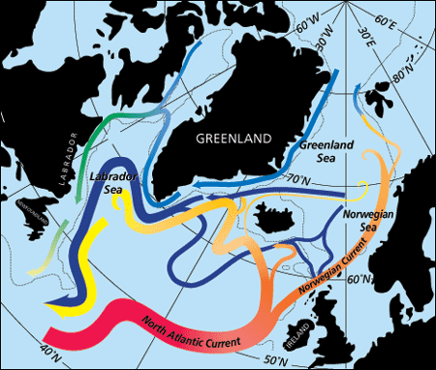
The Sub-Polar Gyre in the Labrador Sea

Slide 64
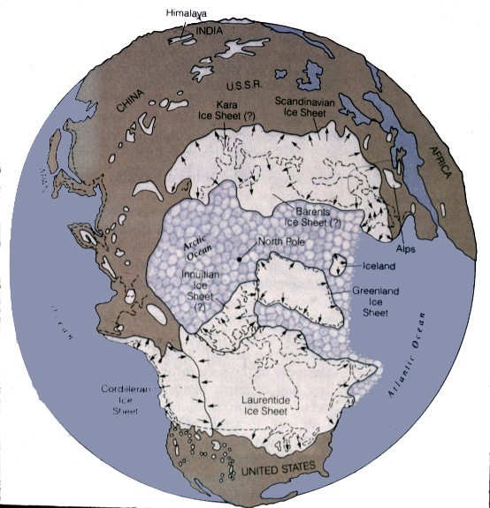
10,000 ya
8,000 ya
Lake
Agassiz

Slide 65
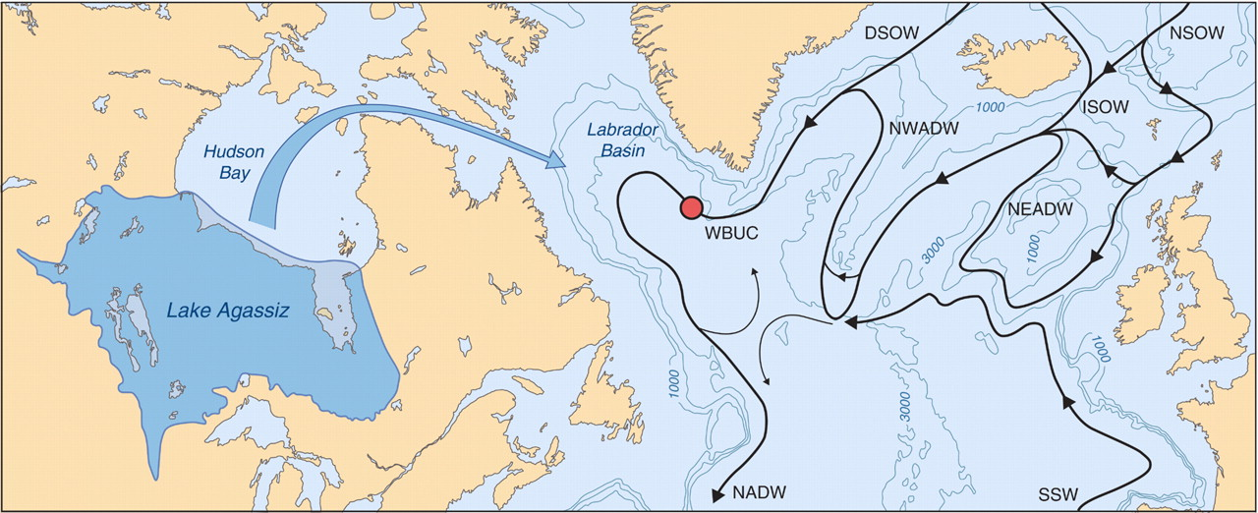
Possible Scenario for the 8400 BP event
Kleiven (Bergen), et al., Science, 4 Jan. 2008

Slide 66
Wally Broeker’s “Conveyor Belt” Circulation
This Fresh
Water From
Lake Agassiz
Shut Down
The Vertical
Circulation
Causing A
10˚C Drop In
Sea Surface
Temperature
These are the “Ventilation” Areas
Where New Deep Water is Formed
Hansen, et al., Science, 13 August, 2004

Slide 67
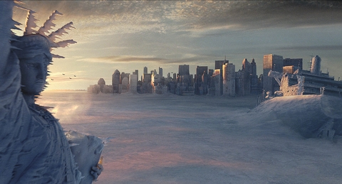
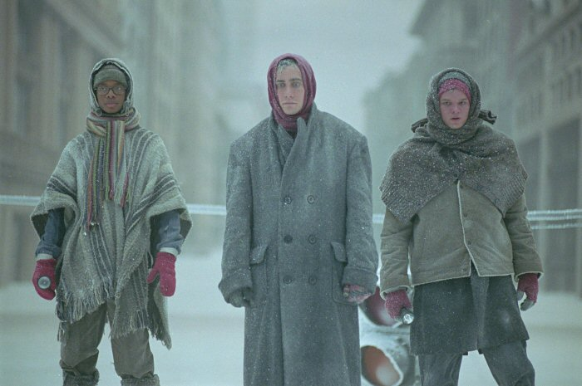
The Day After
Tomorrow

Slide 68
Wally Broecker’s Ocean “Conveyer Belt””

Slide 69
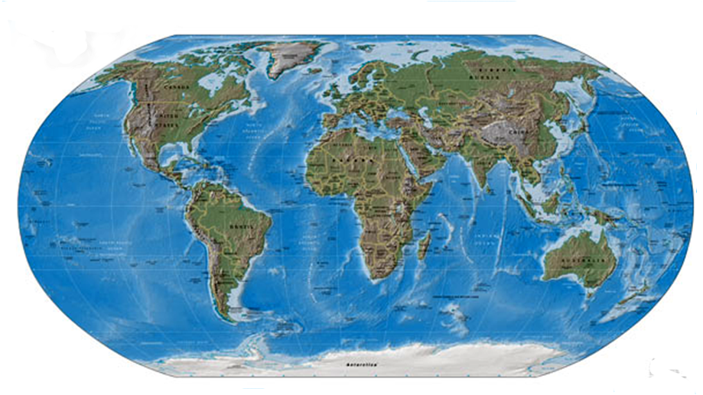
Locations of the World’s Marine Science Centers
?
?
?
?
?

Slide 70
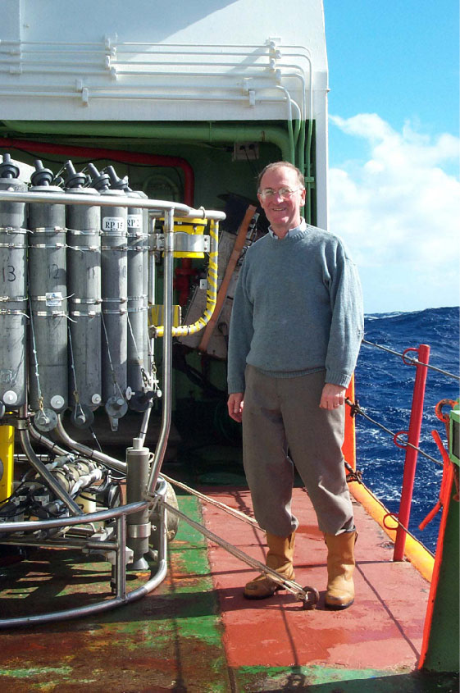
In December 2005,
Harry Bryden, et al.,
(National Oceanography
Centre, Southampton, U.K.)
Nature, Claimed to have
shown a 30% Decrease
in the MOC, Leading to a
Spate of Newspaper Articles
About an Impending New
Ice Age in Europe

Slide 71
It has since been shown
(Science, 23 August 2007)
by the same authors, Bryden et al., that
the Change Reported was
part of a Natural Fluctuation and
That the MOC had Speeded Back Up.
The Name of Dr. Bryden’s
Research Program is RAPID
(Rapid Climate Change Program)

Slide 72

European readers should be reassured
that the Gulf Stream's existence is a
consequence of the large-scale wind
system over the North Atlantic Ocean,
and of the nature of fluid motion
on a rotating planet.
The only way to produce an ocean
circulation without a Gulf Stream
is either to turn off the wind system,
or to stop the Earth's rotation, or both.
C. Wunsch, Nature, 8 April 2004, p. 601

Slide 73
Real questions exist about conceivable changes in
the ocean circulation and its climate consequences. However,
such discussions are not helped by hyperbole and alarmism.
The occurrence of a climate state without the Gulf Stream any
time soon — within tens of millions of years — has a probability
of little more than zero.
C. Wunsch, Nature, 8 April 2004, p. 601

Slide 74
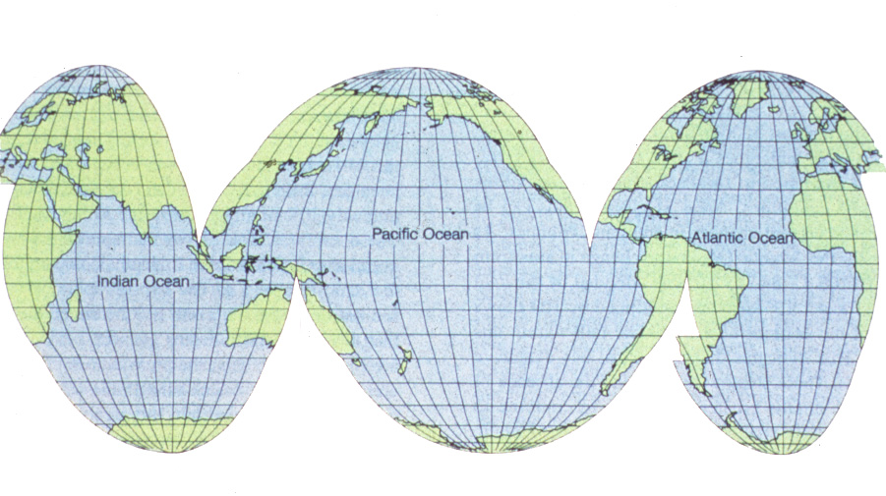
North Atlantic Oscillation (NAO)
NAO

Slide 75
North Atlantic Oscillation (NAO)
NAO

Slide 76
North Atlantic Oscillation (NAO)
NAO

Slide 77
North Atlantic Oscillation (NAO)
NAO

Slide 78
North Atlantic Oscillation (NAO)
NAO

Slide 79
North Atlantic Oscillation (NAO)
NAO

Slide 80
The North Atlantic Oscillation (NAO) is the Difference in Barometric Pressure between the Azores and Iceland
It is Now Recognized that the NAO affects Weather in both North America and Europe

Slide 81
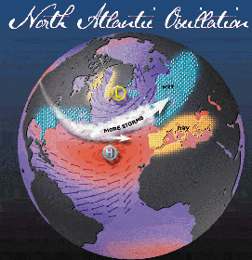
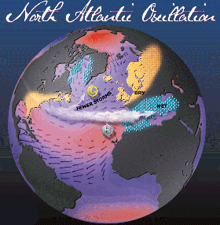
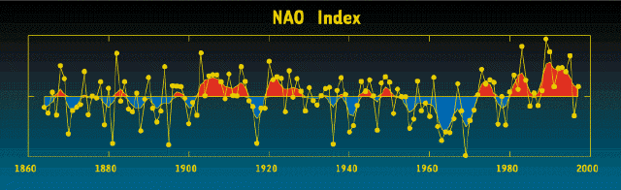
Positive NAO
Negative NAO
NAO= Pressure in the Azores-Pressure in Iceland

Slide 82
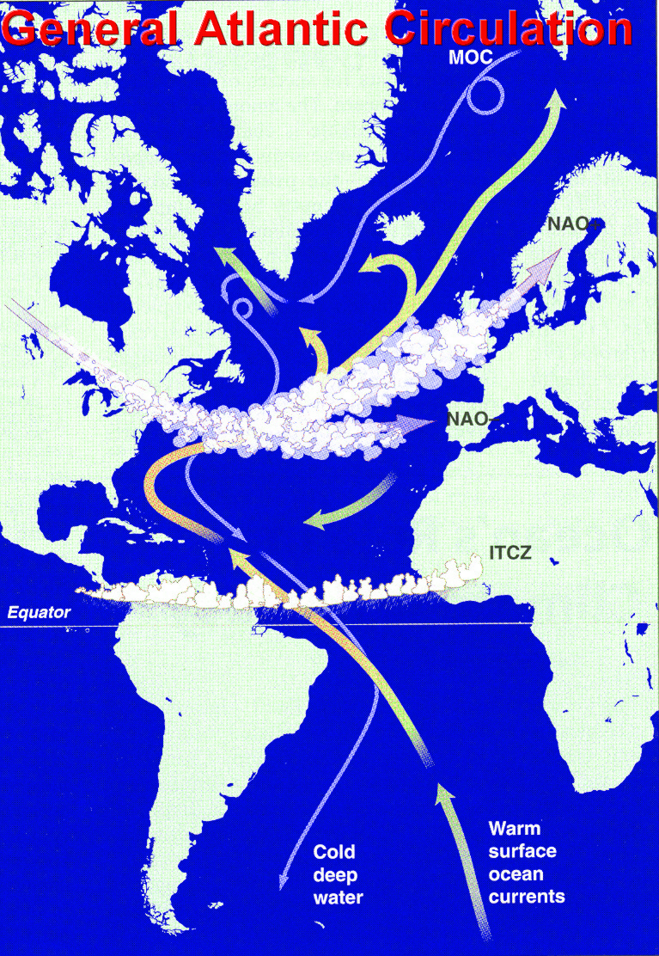
Surface Currents
Positive NAO

Slide 83
Stronger Subtropical High
Deeper Icelandic Low
Stronger Winter Storms on
a More Northerly Track
Warm, Wet Winters in Europe
Cold, Dry Winters in Northern
Canada and Greenland
Mild, Wet Winters in the
Eastern U.S.
Positive NAO

Slide 84
Surface Currents
Negative NAO

Slide 85
Weak Subtropical High
Weak Icelandic Low
Fewer, Weaker Storms
on a More West-East Track
More Cold Air and Snow
in the Eastern U.S.
Moist Air in the Mediterranean
and Cold Air in Northern Europe
Mild Weather in Greenland
Negative NAO

Slide 86
Positive NAO
Negative NAO
NAO= Pressure in the Azores-Pressure in Iceland

Slide 87
The North Atlantic Oscillation Exhibits Long-Term
Cycles, but the Fundamental Variation is on a
Fortnightly Time Scale

Slide 88
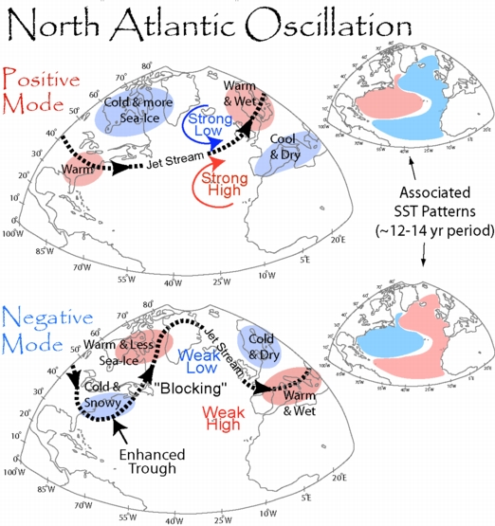

Slide 89
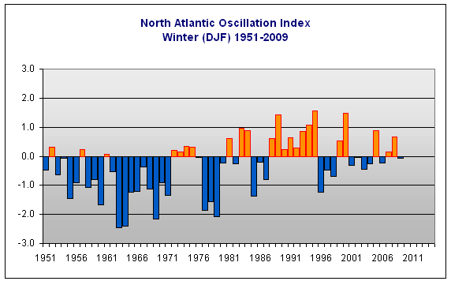
North Atlantic Oscillation Index
Winter (DJF) 1951-2009

Slide 90
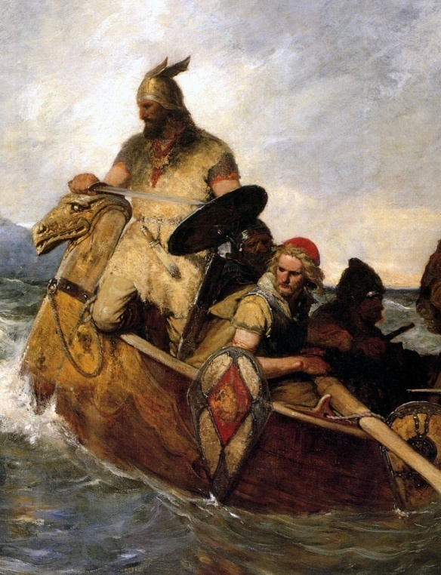
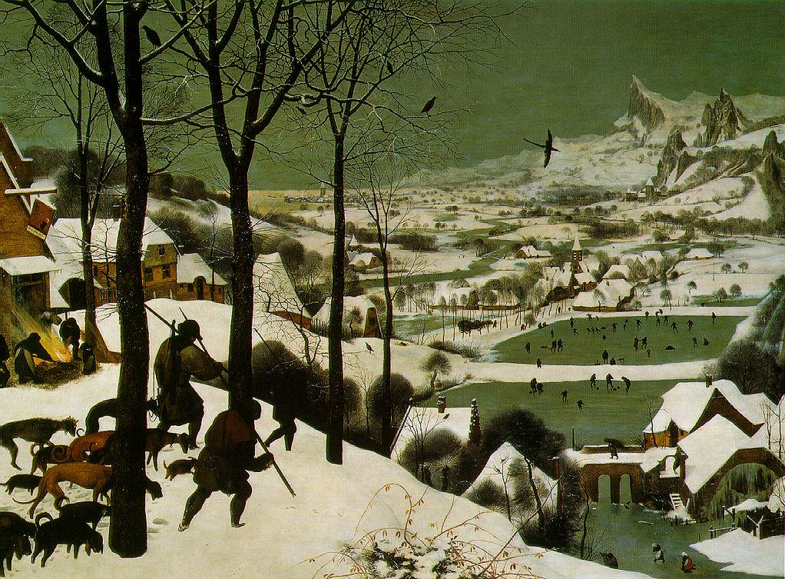
1
0
-1
Little
Ice Age
Temperature Change ºC
Medieval
Warm Period
1000AD 1500AD 1900AD
Figure 22 in the Intergovernmental Panel
On Climate Change Climate Change, 1995

Slide 91
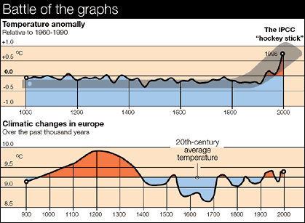

Slide 92
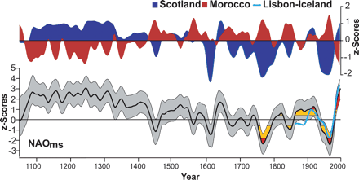
Valérie Trouet, (Swiss Federal Inst. Forests, Ice and Landscapes) et al., Science, 3 April 2009

Slide 93
In the Past 20 Years We Have Come to Recognize
Many Simultaneous Oscillations In the Ocean

Slide 94
In the Past 20 Years We Have Come to Recognize
Many Simultaneous Oscillations In the Ocean

Slide 95
In the Past 20 Years We Have Come to Recognize
Many Simultaneous Oscillations In the Ocean

Slide 96
In the Past 20 Years We Have Come to Recognize
Many Simultaneous Oscillations In the Ocean

Slide 97
In the Past 20 Years We Have Come to Recognize
Many Simultaneous Oscillations In the Ocean

Slide 98
In the Past 20 Years We Have Come to Recognize
Many Simultaneous Oscillations In the Ocean
AOO
PDO
NAO
ENSO
IOD

Slide 99
In the Past 50 Years,
Thanks to the Space Program,
We Have Learned that the
World Ocean “Rings” Like a Bell.
To Understand the Effect
Of these Oscillations on Climate
We Must Seek Longer and Longer
Time Series of Data if We are to
Put Short Term Climate Change
Into Perspective.

Slide 100
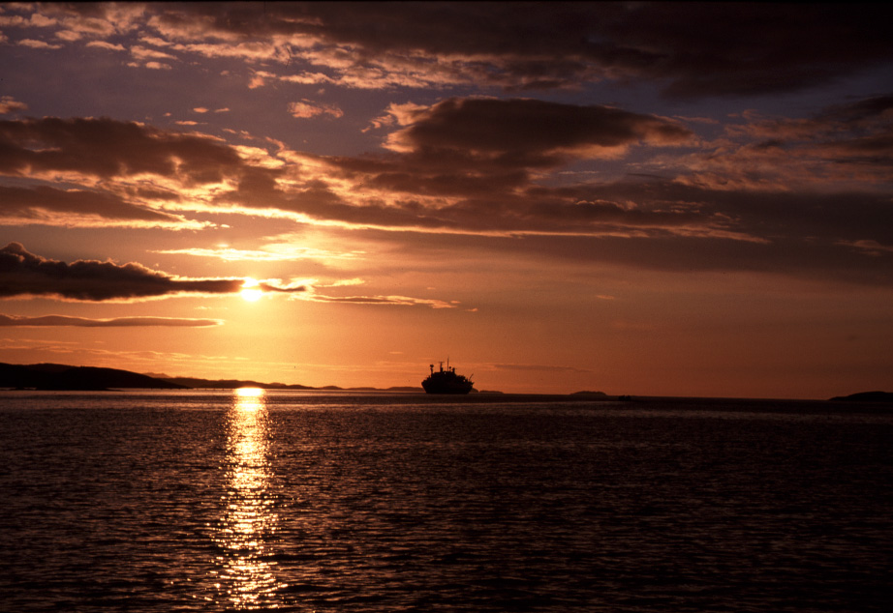
Thank You

