Slide 1
The Green Flash
by Jim Kelley

Slide 2
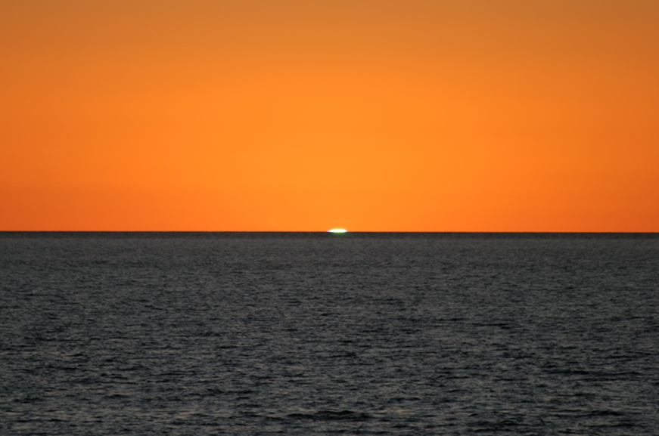
Sunrise Green Flash in Baja California by Mike Greenfelder

Slide 3
According to Nathaniel Bowditch, in the American Practical Navigator (1802), the Following Conditions are Favorable to the
Observation of the Green Flash:
1. A Sharp Horizon
2. A Clear Atmosphere
3. A Temperature Inversion
4. An Attentive Observer

Slide 4
The Visible Spectrum
400nm 500nm 600nm 700nm
1 nm (nanometer) = 10⁻⁹ meters

Slide 5
The Atmosphere Refracts (Bends) Light from the Sun.
Long Wavelength Light (Red) is Bent the Least, because it “Sees” less Atmosphere for a given Distance Traveled
Short Wavelength Light (Violet) is Bent the Most, because in “Sees” more Atmosphere for a given Distance Traveled

Slide 6
D

Slide 7
EARTH
SUN

Slide 8
Attentive Observer
Sunset is Produced
By the Earth Rotating
The Observer Away
From The Sun
Distant Sun

Slide 9
As The Sun Sets, First We See Just the Red…
t₀
t₁
…but
0.7 seconds
later

Slide 10
And After the Green…
Less than a Second Later…
t₁
t₂

Slide 11
Attentive Observer
Sunset is Produced
By the Earth Rotating
The Observer Away
From The Sun
Distant Sun

Slide 12
Sunrise is Produced
By the Earth Rotating
The Observer Toward
The Sun
So the Colors
Appear in
Reverse Order
Distant Sun

Slide 13
The Green and Violet Flash are
Best Seen With Binoculars
Do Not Look Directly at the Sun Until it is
More Than Halfway Set
The Green Flash Can Be Seen at Sunrise—
The Colors Appear in Reverse Order
It Can Also Be Seen With the Rising
and Setting Moon

Slide 14
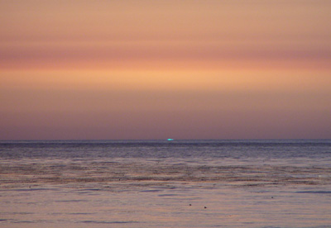

Slide 15
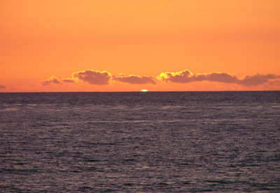

Slide 16
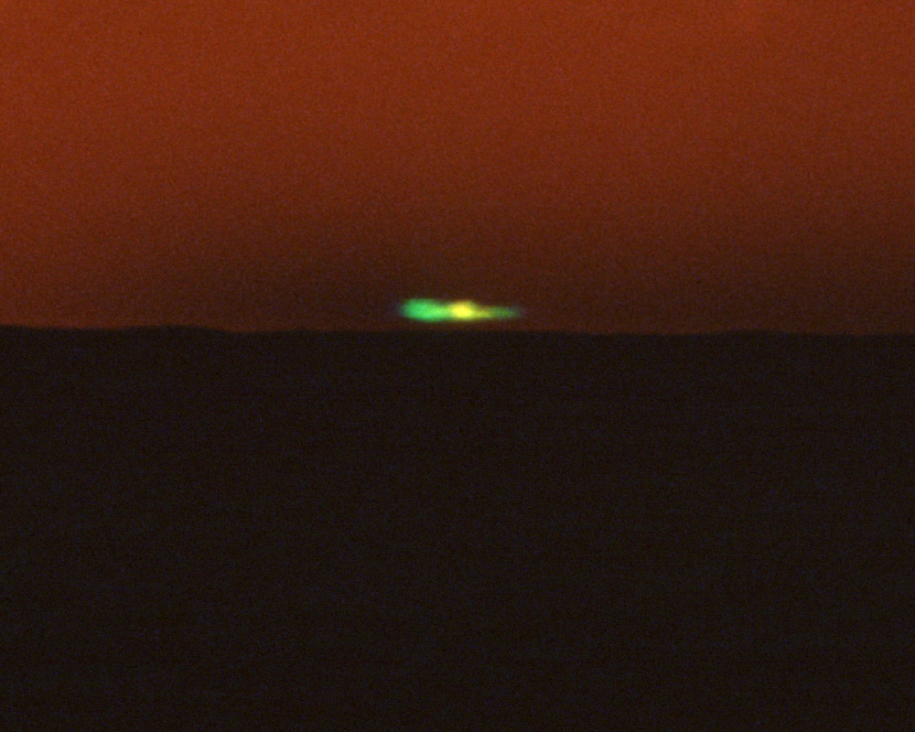

Slide 17
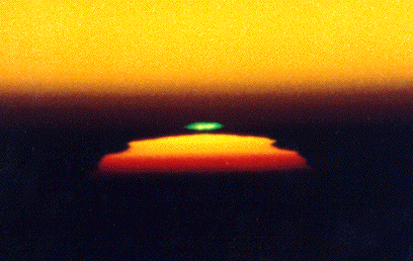

Slide 18
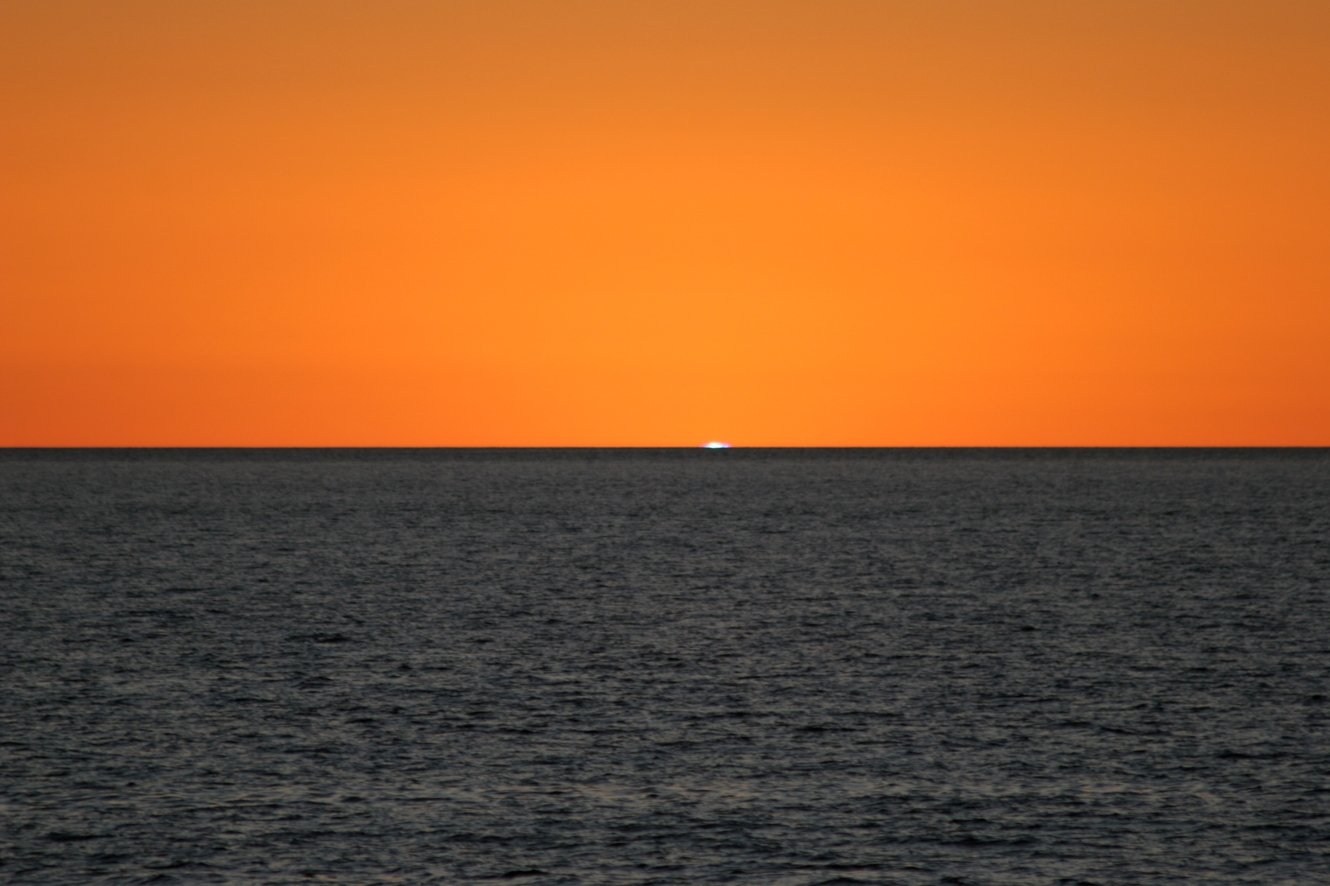
Sunrise Green Flash in Baja California by Mike Greenfelder

Slide 19
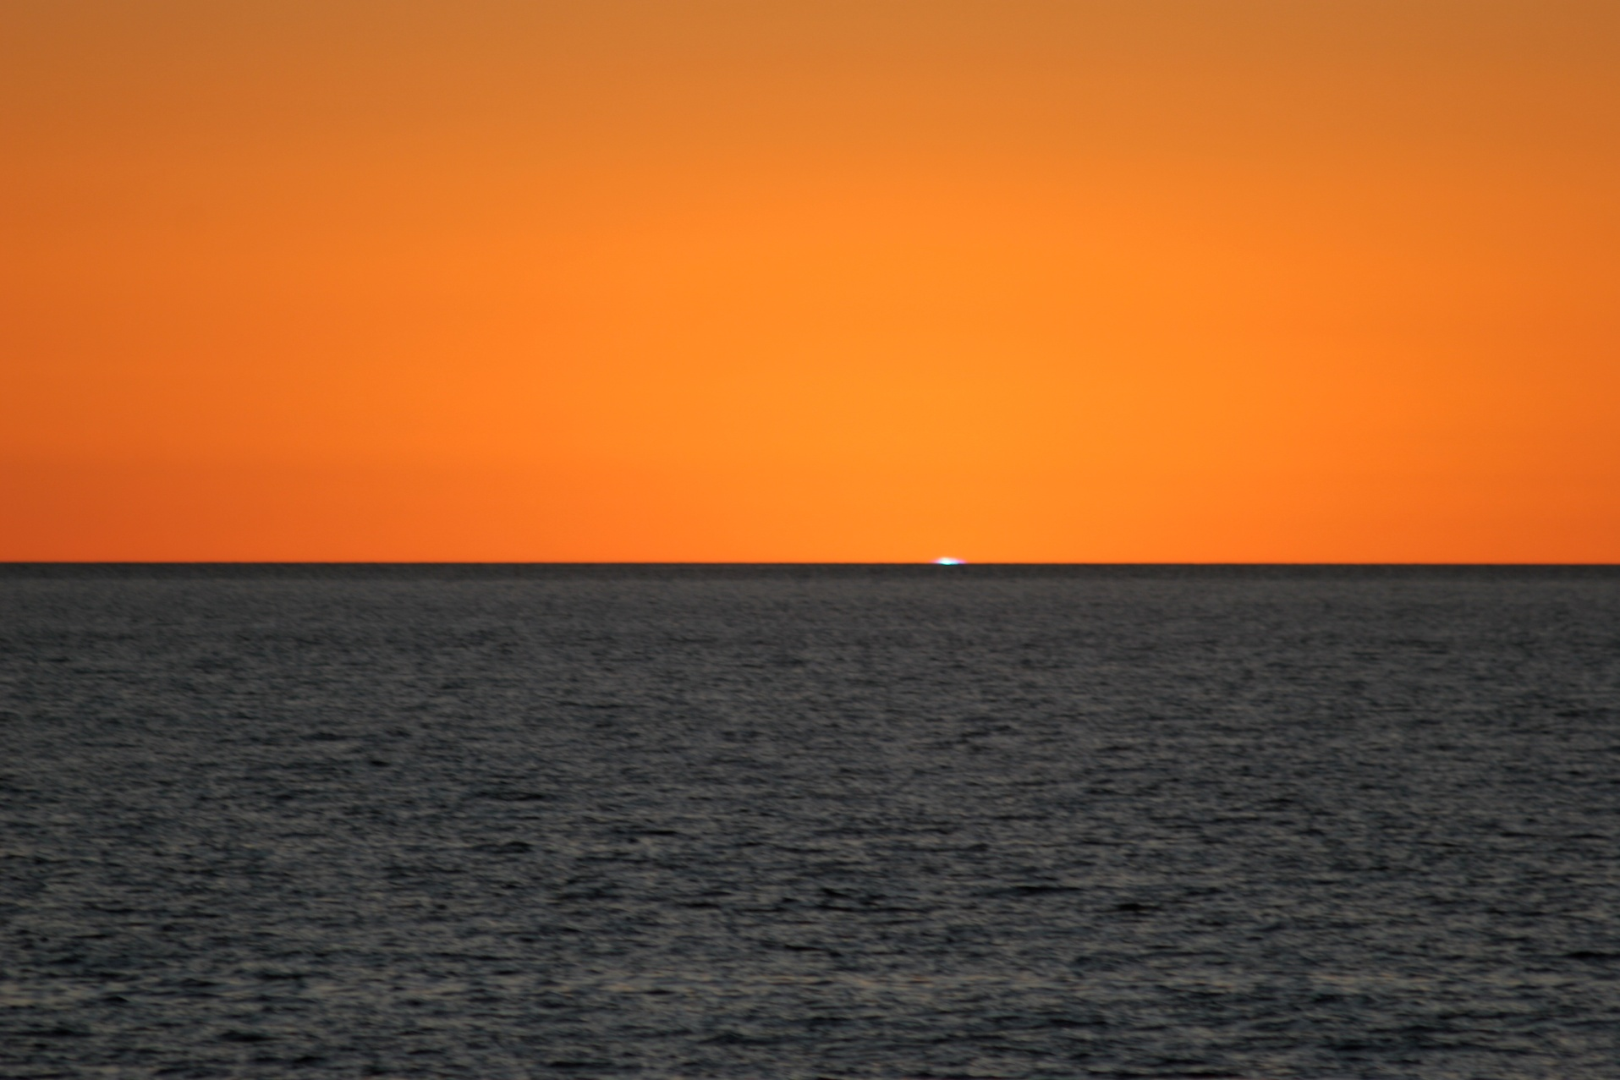
Sunrise Green Flash in Baja California by Mike Greenfelder

Slide 20
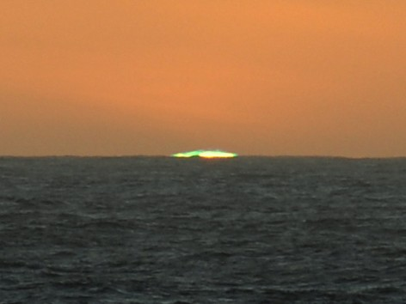
Green Flash in the Drake Passage by Tim Soper

Slide 21
So Look for the
Green Flash!

