Slide 1
Global Climate Change:
Separating the Science
From the Fiction
by
Jim Kelley

Slide 2
The Natural Greenhouse
Visible Light
Visible Light
Heat
Natural
Greenhouse

Slide 3
The Greenhouse Effect Actually Makes It Too Warm
Stratosphere
Troposphere
Natural Greenhouse
(Theory)
Altitude
6 to 12 miles
Natural Greenhouse
+Weather
(Observed}
Temperature
57ºF
140ºF

Slide 4
Weather Moves Heat Up and Poleward
Hot Humid Air Rises
and Condenses
Cool, Dry
Air Sinks
Precipitation Releases
Heat and Causes Further Rising
Evaporation Removes Heat

Slide 5
Point #1
Anecdotal Information,
Especially About Weather,
Is Notoriously Unreliable!

Slide 6
“Things are more like
they are today than they've
ever been before”
Dwight David Eisenhower

Slide 7
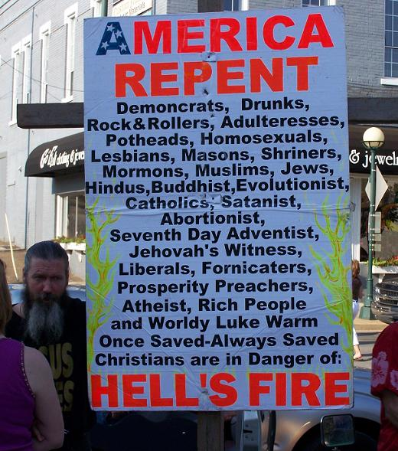
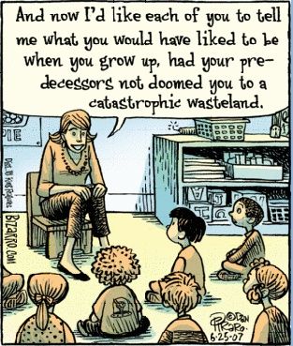
Point #2
Armageddon
Is Not Always
Just Around
the Corner

Slide 8
How Often Have You Seen
A Figure Like This?
You Are Here
…Always
Time

Slide 9
Because Depending on the
Time Window of the Observations
You Could Be Here
Time

Slide 10
…Or Here
Time

Slide 11
…Or Almost Anywhere
Time

Slide 12
In the Case of Global Climate Change,
The Most Important, Often Unasked Question Is:
Would We Expect the Climate to be
Constant over Long Periods of Time?
All The Evidence From Geology
Says the Answer is
“No.”

Slide 13
Point #3
The Climate is Always Changing
The Questions Today are:
“How and Why Is It Changing Now”
And
“Is the Current Change Unusual?”

Slide 14
Once People Went Outside to
Find the Answer to these Questions
These Days it is Popular
In Climate Science to Use
Computer Models
(called GCM’s or
General Circulation Models
or, incorrectly, Global Climate Models)

Slide 15
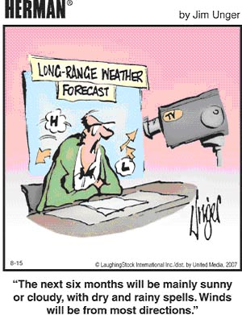
Point #4
Most Models Have
Trouble Reproducing
the Current Situation,
Much Less Forecasting
the Future

Slide 16
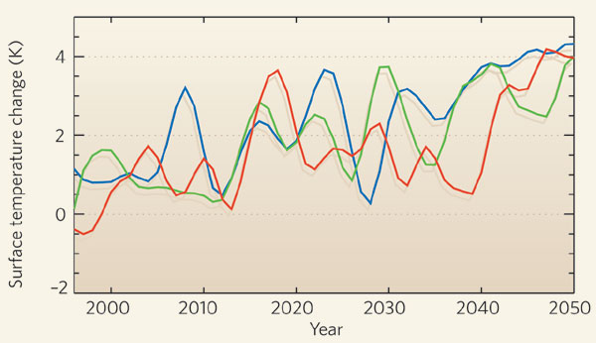
Three Models’ “Predictions “of
Future Temperature in Europe
These are not Predictions,
They are Scenarios
R. Wood, Nature, 1 May 1008

Slide 17
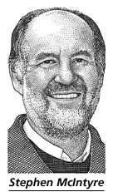
Point #5
There are Problems
With the Data
That Indicate
Warming,
Even in
the U.S.

Slide 18
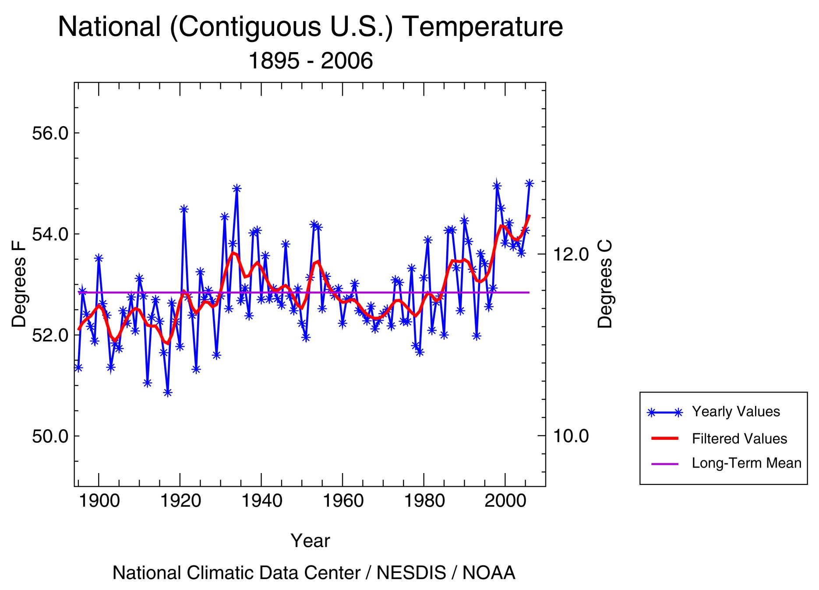
1934

Slide 19
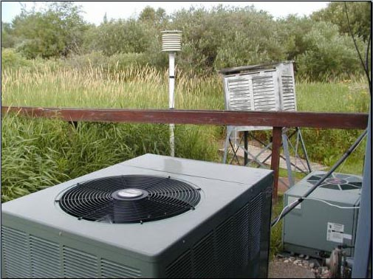
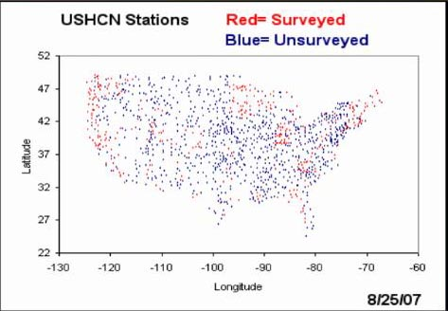

Slide 20
1-5ºC

Slide 21
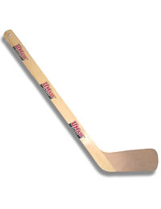
What About the
“Hockey Stick”?

Slide 22
Temperature Anomaly (ºC)
Original “Hockey Stick” Figure, 1998

Slide 23
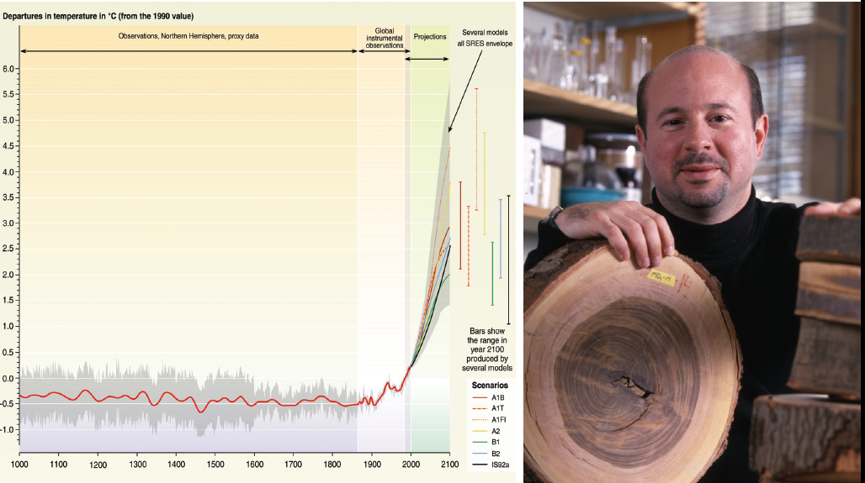
Of Course….You Are Here
Michael Mann (Penn State)
And His Hockey Stick

Slide 24
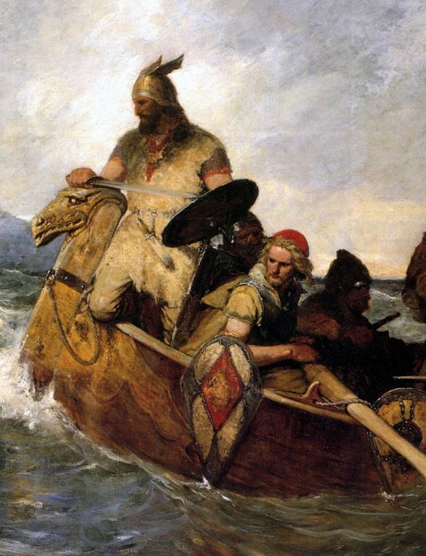
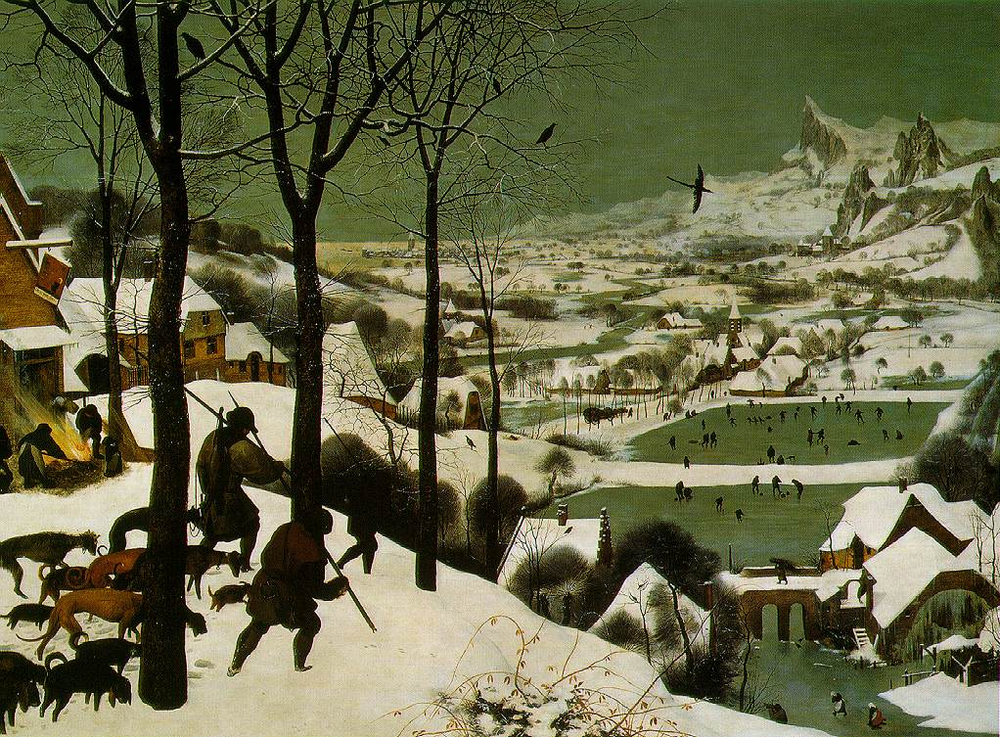
1
0
-1
Little
Ice Age
Temperature Change ºC
Medieval
Warm Period
1000AD 1500AD 1900AD
Figure 22 in the Intergovernmental Panel
On Climate Change Climate Change, 1995

Slide 25
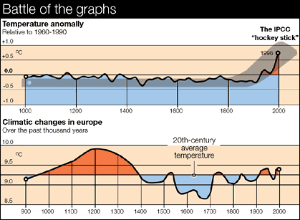

Slide 26
A Few Observations about
Global Climate Prediction:
The Longer the Work Goes On,
The Less Apocalyptic Become
The Predictions.
2. Climate Modeling, Using
General Circulation Models (GCM’s)
Is Hard Work.
3. The Role of the Ocean, Which May Be
The Single Most Important Factor,
Is the Least Well Understood.

Slide 27
A Few Observations about
Global Climate Prediction:
The Longer the Work Goes On,
The Less Apocalyptic Become
The Predictions.
Early models which did not include
a Realistic Ocean predicted the melting
of all Polar Ice, with a Sea Level rise
of 60-70 meters.

Slide 28
A Few Observations about
Global Climate Prediction:
1. The Longer the Work Goes On,
The Less Apocalyptic Become
The Predictions.
Subsequent models with a more
Realistic Ocean, but no Biosphere
Predicted Melting only West Antarctic
Ice with a Sea Level Rise of 6-7 meters

Slide 29
A Few Observations about
Global Climate Prediction:
1. The Longer the Work Goes On,
The Less Apocalyptic Become
The Predictions.
Current Models Predict Sea Level
Rise of 18-59 cm (6-23 inches)
with a Doubling of Atmospheric CO₂.

Slide 30
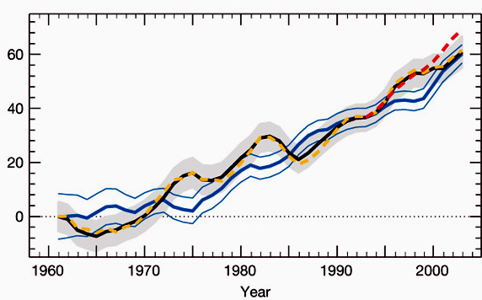
The Most Recent Estimates—Last June
60 mm in 43 years = 5.5”/century
Satellite Data
Sea Level Rise (mm)
Thermal
Expansion
Domingues, et al., Nature, 19 June 2008

Slide 31
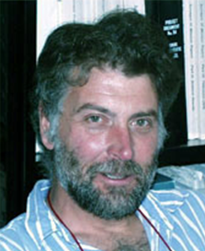
In a More Recent Paper, Tad Pfeffer
and Colleagues Showed that it is
Physically Impossible to Get More
than 800mm of Sea Level Rise in
This Century Even if
Glaciers Flowed 40
Times Faster than
They are Today
W.T. Pfeffer (U. Colorado), et al.,
Science, 5 September 2008

Slide 32
So What About
Carbon Dioxide (CO₂)?

Slide 33
Composition of the Earth’s Atmosphere
Gas Name Chemical Formula Percent Volume
Nitrogen N₂ 78.08%
Oxygen O₂ 20.95%
*Water H₂O 0 to 4%
Argon Ar 0.93%
*Carbon Dioxide CO₂ 0.0380%
Neon Ne 0.0018%
Helium He 0.0005%
*Methane CH₄ 0.00017%
Hydrogen H₂ 0.00005%
*Nitrous Oxide N₂O 0.00003%
*Ozone O₃ 0.000004%
* variable gases Greenhouse Gases

Slide 34
The Keeling Curve

Slide 35
“Climate Sensitivity”
Is how much Temperature
Rise you get when you double
Carbon Dioxide above
pre-industrial levels.
The IPCC Third Assessment Report (2001) estimate for the
Climate Sensitivity was 1.5 to 4.5 °C,
The IPCC Fourth Assessment report (February 2007)
estimates it to be 2-4.5 ºC
With a most likely value of 3ºC

Slide 36
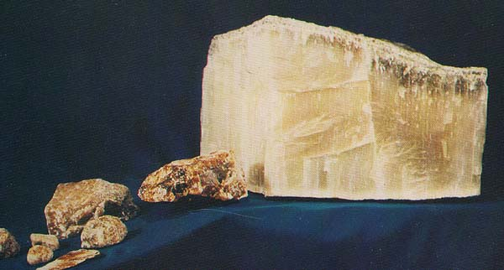
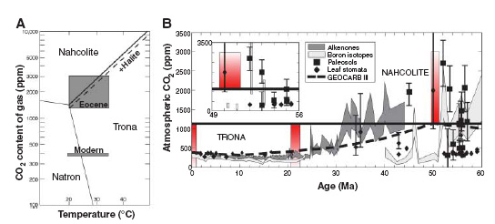
Nahcolite, Soda Ash
NaHCO₃
Only Occurs at CO₂
Concentrations > 1125 ppm
Piceance Creek Basin, Colorado
Lowenstein and Dimicco (SUNY, Binghamton) Science, 29 September 2006

Slide 37
This Presence of Nahcolite in the
Green River Formation Indicates
That From 49 to 56 Million Years Ago,
The Level of Atmospheric CO₂
Was At Least 3 Times the Current Level

Slide 38
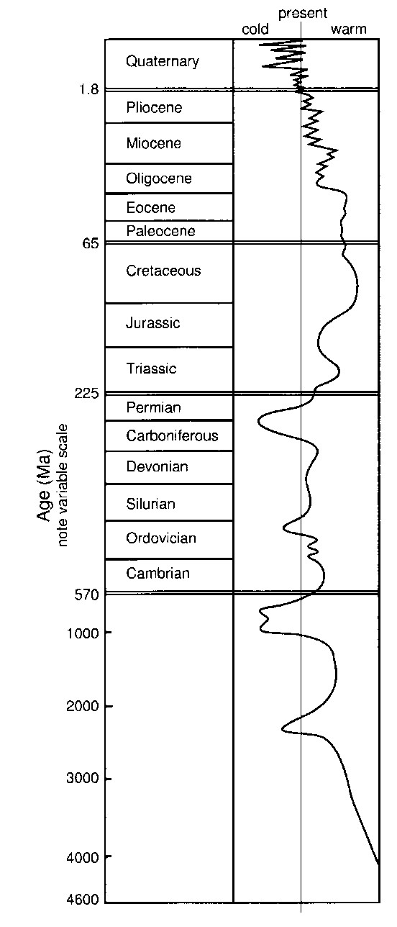
0
1.8
65
225
570
1000
2000
3000
4000
4600
~20 to 35 ºC
(68 to 95 ºF)
in Wyoming and Colorado
This Curves Shows the
Temperatures in the
Geological Past as Cooler
Or Warmer than the Present
Million Years Ago
0 to 23 ºC
(32 to 74 ºF)
In Wyoming Today

Slide 39
One Big Question is:
Does a Rise in CO₂ Cause
Temperature to Rise
Or is it the Other Way Around?

Slide 40
Data From Antarctica at the End of the Ice Age 9
280
260
240
220
200
Co₂ Lags
Temperature
By 800 years
Carbon Dioxide, ppm
Temperature proxy, Ar
235 240 245 250
Thousands of years ago
Caillon, et al., Science, 14 March 2003

Slide 41
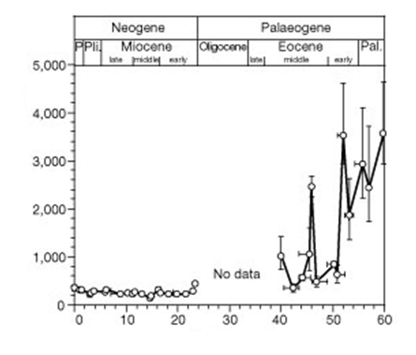
Atmospheric Carbon Dioxide
concentrations over the past 60 million years
CO₂ (ppmv)
Age (mya)
N. Pearson and Martin R. Palmer, Nature 406, 695-699 (17 August 2000)

Slide 42
Increasing CO₂ Changes
Climate Logarithmically,
Not Linearly
Doubling CO₂ Changes
The Atmosphere
by only 2%
12
10
8
6
4
2
0
Linear Change
Increase in Radiative Forcing (%)
Logarithmic Change
Richard Lindzen (MIT), Proc. Erice Meeting, 2005
400 600 800 1000 1200 1400
CO₂(ppmv)

Slide 43
It is Difficult to Compare the Role
Of Water Vapor to Other
Greenhouse Gases but the
Effects are Roughly:
Water Vapor 36-70%
Carbon Dioxide 9-26%
Methane 4-9%
Ozone 3-7%

Slide 44
What About
The Sun?

Slide 45
In 2003 Peter Foukal Suggested that Perhaps
One Half of Earth Warming Could be Caused
by the Warming of the Sun
0.06
0.04
0.02
0.00
S=Solar Irradiance
%
Change
T=Global Temperature
1920 1940 1960 1980 2000
Peter Foukal (Heliophysics, Inc.) EOS, June 2003

Slide 46
Global Temperature vs. Solar Wind Strength
14.3
14.2
14.1
14.0
13.9
13.8
13.7
13.6
+0.2
+0.1
0.0
-0.1
-0.2
-0.3
-0.4
-0.5
Temperature (ºC)
Krakatoa
Solar Wind Activity (a-a index
1880 1900 1920 1940 1960 1980
Mathiesen, Global Warming, Fig 6.5

Slide 47
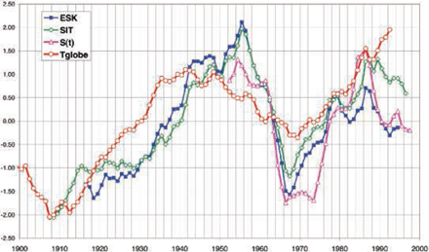
Cosmic Ray Flux and Solar Irradiance vs. Climate
Magnetic Field Strength
Solar Irradiance
Global Temperature
“Anomalous
Warming”
Le Mouél, et al., EPSL 232, 273 (2005), Elsevier
See, Pasotti, Science, 11 January, 2008

Slide 48
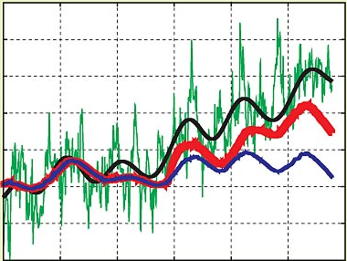
Global Temperature Anomaly and Total Solar Irradiance
1.2
1.0
0.8
0.6
0.4
0.2
0
-0.2
Temperature
Filtered
Temperature
compared to
1890-1910
Temperature Anomaly (K)
2 Solar Cycle Models
1960 1970 1980 1990 2000 2010
Year
Scafetta, N. (Duke), and West, B., (U.S. Army Research Office}
Physics Today, March 2008

Slide 49
Global Temperature vs. Carbon Emissions
14.3
14.2
14.1
14.0
13.9
13.8
13.7
13.6
7
6
5
4
3
2
1
0
Temperature (ºC)
Global Carbon Emissions (GT/Yr
1880 1900 1920 1940 1960 1980 2000
Mathiesen, Global Warming, Fig 6.4

Slide 50
We Know That for the Past 65 Years We Have
Been in an Unusually Active Period For Sunspots,
Which Increases Outgoing Solar Energy
80
60
40
20
0
Sunspot Number
1200 1400 1600 1800 2000
Solanski, et. al. (Max-Plank Inst), Nature, 28 October 2004

Slide 51
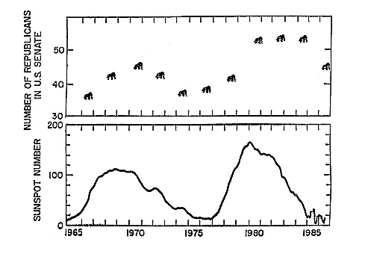
Richard Lindzen (MIT), Proc. Erice Meeting, 2005

Slide 52
Is It Really
Global Warming?

Slide 53
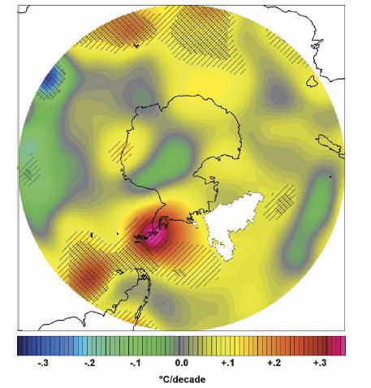
Change In
Temperature
1958-2000

Slide 54
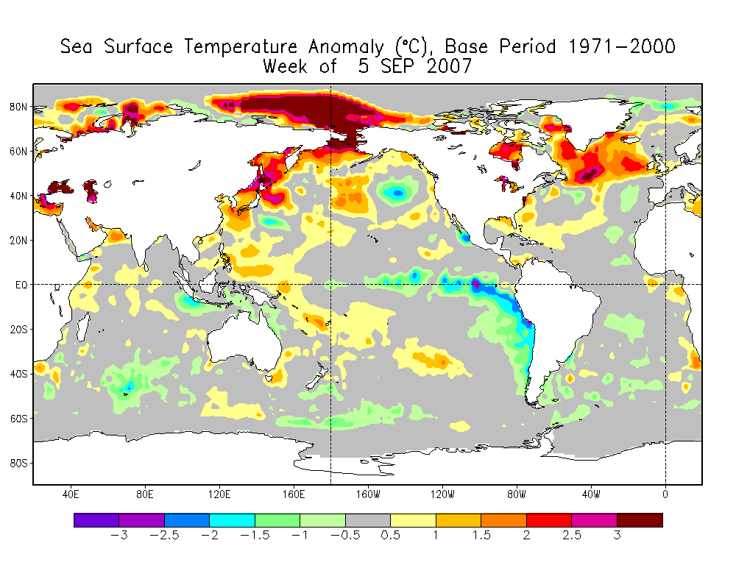

Slide 55
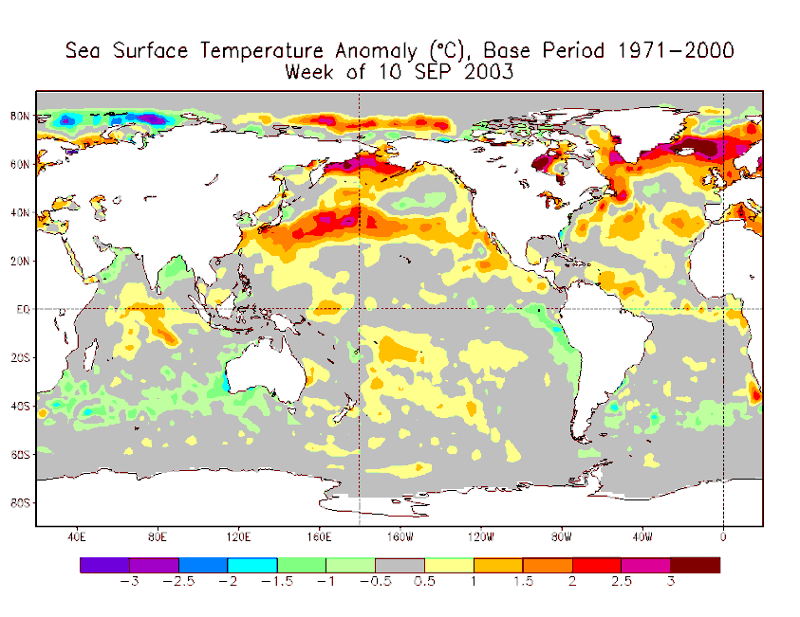
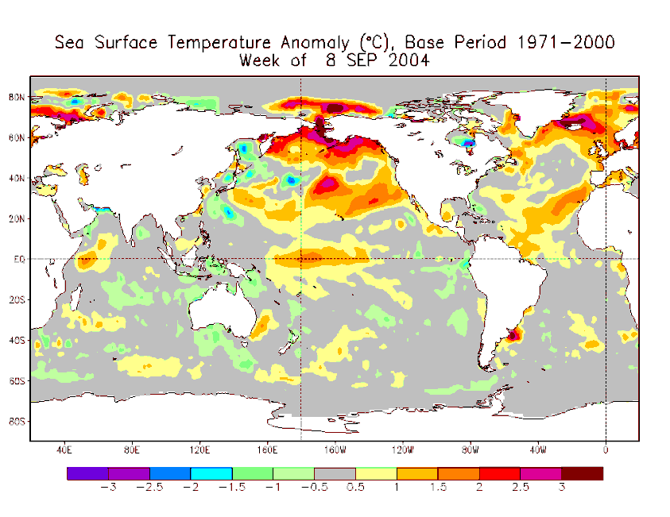
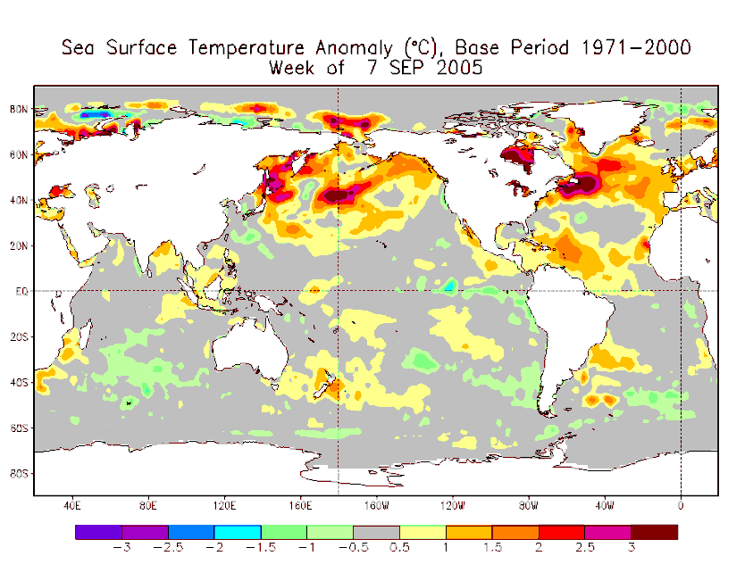
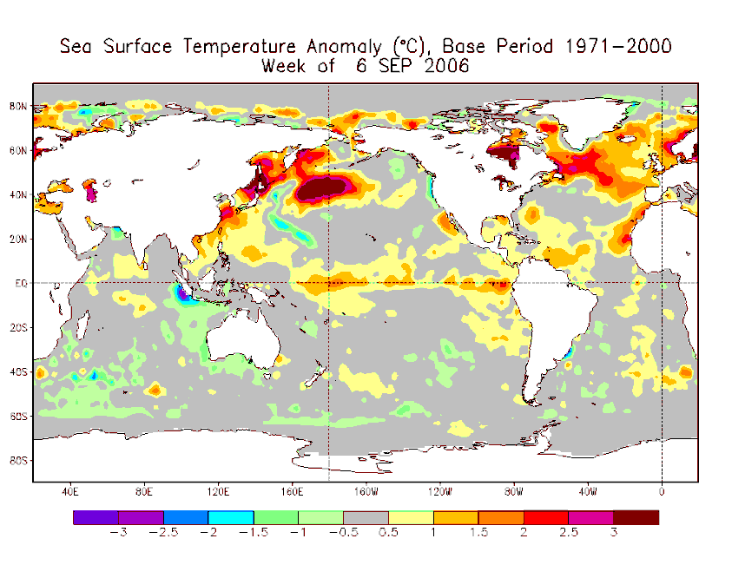

Slide 56
Remember that the Ocean
Is 1000 Times More Important
That the Atmosphere in
Determining the Earth’s Climate

Slide 57
Point #6
Climate Change
Of the Predicted Magnitude
Is Not Unusual
Nor Unprecedented

Slide 58
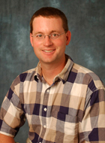
Roger Pielke, Jr.
Professor in the Environmental Studies
Program and a Fellow of the Cooperative
Institute for Research in the
Environmental Sciences (CIRES).
(University of Colorado At Boulder).
Roger Pielke, Sr., Senior Research Scientist CIRES, University of Colorado at Boulder and Professor Emeritus Department of Atmospheric Science, Colorado State University

Slide 59
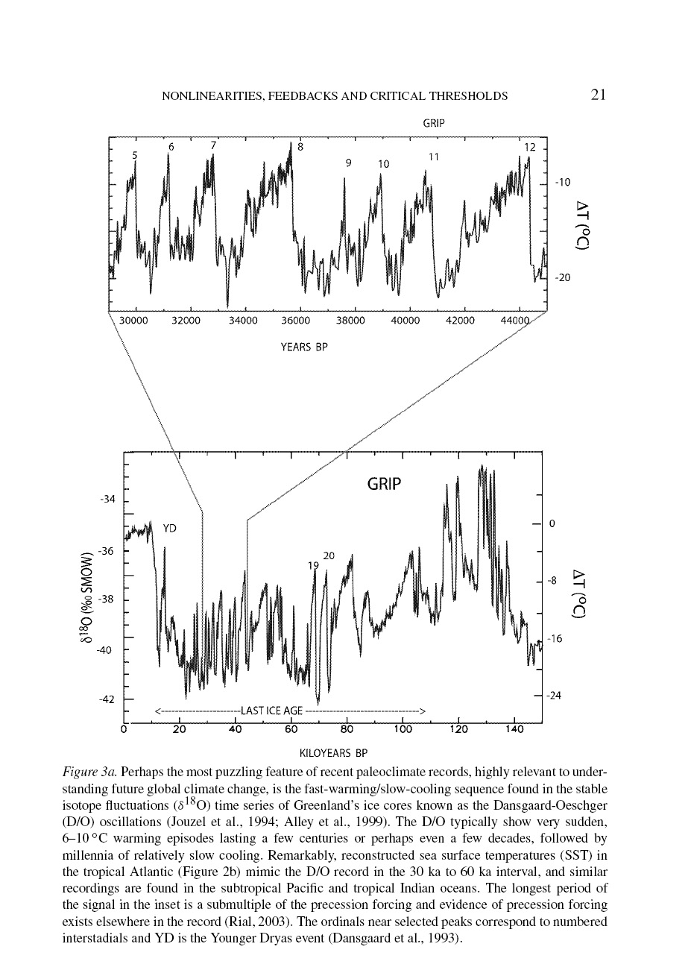
Roger Pielke, Sr.
Points Out
That The Typical
Pattern of Climate
Change is
Rapid Warming
Followed by
Slow Cooling
At All
Time Scales
30,000 years ago 45,000
0 thousand years ago 150

Slide 60
15ºC in 100-1000 years = 1.5º- 15ºC per Century
Current warming is at about 0.5ºC over the
last century
The IPCC Third Assessment Report (2001) estimate for the
Climate Sensitivity is 1.5 to 4.5 °C; and the average
surface temperature is projected to increase
by 1.4 to 5.8 Celsius degrees over the period 1990 to 2100,
with a most likely figure of 3ºC

Slide 61
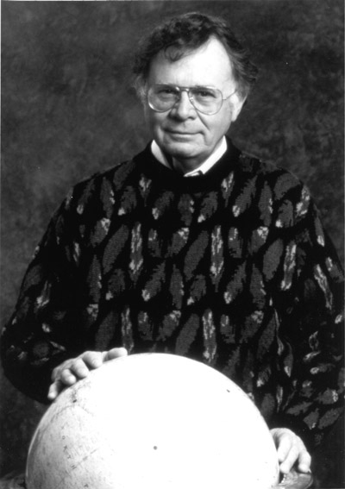
Wally Broecker
Newberry Professor of
Earth & Environmental Sciences
Lamont-Doherty Earth Observatory
Columbia University

Slide 62
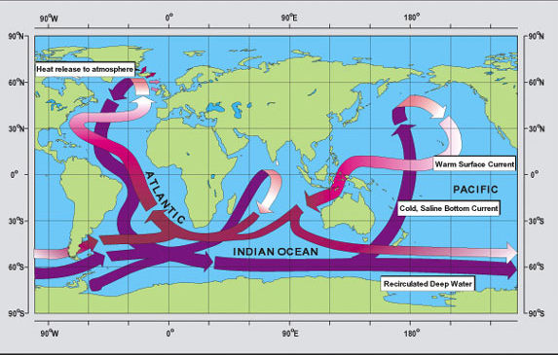
Wally Broecker’s Ocean “Conveyer Belt””

Slide 63
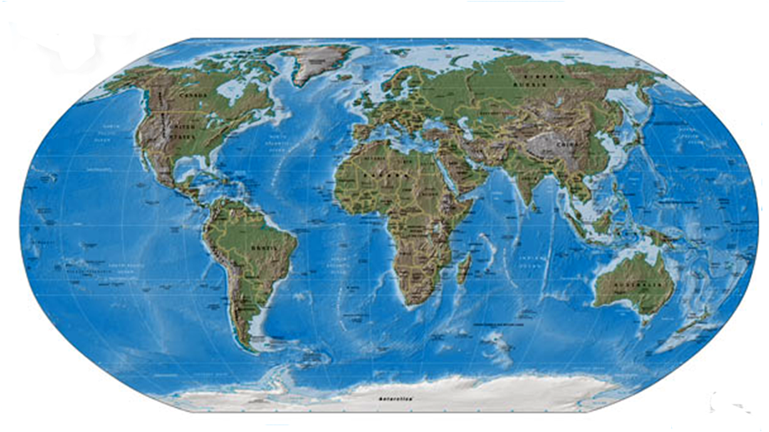
Locations of the World’s Marine Science Centers
?
?
?
?
?

Slide 64
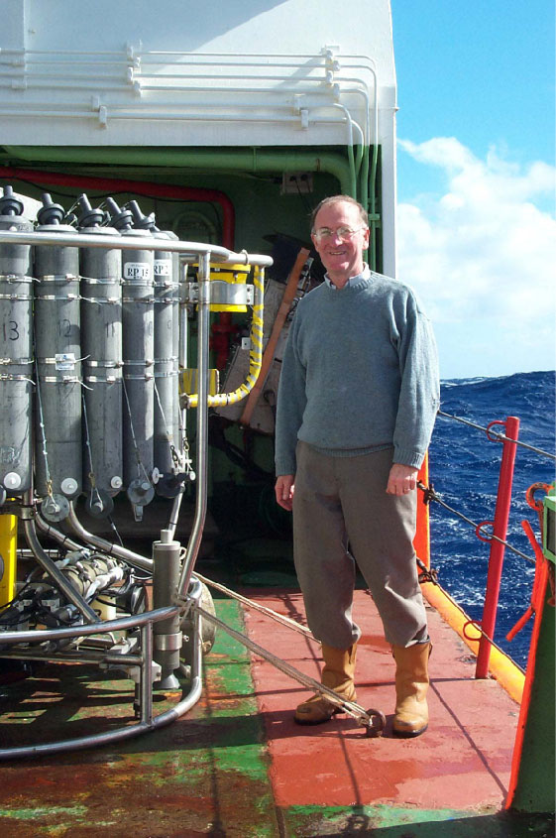
In December 2005,
Harry Bryden, et al.,
(National Oceanography
Centre, Southampton, U.K.)
Nature, Claimed to have
shown a 30% Decrease
in the MOC, Leading to a
Spate of Newspaper Articles
About an Impending New
Ice Age in Europe

Slide 65
It has since been shown
(Science, 23 August 2007)
by the same authors, Bryden et al., that
the Change Reported was
part of a Natural Fluctuation and
That the MOC had Speeded Back Up.
The Name of Dr. Bryden’s
Research Program is RAPID
(Rapid Climate Change Program)

Slide 66
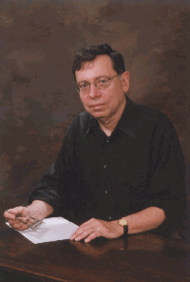
European readers should be
reassured that the Gulf Stream's existence
is a consequence of the large-scale
wind system over the North Atlantic
Ocean, and of the nature of fluid motion
on a rotating planet. The only way to produce
an ocean circulation without a Gulf Stream
is either to turn off the wind system,
or to stop the Earth's rotation, or both.
C. Wunsch, Nature, 8 April 2004, p. 601

Slide 67
Real questions exist about conceivable changes in
the ocean circulation and its climate consequences. However,
such discussions are not helped by hyperbole and alarmism.
The occurrence of a climate state without the Gulf Stream any
time soon — within tens of millions of years — has a probability
of little more than zero.
C. Wunsch, Nature, 8 April 2004, p. 601

Slide 68
Keeleyside, et al., Nature, 1 May 1008

Slide 69
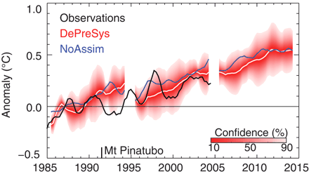
North Atlantic Temperatures
Smith, et al,., Science, 10 August 2007

Slide 70
What about the
Intergovernmental Panel On Climate Change
(the IPCC), winner of the
2007 Nobel Peace Prize shared with
Al Gore?

Slide 71
If you want to know what
The IPCC view is, you have
To read the reports, not just
“The Summary for Policy Makers”

Slide 72
Point #7
Climate Warming
Is not all Bad
e.g.,
Every Year 5 Times as Many People
Die from the Cold as Die of the Heat
Recommended reading
“Cool It”, by Bjorn Lomborg

Slide 73
What Can We
Do About It?
This is Called
“Adaptation”

Slide 74
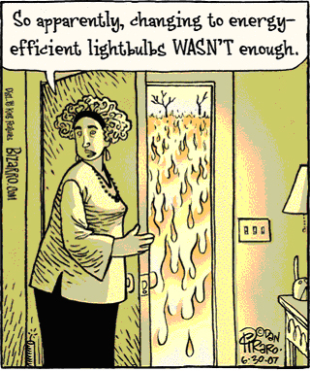

Slide 75
Point #8
We’re Going to do the Experiment
A Word About Time Scales
If you Stopped Pumping CO₂ today
How Long would it take the Atmosphere
To Recover to Pre-Industrial levels?
Compare Ozone Reducing Gases, CFC’s, etc.
And Carbon Dioxide

Slide 76
The Montreal Accord was ratified in 1987
Ozone depletion was predicted to have a time
scale of order 100 years.
We are now seeing a flattening out of a still
rising curve
1987 2008 2037 2087

Slide 77
For Greenhouse Warming, the comparable
Time Scale is of order 1000 years
The Kyoto accord took effect
in February, 2005
2005 2008 2500 3005

Slide 78
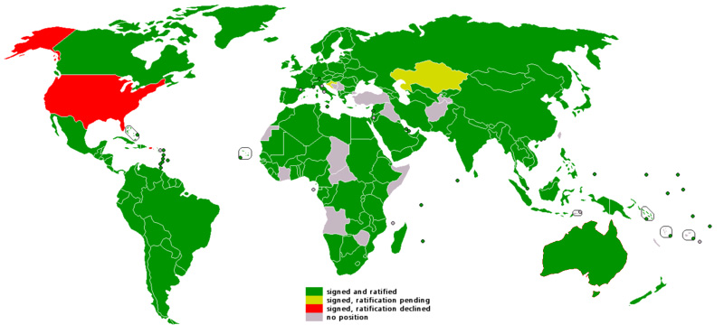
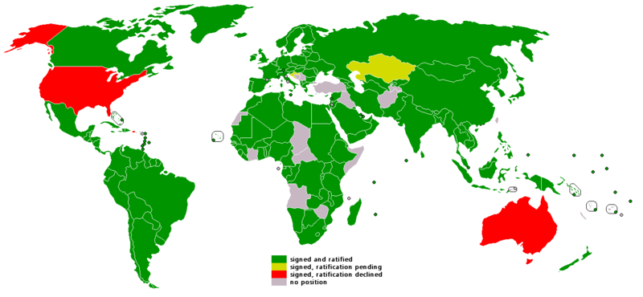
Status of the Kyoto Accord
As of December 2006
2007

Slide 79
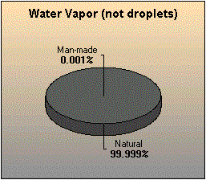
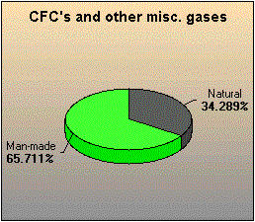
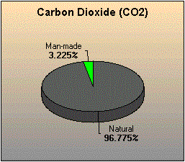
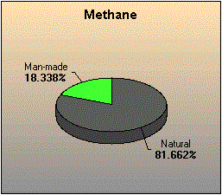

Slide 80
So What Are We Doing
About Developing Alternate
Energy Technology?
Not Much. At Least in the Federal Government
In the Carter Administraton Understood
The Importance of this Work.
Later Administrations, Republican
And Democratic, including Clinton-Gore
Have Not.
Industry is Doing Much More.

Slide 81
Total Government Energy R&D Investment
9000
8000
7000
6000
5000
4000
3000
2000
1000
0
US
$ Miilions (2004 Purchasing Power Parity)
Carter
Japan
Germany
1975 1980 1985 1990 1995 2000 2005
Clery, Science, 9 Feb. 2007, p. 782

Slide 82
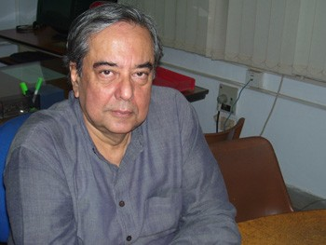
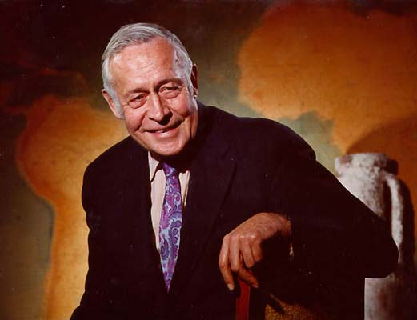
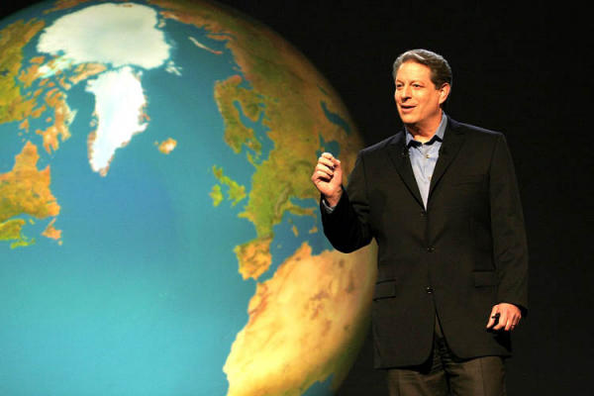
Al Gore says He was Inspired by
Roger Revelle.
Roger was an
important contributor
to the Greenhouse Gas Idea
In the late ’50’s
Ashok Khosla
Taught the Course
Gore’s Contact with Roger
Amounted to a Couple
Of Lectures in the Required
Freshman Science Class
…He Got a “D” in the Class

Slide 83
The whole aim of practical politics
is to keep the populace alarmed
(and hence clamorous to be led to safety)
by menacing it with an endless series
of hoblgoblins, all of them imaginary.
Henry Louis Mencken

Slide 84
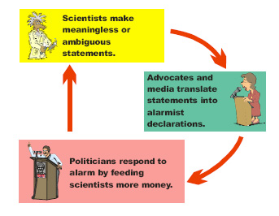
Richard Lindzen (MIT), Proc. Erice Meeting, 2005

Slide 85
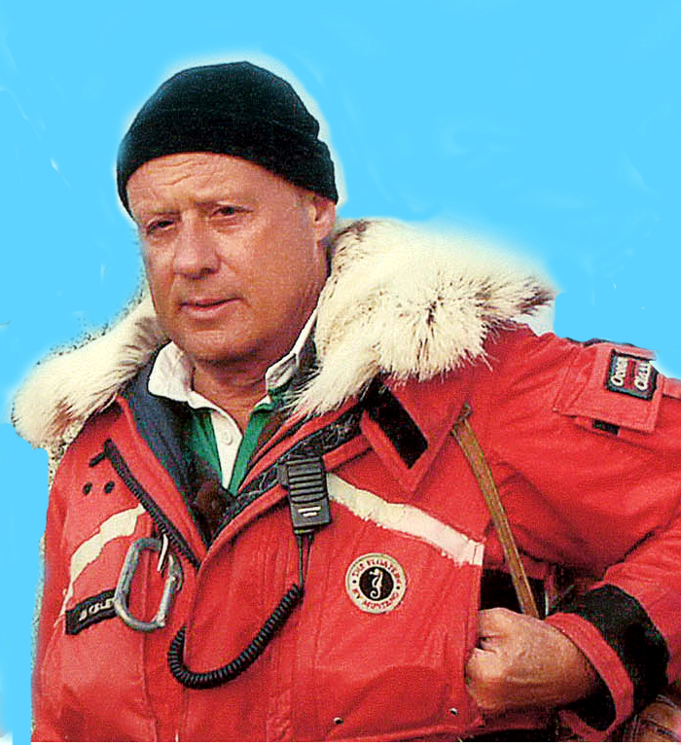
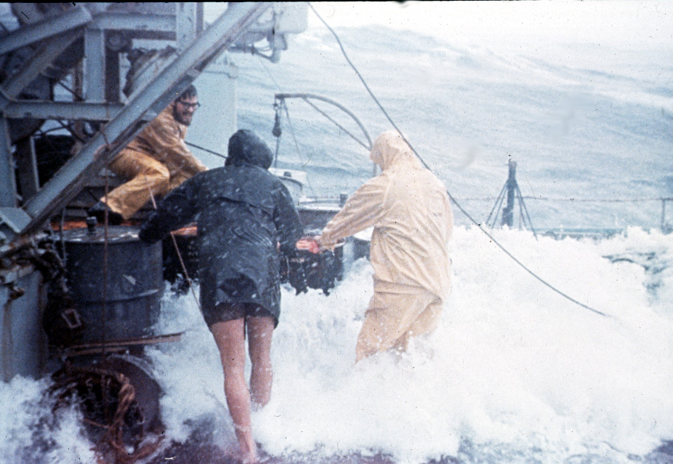
Finally, a little personal perspective…
When I’m at work,
I dress like this
And my office
Looks like this

Slide 86
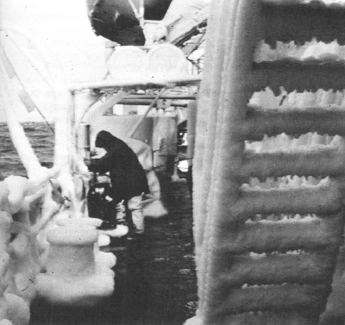
O. I. F.
“Oceanography
is Fun”

Slide 87
This is the
Way We Have Done
Oceanography
in the Past

Slide 88
Working on a
Rolling Deck
For Months
At Sea

Slide 89
You Learn a Lot
About the Ocean
And
How She Behaves
And Responds

Slide 90
A Ship?
What’s a Ship?
Some People’s
Idea of
Oceanography
In 2008

Slide 91
“Even When All the Experts Agree
They May Well be Mistaken”
Bertrand Russell

Slide 92
"Only an insignificant fraction of scientists
deny the global warming crisis. The time for
debate is over. The science is settled."
…Al Gore, 1992
Anyone who says “the science is settled”
reveals his complete ignorance of the
fundamental nature of Science…Science is
always provisional!
…J.C.K., 2008

Slide 95
So if you really want to be prepared…
Thank You!

