Slide 1

El Niño: Boy Wonder
by
Jim Kelley

Slide 2
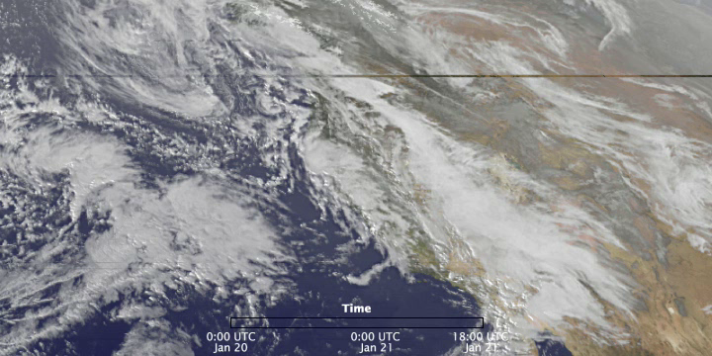
Remember this Week?
(19 January-21 January 2010)

Slide 3
Remember this Week?
(19 January-21 January 2010)

Slide 4
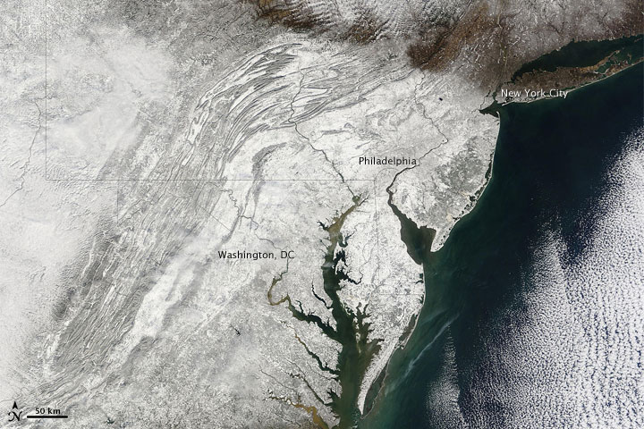
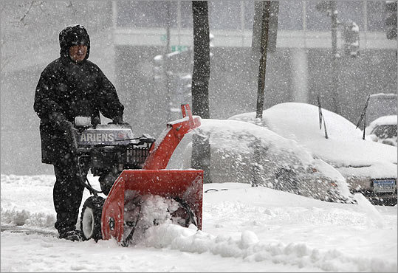
9 February, 2010
Or This One?
3 February 2010

Slide 5
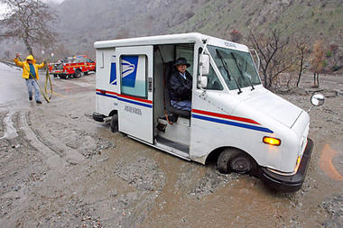
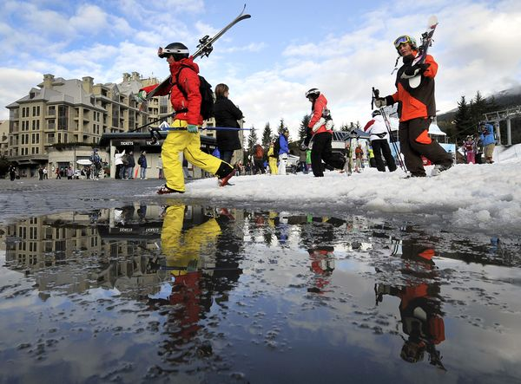
La Cañada, California
22 January 2020
Or These Scenes?
Vancouver, B.C
13 February, 2010

Slide 6
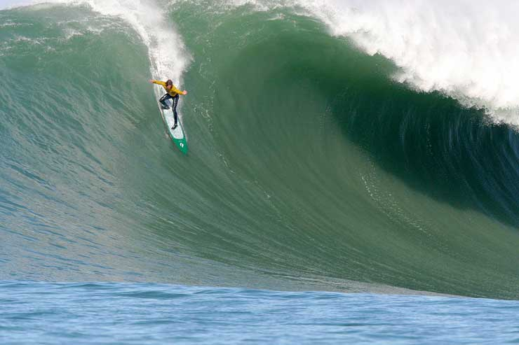
Or?….
Maverick’s --13 February 2010
“Biggest Waves Ever”

Slide 7
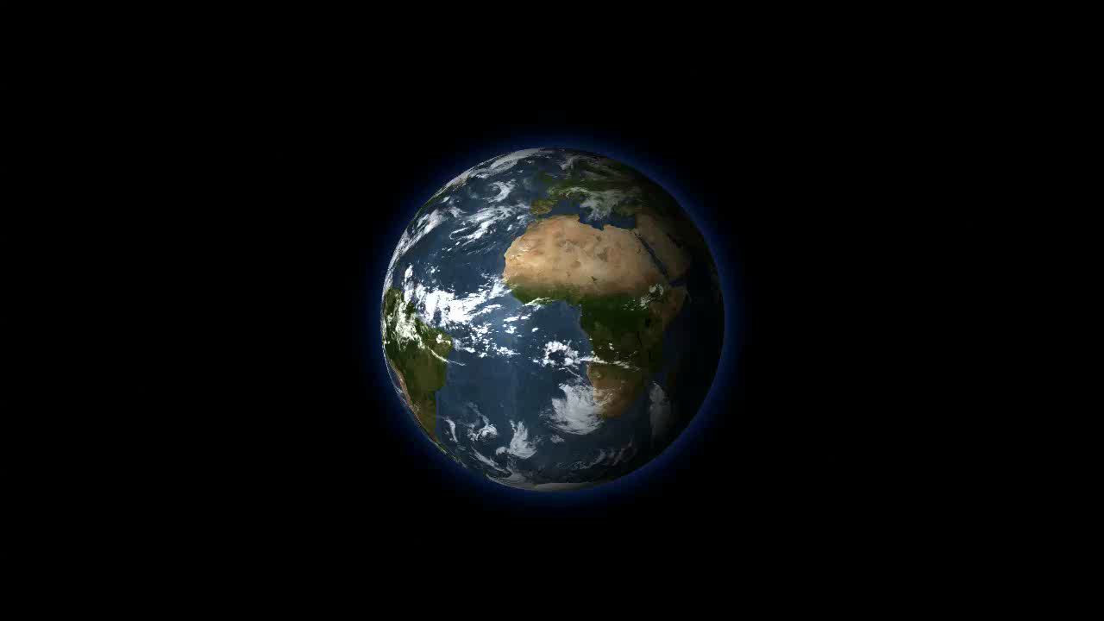
They Were All Produced by a
Warming of the Eastern Tropical Pacific
that Started Last Summer

Slide 8
This Warming is Called “El Niño”
And It Is One Phase of
A “Quasi-Periodic” Oscillation
Which Affects
The Tropical Pacific Ocean,
The El Niño-Southern Oscillation
Or ENSO

Slide 9
Why Do We Care about El Niño?
Because, after the Seasons, the
El Niño-Southern Oscillation (ENSO)
Is the Second Most Important
Factor Determining Global Climate

Slide 10
Today We Will Discuss:
What is ENSO
(the El Niño-Southern Oscillation)?
What Causes ENSO?
What are the Physical and Economic Effects
of ENSO, Locally and Globally?
What New Technologies are Available
to Help Us Understand ENSO?

Slide 11
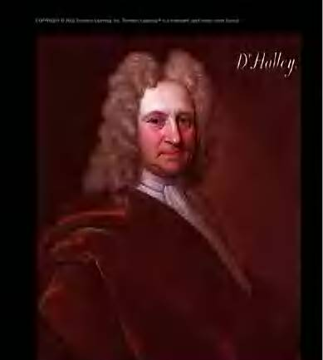
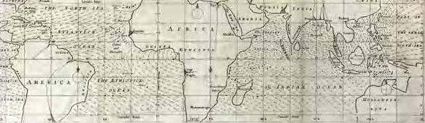
Sir Edmond Halley
1656-1742
Halley’s 1686 Map
of the Trade Winds

Slide 12
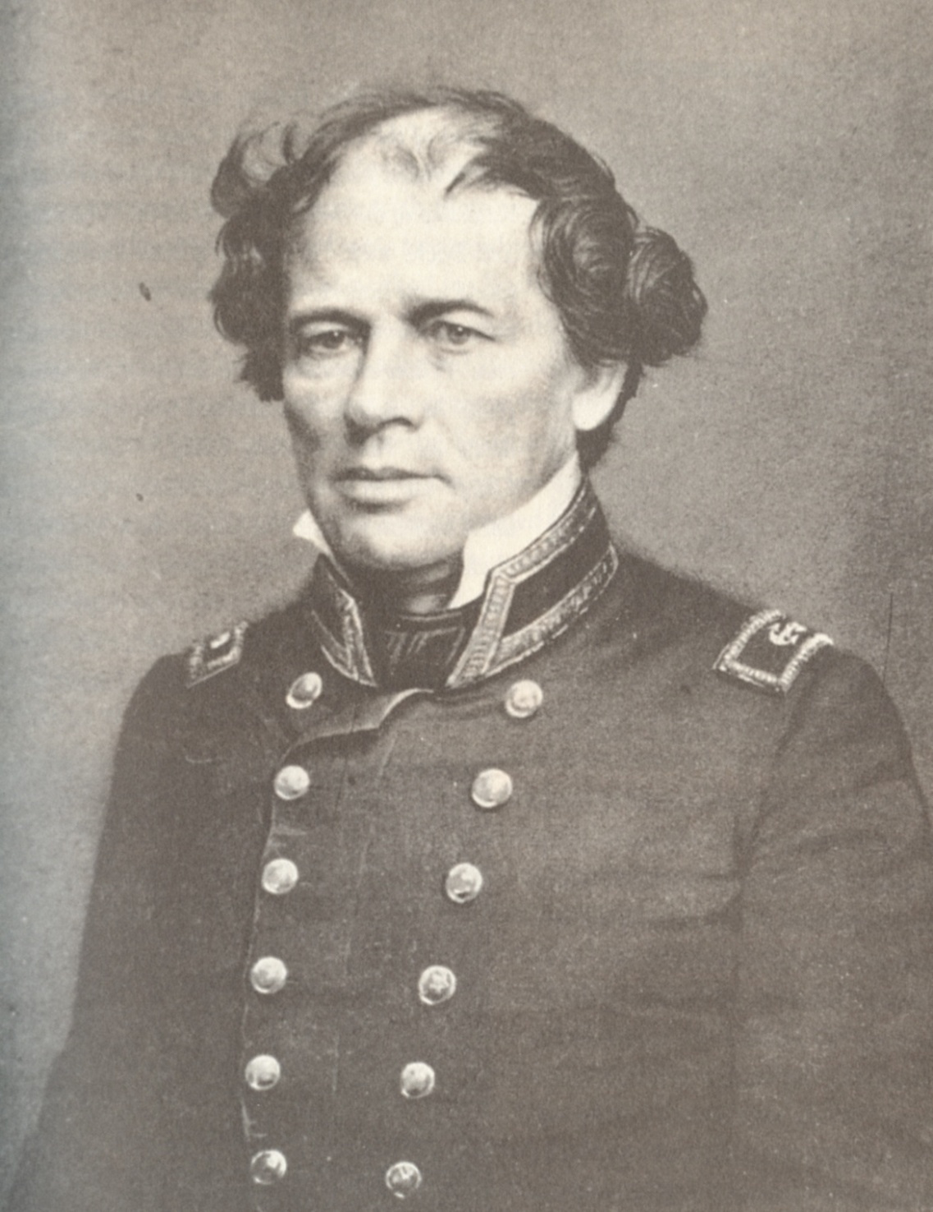
Matthew Fontaine
Maury
(1806-1873)
----------
“Pathfinder of the Seas”
-----------
First Hydrographer
Of the U.S. Navy
----------
1842-1861

Slide 13
“Nevertheless, as Halley said,
in his paper reed (sic) before the
Royal Society in London in 1686,
‘it is likewise very hard to conceive
why the limits of the trade-wind
should be fixed about the parallel
of latitude 30º all around the globe,
and that they should so seldom
exceed or fall short of those bounds.’“
Matthew Fontaine Maury
Sailing Directions, 1858

Slide 14
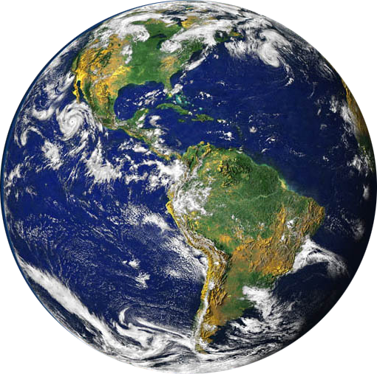
Incident Solar Radiation

Slide 15
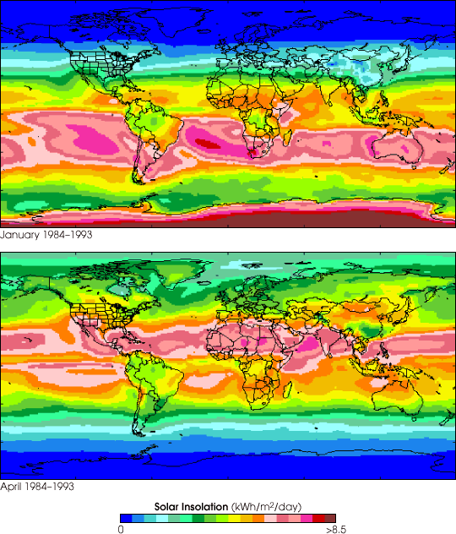
Total Solar
Radiation
at the Earth’s
Surface
--------
1984-1993
January
April

Slide 16
Hot Air Rises

Slide 17
As the Air Rises,
It Cools, Condenses
and Moves
Poleward

Slide 18
At About 30˚
Latitude,
the Dense Air
Falls Back to
The Surface

Slide 19
On Reaching the
Surface, This Air
Spreads Both
Equatorward and
Poleward

Slide 20
This Falling Air
Produces the
Subtropical
High Pressure
Areas at
30˚ N and 30˚ S
Latitudes
On Reaching the
Surface, This Air
Spreads Both
Equatorward and
Poleward

Slide 21
And the
Spreading Air
Produces
Surface Winds
Blowing
Equatorward
And Poleward
On Reaching the
Surface, This Air
Spreads Both
Equatorward and
Poleward

Slide 22
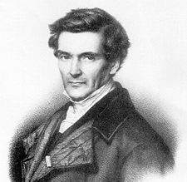
Gaspard
Gustave
De Coriolis
-----
1792-1843
«Sur les
équations du
mouvement
relatif des
systèmes de
corps», 1835

Slide 23
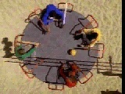
An Example of the Coriolis Effect:

Slide 24
In the Northern Hemisphere, Coriolis
Moves Things in Motion to the Right
In the Southern Hemisphere, Coriolis
Moves Things in Motion to the Left

Slide 25
So the Equatorward Winds Become the NE and SE Trades
60˚ N
Subpolar Low
30˚ N
Subtropical
High
NE Trades
Equator—
Doldrums
SE Trades
Subtropical
High
30˚ S
60˚ S
Subpolar Low

Slide 26
Major Wind Zones on an Earth with No Land
Polar Easterlies
Polar Front
60˚ N
Subpolar Low
Westerlies
30˚ N
Subtropical
High
Horse Latitudes
NE Trades
Inter-Tropical Convergence Zone
Equator—
Doldrums
SE Trades
Subtropical
High
Horse Latitudes
30˚ S
Westerlies
Polar Front
60˚ S
Subpolar Low
Polar Easterlies

Slide 27
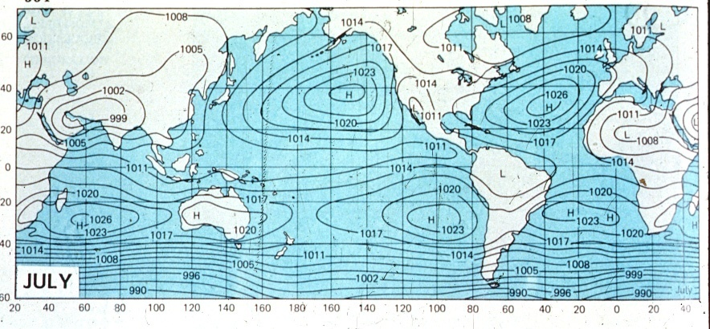
Average Surface Barometric Pressure Field
H
H
H
H
H
July
Surface Wind

Slide 28
Average Surface Barometric Pressure Field
H
H
H
H
H
July
Surface Wind

Slide 29
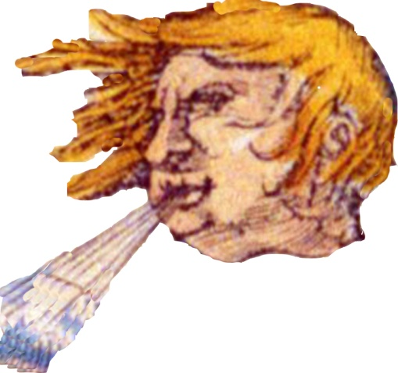

And Let’s Introduce Aeolus
The God of Wind
Who, of course,
Can Blow From
All Points of the
Compass Rose

Slide 30

Average Surface Barometric Pressure Field
H
H
H
H
H
July
Surface Wind

Slide 31
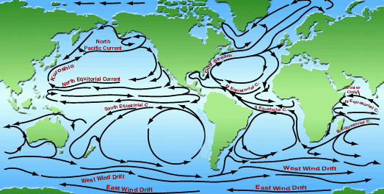
The Major Current Gyres of the Global Ocean
California
Current
Canary
Current
Peru
Current
Benguela
Current

Slide 32
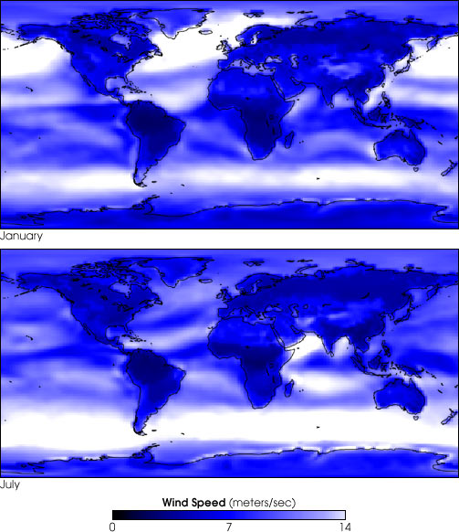
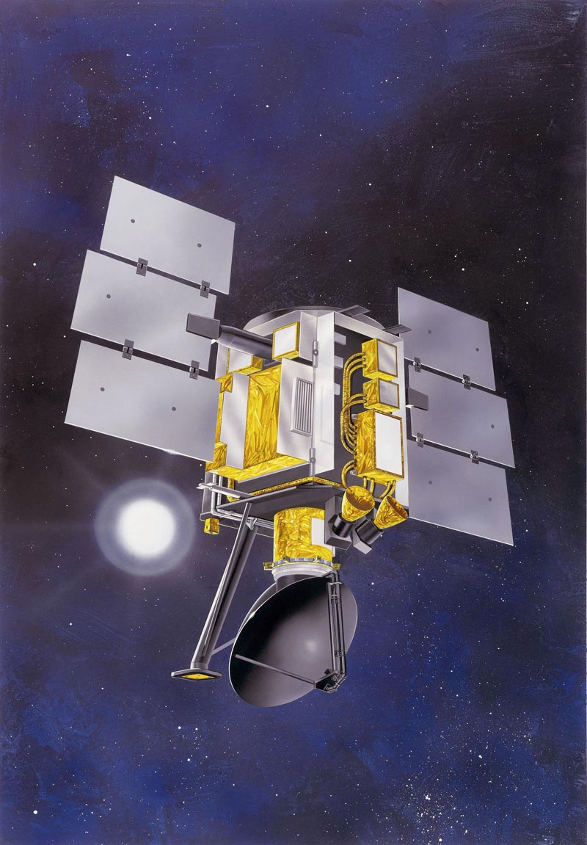
QUIKSCAT
Global Averages
Of Wind Speed
1 m/sec ≈ 2 knots
January
July
Wind Speed (m/sec)
0 7 14

Slide 33
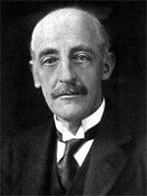
Sir Gilbert Walker, FRS
(1868-1958)
~~~~~~~~~~
Director, Indian
Meteorological
Department
1903-1924
Professor of
Meteorology
Imperial College
of Science
and Technology
1924-1934

Slide 34
Sir Gilbert Walker, FRS
(1868-1958)
~~~~~~~~~~
Walker was trying
To predict the Monsoon
And realized that
Pressure Differences
Can be Used to
Predict Winds
~~~~~~~
Defined the
“Southern Oscillation”

Slide 35
If the Trade Winds are Blowing Fresh From the
East, the Barometric Pressure in Darwin Should
Be Lower than that at Tahiti .
This Pressure Difference is Called the
Southern Oscillation Index (SOI).
˚
0˚
20˚
0˚
20˚
120˚ 140˚ 160˚ 180˚ 160˚ 140˚ 120˚ 100˚ 80˚
.
.
Darwin
H
.
L
.
Tahiti
120˚ 140˚ 160˚ 180˚ 160˚ 140˚ 120˚ 100˚ 80˚

Slide 36
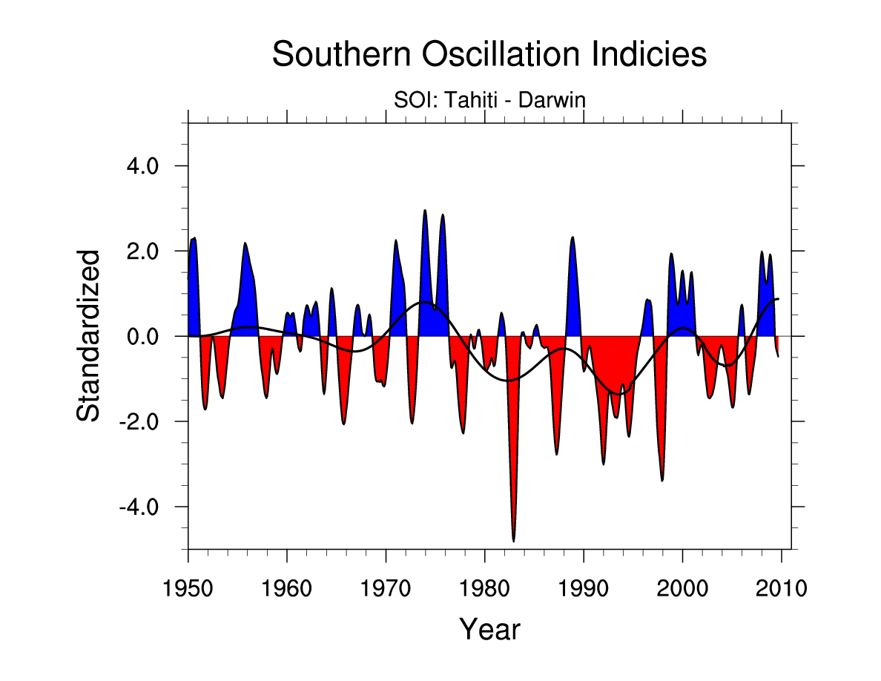
Southern Oscillation Index

Slide 37
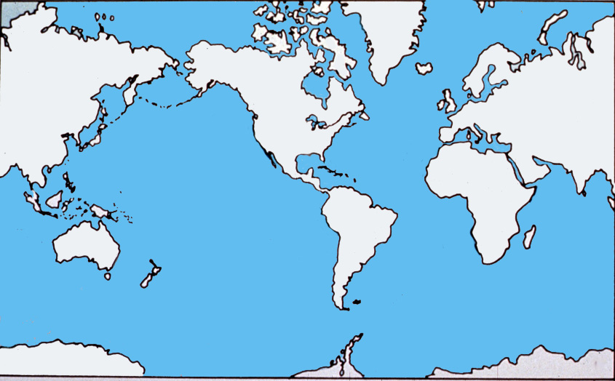
The Trades Winds are Not Always Steady

Slide 38
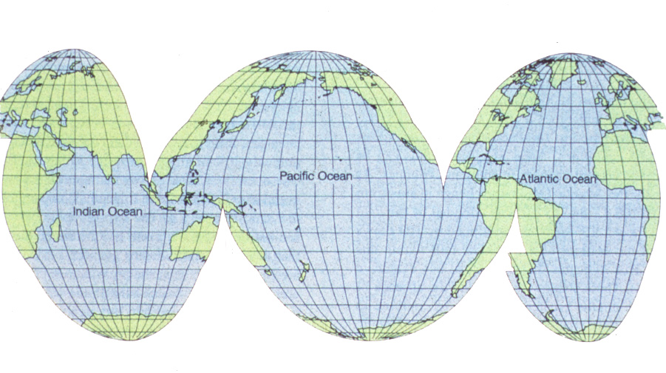
Global Weather is Created in the Pacific
The Pacific is Really Big!
150˚ of Longitude

Slide 39
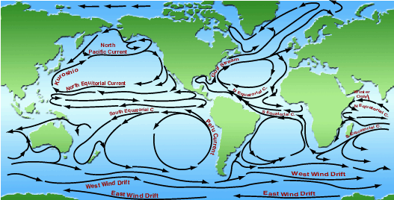
The North and South Equatorial Currents
Pool Warm Water in the
Western Tropical Oceans

Slide 40
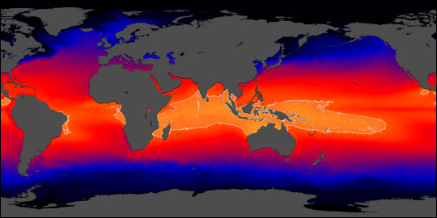
Sea Surface Temperature (SST)
-----
Global Average Climatology
Pacific Warm Pool

Slide 41
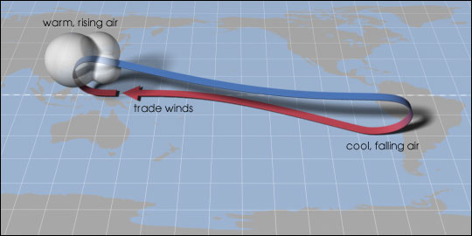
Walker Circulation--Pacific

Slide 42
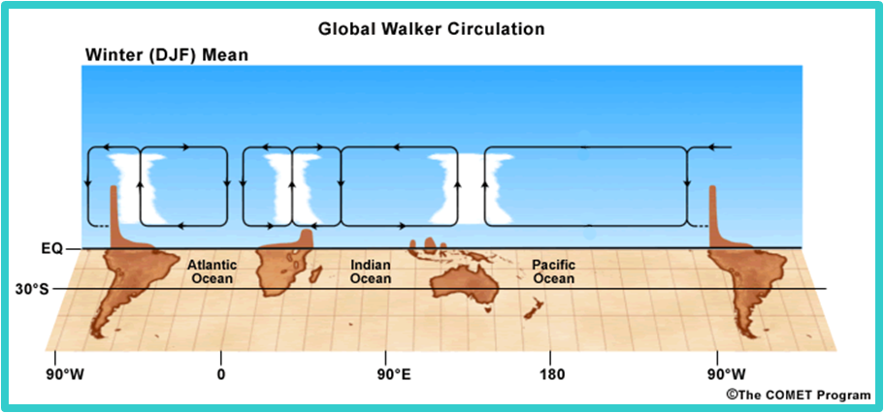
Global Walker Circulation—Dec.-Feb.

Slide 43
“Normal Conditions”
Warm
Water

Slide 44
Global Walker Circulation—Dec.-Feb.

Slide 45
“Normal Conditions”
Warm
Water

Slide 46
Onset of El Niño
Warm
Water

Slide 47
Fully Developed El Niño
Warm
Water

Slide 48
“Normal” Conditions
El Niño Conditions
Trade Winds
Equatorial Current
South
America
Asia

Slide 49
El Niño Conditions
Equatorial Current
South
America
Asia

Slide 50
Changes in Sea Level Indicate the Onset of El Niño
120˚ 140˚ 160˚ 180˚ 160˚ 140˚ 120˚ 100˚ 80˚
20˚
0˚
20˚
20˚
0˚
20˚
Fanning
.
.
.
.
Rabaul
Darwin
Santa Cruz
.
Tahiti
Callao
120˚ 140˚ 160˚ 180˚ 160˚ 140˚ 120˚ 100˚ 80˚

Slide 51
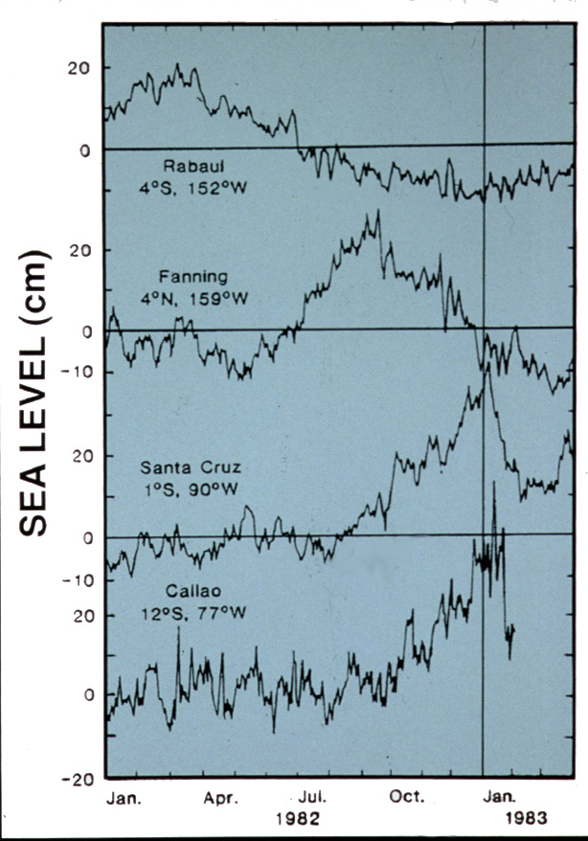
Shoreside
Tide Gauges
Show Sea Level
Height
Lowering in the
West
And Rising in the
East

Slide 52
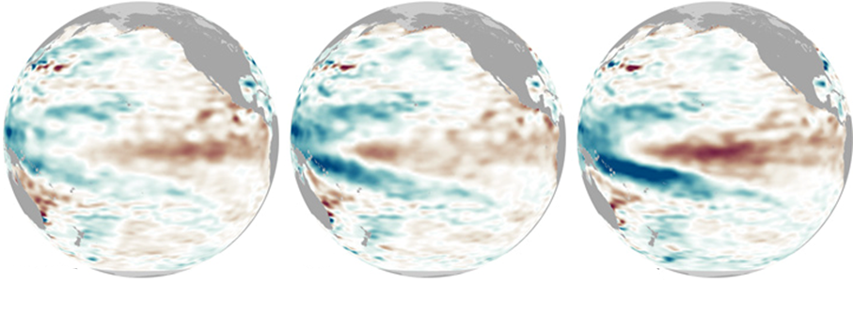

January 15 January 30 February 15
Sea Surface Height Anomaly (mm)
-220 0 220
Kelvin Wave Crossing the Pacific
January-February 2010

Slide 53
El Niño Conditions
Equatorial Current
South
America
Asia

Slide 54
Some Definitions:
Temperature
0-200m
Mixed Layer
Thermocline
Depth
Deep Layer

Slide 55
“Normal” Conditions
Trade Winds
Sea Surface
Equatorial Current
Thermocline
South
America
Asia

Slide 56
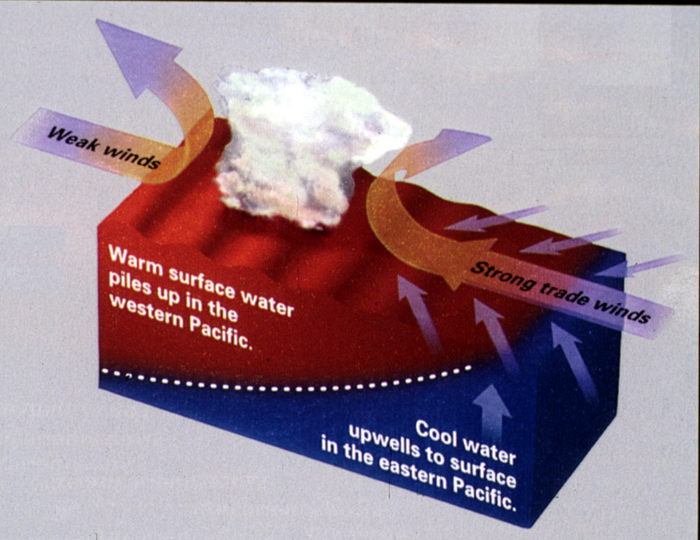
Normal Conditions

Slide 57
El Niño
Weak or Reversed Trade Winds
Equatorial Current
Thermocline

Slide 58
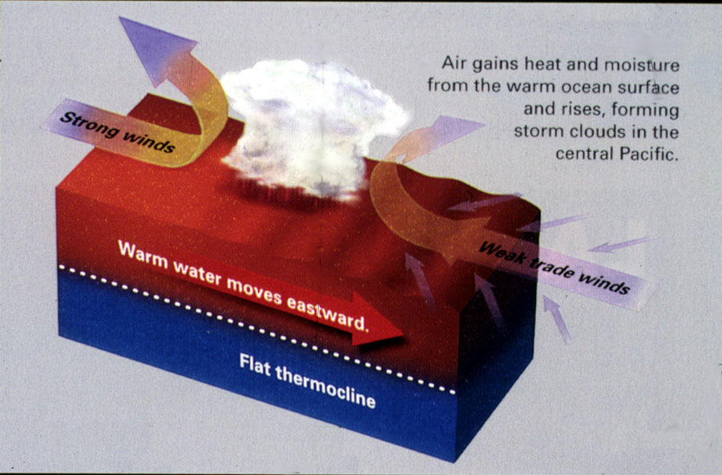
El Niño Conditions

Slide 59
La Niña
Very Strong Trade Winds
Sea Surface
Equatorial Current
South
America
Asia
Thermocline

Slide 60
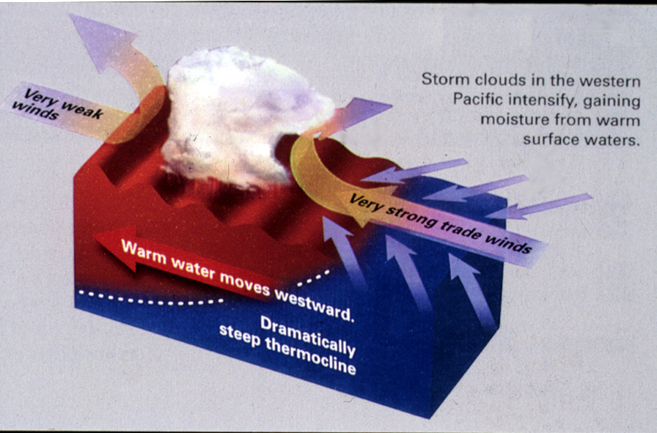
La Niña Conditions

Slide 61
The Last Two Great El Niño Events
Were in 1982-83 and in 1997-98

Slide 62
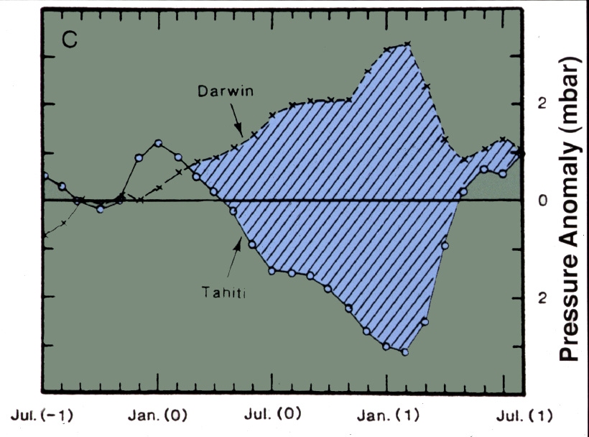
Darwin
2
0
-2
El Niño Condition
Pressure Anomaly (mbar)
“Normal”
Tahiti
1982
1983
July 1981) Jan (1982) July (1982) Jan. (1983) July (1983)

Slide 63
Darwin
2
0
-2
El Niño Condition
Pressure Anomaly (mbar)
7 months
“Normal”
Tahiti
1982
1983
July (-1) Jan (0) July (0) Jan. (0) July (-1)

Slide 64
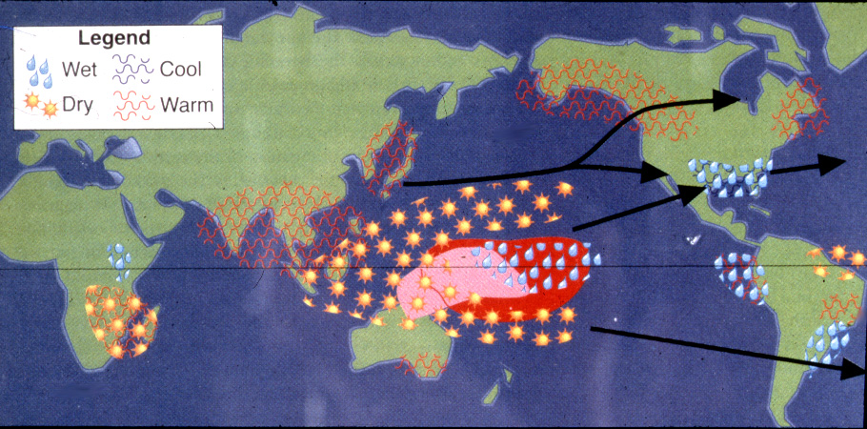
Effects of El Niño as Seen in 1983

Slide 65
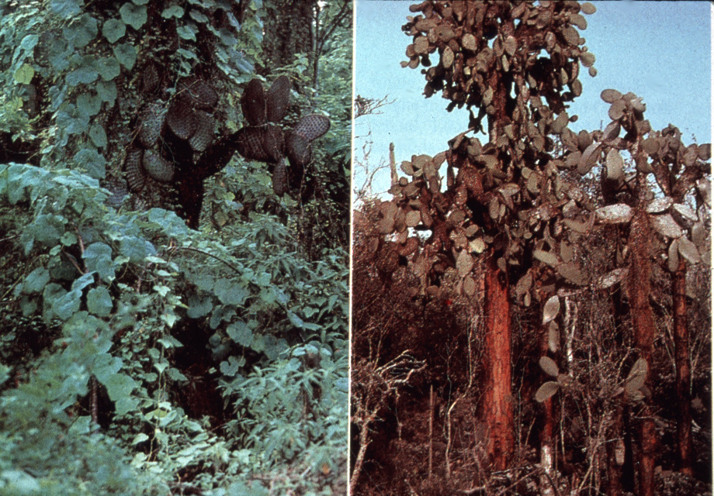
Isla Santa Cruz, Galapagos
1983
Normal

Slide 66
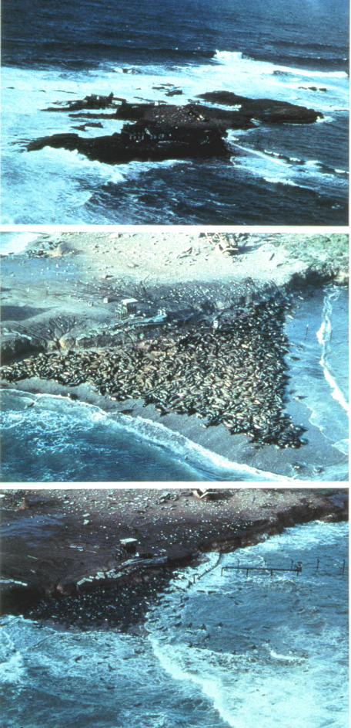
Año
Nuevo
Normal
1983
Elephant Seal
Breeding Beach
At Año Nuevo
Island,
Northern California

Slide 67
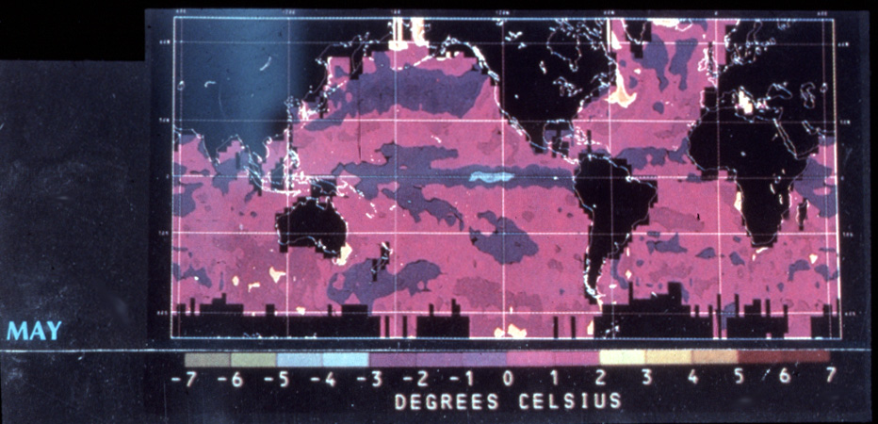
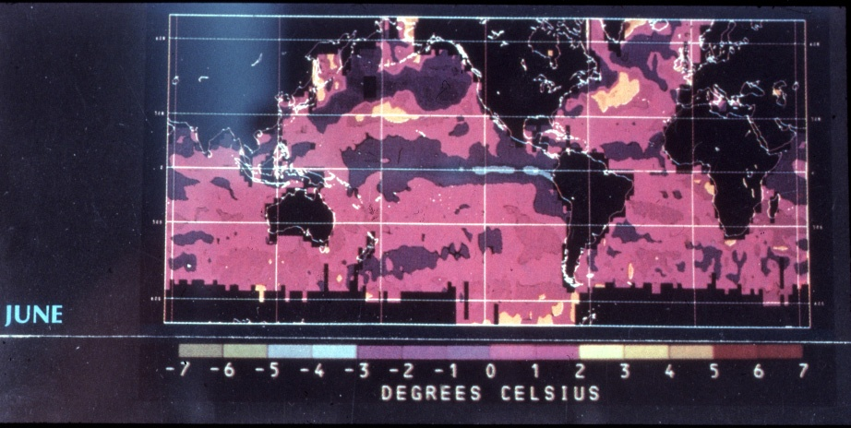
1988

Slide 68
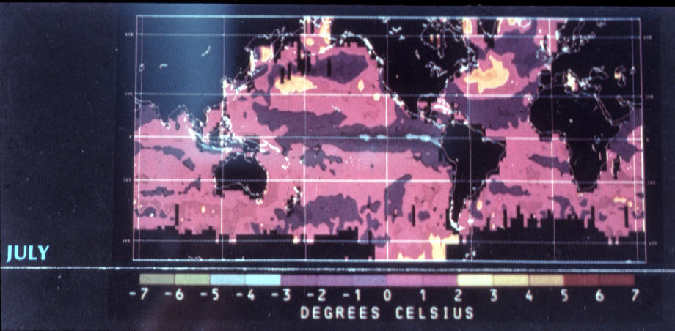
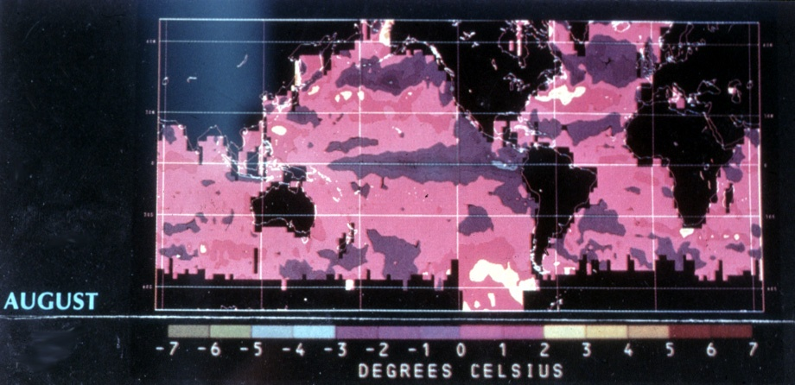
1988

Slide 69
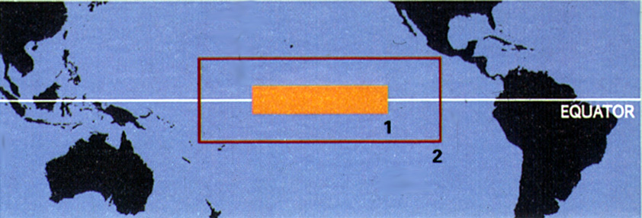
After the Experience of 1982-83 It
Became Clear That We Needed to
Instrument the Equatorial Pacific

Slide 70
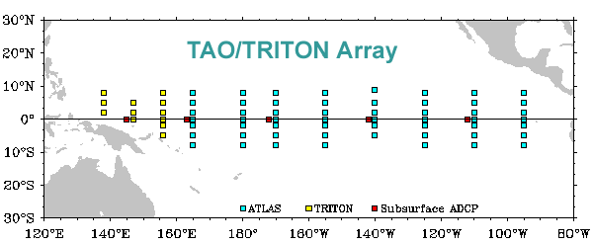



The TAO/TRITON Array
70 moorings
Tropical Atmosphere Ocean (TAO)/
Triangle Trans-Ocean Buoy Network (TRITON)

Slide 71
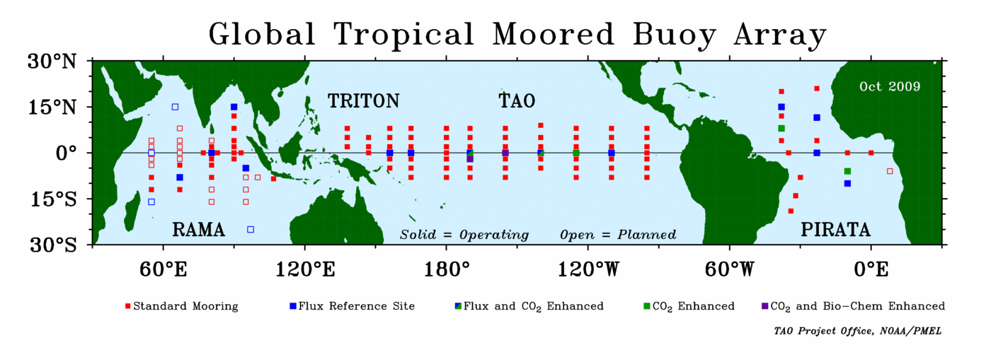



Research Moored Array for African-Asian-Australian
For Monsoon Analysis and Prediction (RAMA)
Tropical Atmosphere Ocean (TAO)/
Triangle Trans-Ocean Buoy Network (TRITON)
Prediction and Research Moored Array in
The Atlantic (PIRATA)

Slide 72
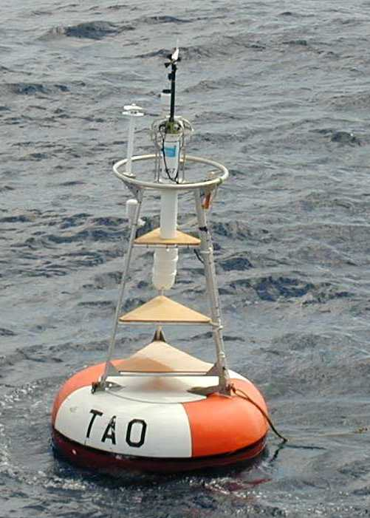
The ATLAS Buoy
-----
(Autonomous Temperature
Line Acquisition System)
-----
Water Depths
1500-6000m

Slide 73
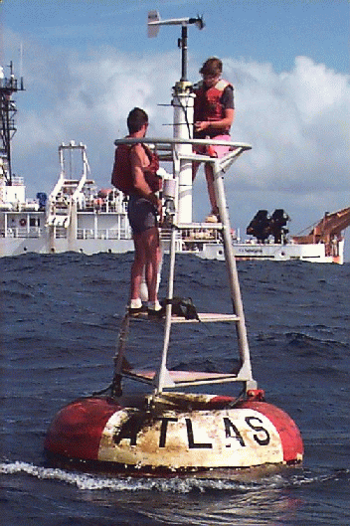
Servicing an
Atlas Buoy

Slide 74
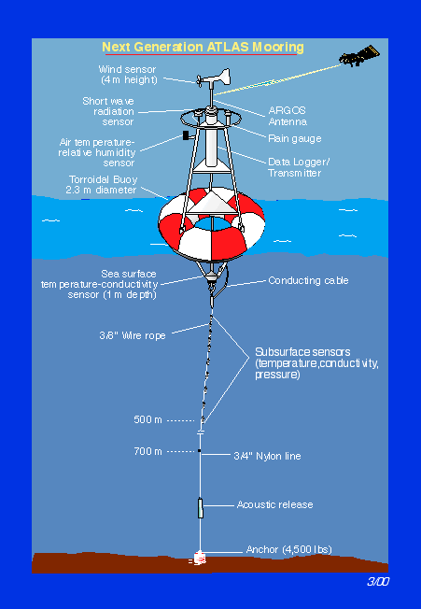
The New ATLAS
Mooring
-----
Water Depths
1500-6000m

Slide 75
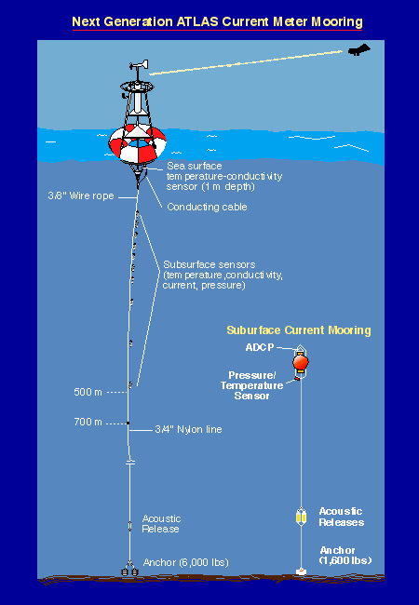
The New ATLAS
Current Meter
Mooring

Slide 76
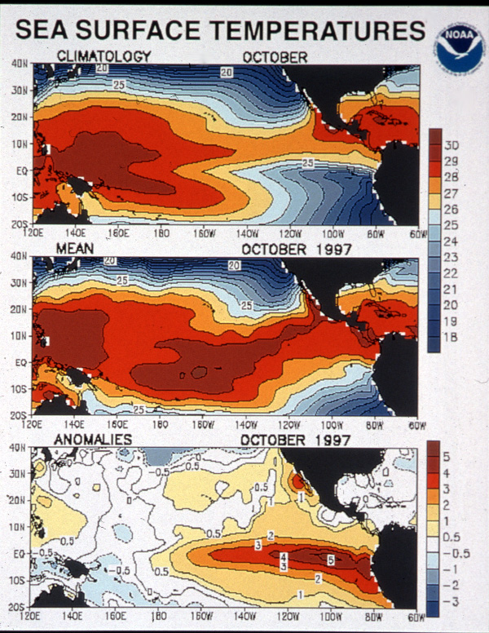
Onset of the
1997-98 El Niño
----
October, 1997

Slide 77
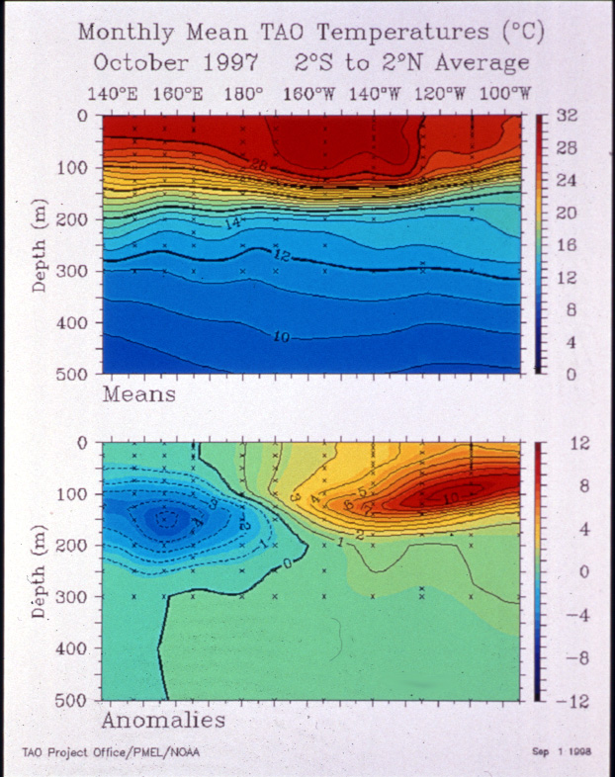
The TAO Array
Provides Vertical Sections
Across the Pacific
The Onset of the El Niño
October 1997

Slide 78
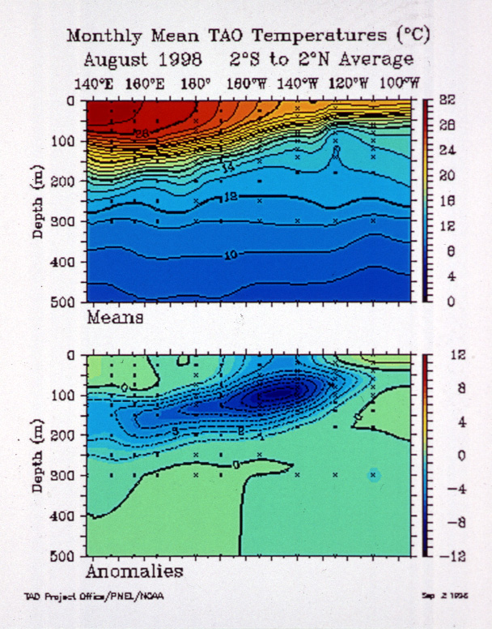
The TAO Array
Provides Vertical Sections
Across the Pacific
The End of the El Niño
August 1998

Slide 79

S
N
The TAO Array
Provides Vertical Sections
Across the Equator
End of the El Niño
August 1998

Slide 80

The TAO Array
Provides Time-Depth
Profiles

Slide 81

The TAO Array Provides Time Series Across the Pacific

Slide 82

SEAWiFS
Sea-viewing Wide Field-of-view Sensor

Slide 83

SeaWIFS
Satellite Images of
Sea Surface
Temperature

Slide 84


Slide 85

Sea Surface Temperature Anomaly

Slide 86

TOPEX/
Poseidon
Launched 1992
Accuracy 5cm

Slide 87

Jason 1
Launched 7 December 2001
Accuracy 3.3cm

Slide 88

Jason 1 Satellite
Argo Float

Slide 89

The TOPEX/Poseidon Satellite Records Sea Level Height

Slide 90

Topex/Poseidon Follows
Jason 1 by about 1 minute = 370km
Altitude = 1336 km

Slide 91

Jason 2
Launched 20 June 2008, Altitude 1336 km
Accuracy 1 cm, Sea Level at 1mm

Slide 92

JASON 2 Sea Level Residuals --30 January 2010
60N
40N
20N
O
20S
40S
60S
0 40E 60E 120E 160E 160W 120W 80W 40W 0
-176 -132 -88 -44 0 44 88 132 176
mm

Slide 93


Argo Floats
Measure the
Upper 2000m
Of the Ocean

Slide 94

Sea Surface Temperature Anomaly—January 2010

Slide 95

Sea Surface Temperature Anomaly—February 2010

Slide 96

Sea Surface
Temperature Anomalies
January-February 2010

Slide 97

This Multivariate Enso Index
Shows El Niño’s and La Niña’s
--------
There Is No “Normal” Condition
Current as of 3 February 2010
Available at the Website
http://www.cdc.noaa.gov/~kew/MEI/

Slide 98

ENSO Index through 3 February 2010

Slide 99

Another Measure of ENSO is the Oceanic Niño Index (ONI)
Which is Simply the Temperature
Anomaly in the Niño 3.4 Area

Slide 100

From Jan Null at: http://ggweather.com/enso/oni.htm

Slide 101


Slide 102

The Peruvian Anchoveta
10 cm

Slide 103



Peruvian Bolicheras

Slide 104
40
36
32
28
24
20
16
12
8
4
0
10
9
8
7
6
5
4
3
2
1
0
Catch of Anchoveta
Effect of
Anchoveta
Catch on
Seabird
Populations
in Peru
1953-1969
Millions of Birds
Bird
Population
Catch (million mtons)
1956
1958
1960
1962
1964
1966
1968
El Niño Events

Slide 105
14
12
10
8
6
4
2
0
1950
1952
1954
1956
1958
1960
1962
1964
1966
1968
1970
1972
1974
1976
1978
1980
1982
1984
1986
1988
1990
1992
1994
1996
El Niño Events
Anchoveta Catch

Slide 106
Anchoveta are Adapted to the Cold Water
Which Normally is at the Surface
•
•
•
•
•
•

Slide 107
During El Niño, the Anchoveta Move
Down with the Cold Water and are
Out of Reach of Seabirds
•
•
•
•
•
•

Slide 108
When the Anchoveta Move Down with
the Cold Water they are also out of
Reach of the Fishing Boats
•
•
•
•
•
•
•

Slide 109


One of El Nino’s
Effects is Mass
Mortality of Birds
And Pinnipeds

Slide 110
El Niño-Southern Oscillation (ENSO)
ENSO

Slide 111
El Niño-Southern Oscillation (ENSO)
ENSO

Slide 112
El Niño-Southern Oscillation (ENSO)
ENSO

Slide 113
El Niño-Southern Oscillation (ENSO)
ENSO

Slide 114
El Niño-Southern Oscillation (ENSO)
ENSO

Slide 115
North Atlantic Oscillation (NAO)
NAO

Slide 116
North Atlantic Oscillation (NAO)
NAO

Slide 117
Pacific Decadal Oscillation (PDO)
PDO

Slide 118
Pacific Decadal Oscillation (PDO)
PDO

Slide 119
Arctic Ocean Oscillation (AOO)
AOO

Slide 120
Arctic Ocean Oscillation (AOO)
AOO

Slide 121
Indian Ocean Dipole (IOD)
IOD

Slide 122
Indian Ocean Dipole (IOD)
IOD

Slide 123
In the Past 20 Years We Have Come to Recognize
Many Simultaneous Oscillations In the Ocean
AOO
PDO
NAO
ENSO
IOD

Slide 124
In the Past 20 Years We Have Come to Recognize
Many Simultaneous Oscillations In the Ocean
AOO
PDO
NAO
ENSO
IOD

Slide 125
In the Past 20 Years We Have Come to Recognize
Many Simultaneous Oscillations In the Ocean
AOO
PDO
NAO
ENSO
IOD

Slide 126
In the Past 20 Years We Have Come to Recognize
Many Simultaneous Oscillations In the Ocean
AOO
PDO
NAO
ENSO
IOD

Slide 127
In the Past 20 Years We Have Come to Recognize
Many Simultaneous Oscillations In the Ocean
AOO
PDO
NAO
ENSO
IOD

Slide 128
In the Past 20 Years We Have Come to Recognize
Many Simultaneous Oscillations In the Ocean
AOO
PDO
NAO
ENSO
IOD

Slide 129
In the Past 20 Years We Have Come to Recognize
Many Simultaneous Oscillations In the Ocean
AOO
PDO
NAO
ENSO
IOD

Slide 130

Dake Chen, et al, (Lamont), Nature 15 April 2004, p. 733

Slide 131

The Extended Record of El Niño: 1649-2003
Brad Adams (U. of Va.), Michael Mann (Penn State), Caspar Amman (NCAR),
Nature, 20 November, 2003

Slide 132


Slide 133


Slide 134


During El Niño Years there are 60-70% fewer, and Less Intense Atlantic Hurricanes
Strong Westerlies
Produce Upper-Level
Wind Shear which
Moderates Hurricane
Development
EYE

Slide 135

Typical January-March Weather Anomalies
During Moderate-Strong El Niño
L

Slide 136

Typical January-March Weather Anomalies
During Moderate-Strong La Niña
H
BLOCKING
HIGH
PRESSURE

Slide 137


Slide 138


Seasonal Outlook (March,2010)
Temperature Precipitation

Slide 139


Seasonal Outlook (March-May, 2010)
Temperature Precipitation

Slide 140
Commodities Affected by El Niño (Cause):
Hard Commodities:
Heating Oil (Cold Weather)
Coal (Cold Weather)
Cotton (Drought)
Soft Commodities:
Fish Meal (Fisheries Failure)
Soy (Fisheries Failure)
Sugar (Drought)
Coffee (Drought)
Palm Oil (Drought)
Live Cattle (Drought)
Orange Juice (Cold Weather)
Rice (Drought)

Slide 141
What are some Good and Bad Effects of El Niño?
Good
Atlantic Hurricanes Decrease
Commodity Futures Rise
Rain in California
?
Bad
Birds and Mammals Die
Property Damage
Drought and Fire in SE Asia, Australia
Federal Government Shut
Down for 4 Days in
Early February

Slide 142
The Latest Word:
In a Paper Published Online on Monday
in Nature Geosciences,
Takeshi Izumo, et al.,
“Influence on the state of the Indian Ocean Dipole
on the following year’s El Niño”,
the authors report
That They have been Able to Forecast El Niño 14 months
In Advance by Using the IOD which seems to drive
El Niño by Enhancing the Walker Circulation.
This Resulted from the Analysis
Of Data Collected in the RAMA Array

Slide 143

El Niño

Slide 144
If the Warm Even is Named
After the Christ Child,
What Should the Cold Event Be Called?

Slide 145


Anti-El Niño?
Too close to the
Anti-Christ
Luca Signorelli, 1499-1502

Slide 146


¿La Fria?
From “The Day
After Tomorrow”

Slide 147

La Niña

Slide 148

¿La Niña o El Viejo?

Slide 149
In Summary, El Niño…
Is the Second Most Important Climate Forcing
Causes Global Changes in Weather
Is an Episodic, Quasi-Periodic Phenomenon, and Therefore Hard to Predict
Does Significant Damage, ~ $ 33 Billion and 23,000 Lives Lost in 1997-98
Locally, in the Eastern Pacific, Severely Disrupts the Anchoveta Fishery and Causes Mass Mortality of Birds and Marine Mammals

Slide 150

Thank You!

